Slide 1

Welcome
Part 2
Tools for Life Early Years

Slide 2
KEY CONCEPTS
TOOLS FOR LIFE –
EARLY YEARS EDITION
The nine concepts introduced present opportunities for children to develop awareness and beginning competence in social interactions.
Concept 1: Building a Culture of Belonging
Concept 2: How to Calm Down
Concept 3: Communication Build Connection
Concept 4: Self-esteem
Concept 5: All Feelings are Okay!
Concept 6: Body Cues
Concept 7: Identifying Feelings of Others
Concept 8: Friendly Words!
Concept 9: The Problem-Solving Light and Tools

Slide 3
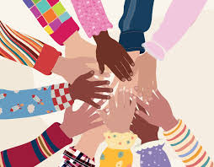
CONCEPT 1: Building a Culture of Belonging
Ways to show we care – smile, hug, comfort, share, morning greeting
and family pictures.
Children need to know that they are accepted for who they are. They should know that what they do can make a difference and that they can explore and try out new activities.
Notes:
It means that kids should feel like they're liked and appreciated just the way they are. They should understand that the things they do can be important and can change things for the better. Also, they should feel free to try new things and have fun exploring different activities.

Slide 4
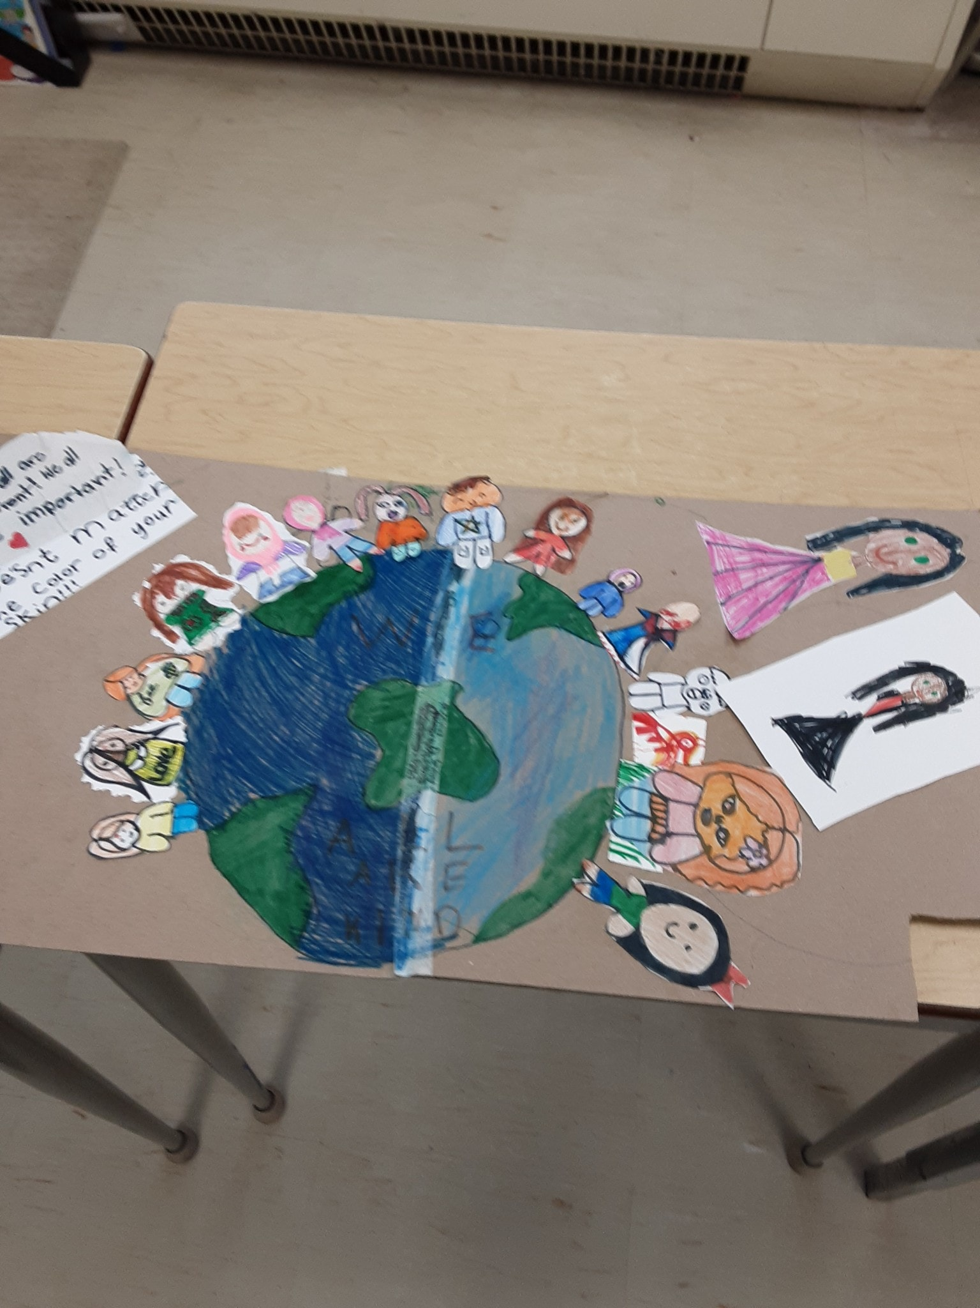
Informed Practice
Educators can know more about the complexity of each child and can deepen children’s learning and experiences when they look at and listen to children from multiple perspectives, asking, for example:
What are the unique strengths and needs, approaches, attitudes, and dispositions of each child?
Notes:
What are the unique strengths and needs, approaches, attitudes, and dispositions of each child?
An example of understanding the unique strengths and needs of each child - Let's say a teacher notices that one child is particularly good at drawing and loves to express themselves through art, while another child is very good at puzzles.
The educator might tailor their approach to accommodate each child's strengths and needs.
staff might provide the artistic child with more opportunities to express themselves through drawing This way, each child feels valued for their strengths and supported in areas where they may need extra help.

Slide 5
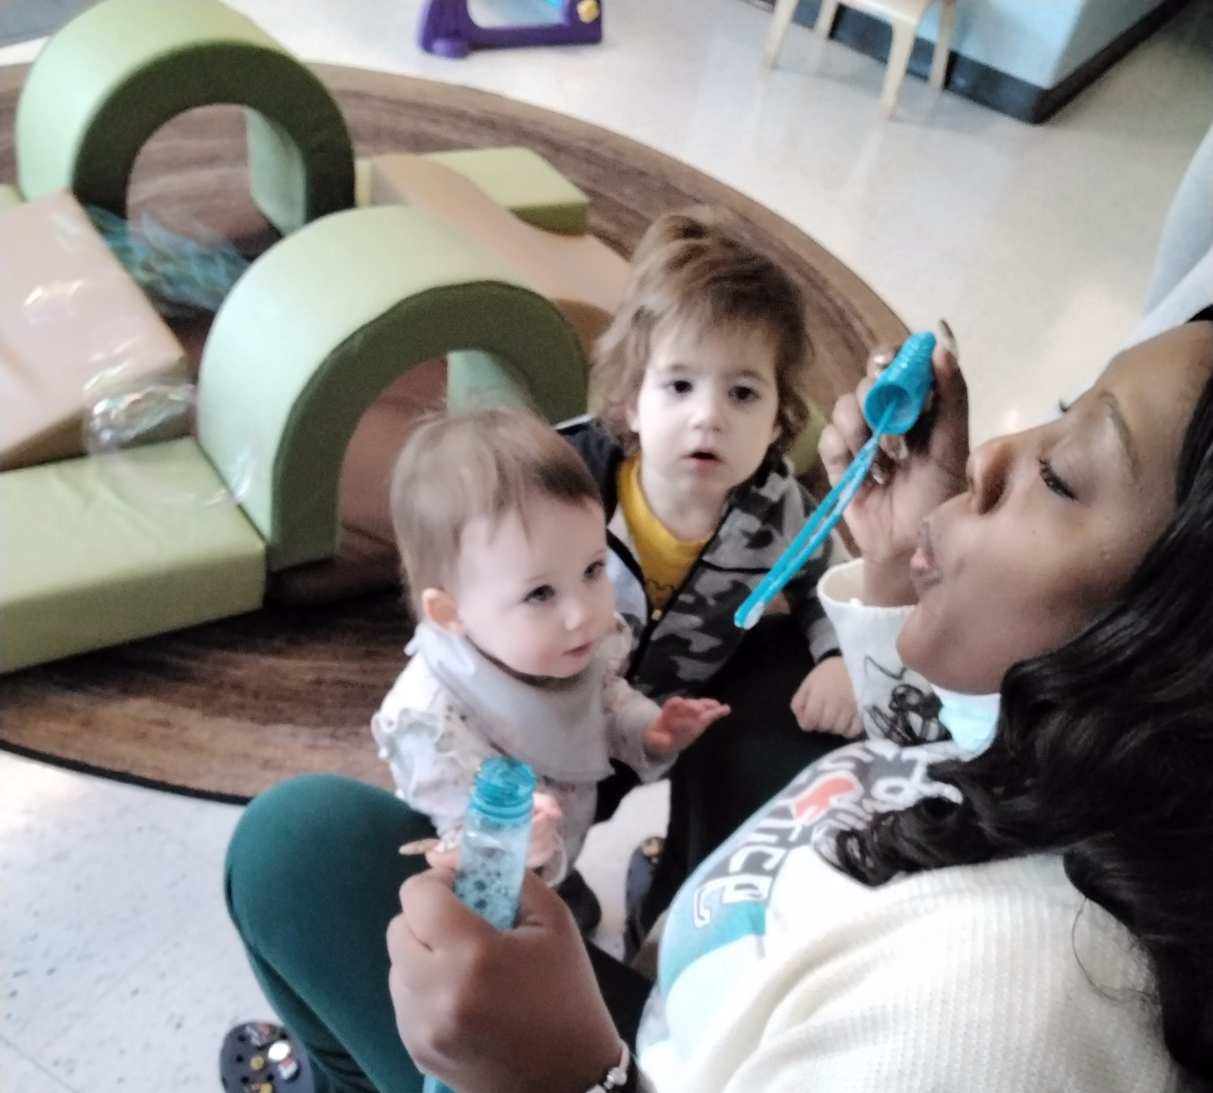
Relationships
The role of the educator is paramount in setting the climate for a caring community!
Building a Relationship
Welcoming Practices
Separation Times
Notes:
Building a relationship –
- Time and attention
- Words and gestures of caring and affection at the level of the child’s comfort.
- acceptance and respect for who the child is
- Listen to conversations
- approach children, offer to be with the child.
Welcoming Practices
- Children need to understand that each day children are welcomed and wanted, create practices that allow children to see that they are welcomed.
- Use a hug, fist pump, high five, or even acknowledging the child with a hello, how was your weekend.
- you get to know your children, so you can see what makes them comfortable and how they like to be greeted.
Separation Times
- Some tips to help support transition times, keeping drop-off time brief
- Invite children to include other children as they child arrives
- Use a transition toy
- Stick to a routine that the child knows best.

Slide 6
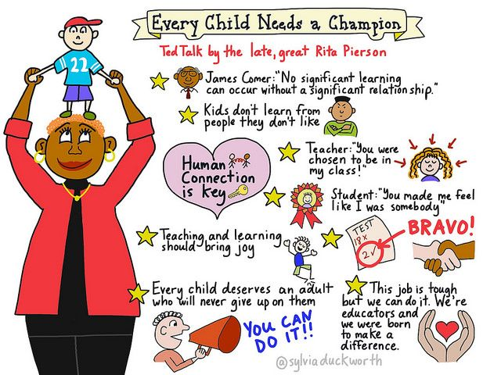

Slide 7
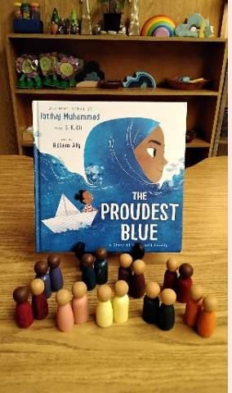
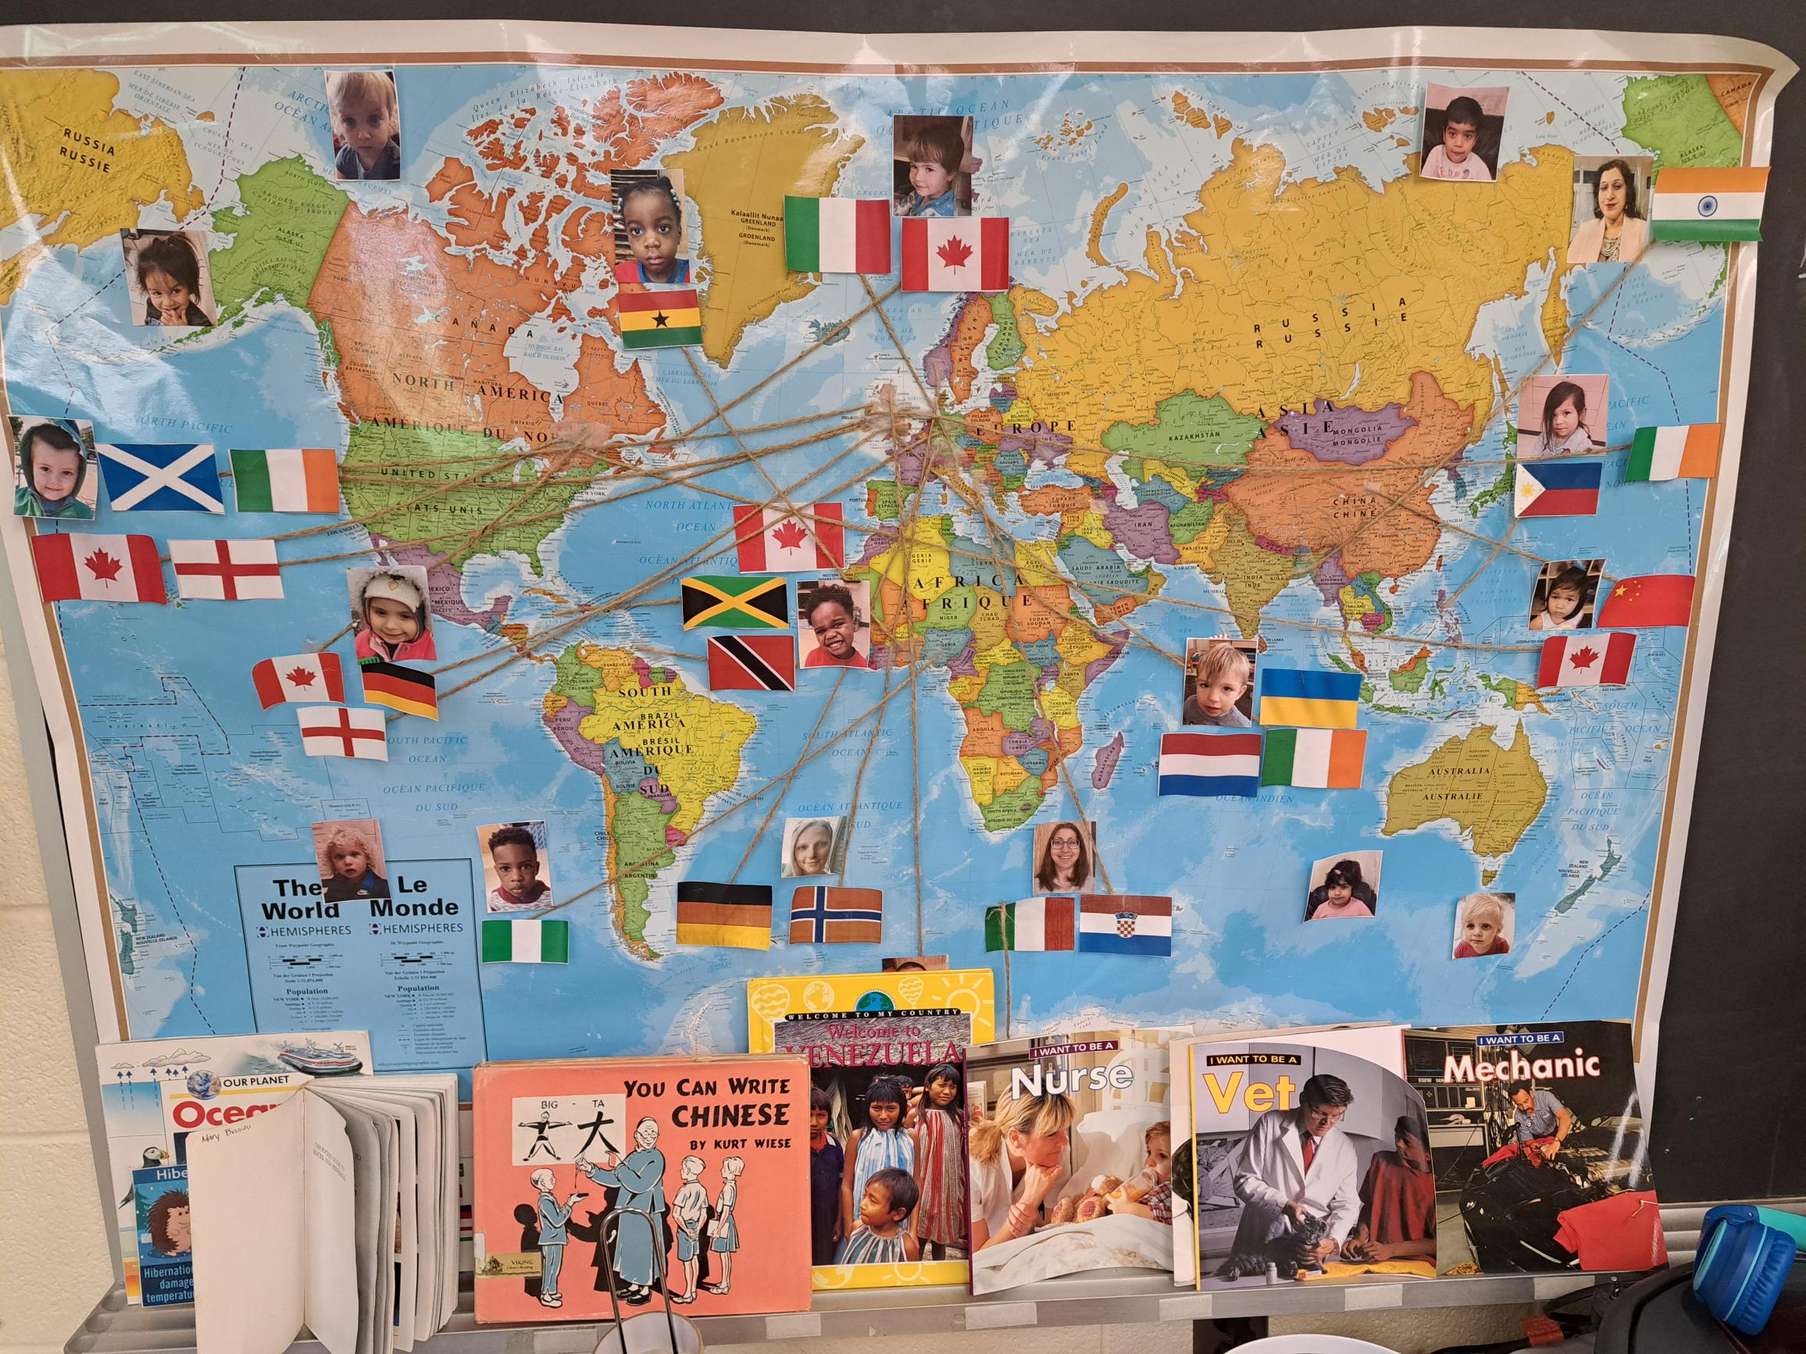

Setting up the Environment
Create Environments
Family Photo Wall
Opportunities for Play and Relationship Building
Use EDIB books to build a sense of belonging
Art Materials should be reflective to the children in the classroom.
Notes:
Educators create Environment: -
- Create an environment that celebrates the children with photos, art works and cultural artifacts.
- Create an environment where children are encouraged to co-operate and collaborate while using imagination and creativity.
- Plan for children to have opportunities where they have the freedom to explore their own possibilities and interest.
Family Photo Wall –
- Ask for pictures of families, pets, relatives or other important people or things in their lives. Label the photos with names to allow children to speak on.
Opportunities for Play and Relationship Building –
- Provide materials for children in the learning areas to represent children’s ideas
- Have areas for group play
- provide daily sensory materials for expression
- Puppets
- books on friendships
- Music and Movement opportunities to express emotions, enhance self concept by sharing dances from different cultures.
Use EDI books to build a sense of belonging –
- books can be mirrors for children to see themselves or a window to help see and understand others.
Art Materials should be reflective to the children in the classroom.
- Skin tones should be represented and available in various materials such as playdough, markers, crayons, paints etc.

Slide 8
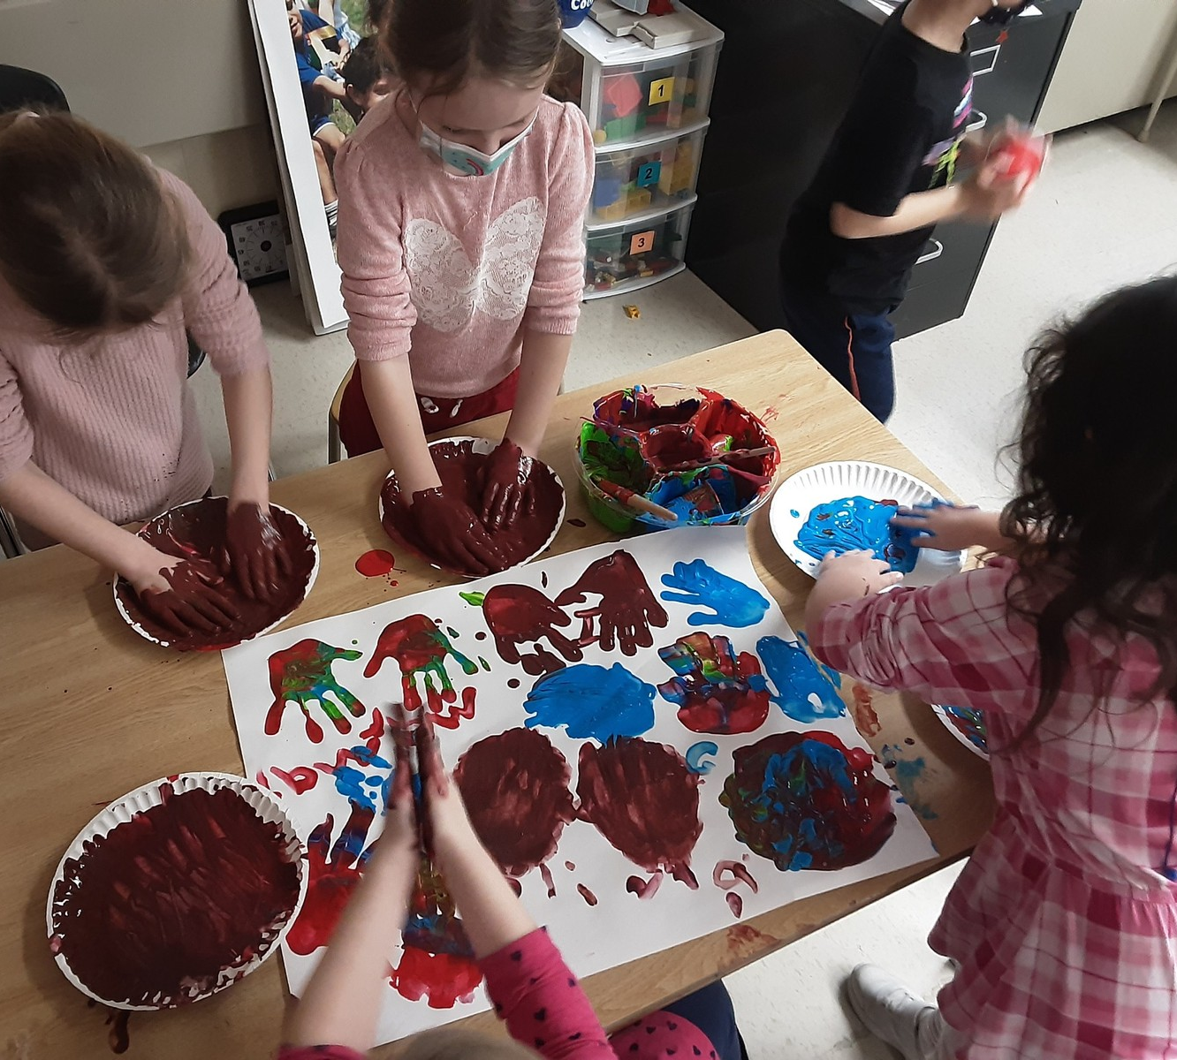
All Day…Every Day – Intentional Practices
To create an atmosphere of safety and belonging, the educator’s prime role is to be
engaged in the play and social scenarios of the children.
The best advice is to follow the children’s lead.
Notes:
- support and include all children
- have opportunities for children for song, movement and small group interactions
- Build on children’s interest, identify their strengths, motivations and needs
- promote social emotional learning
- Support children who are making an effort
- Encourage children to lead conversations
- Invite families to share, have conversations what is important to them.

Slide 9
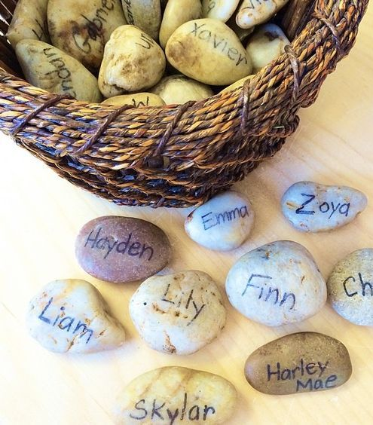
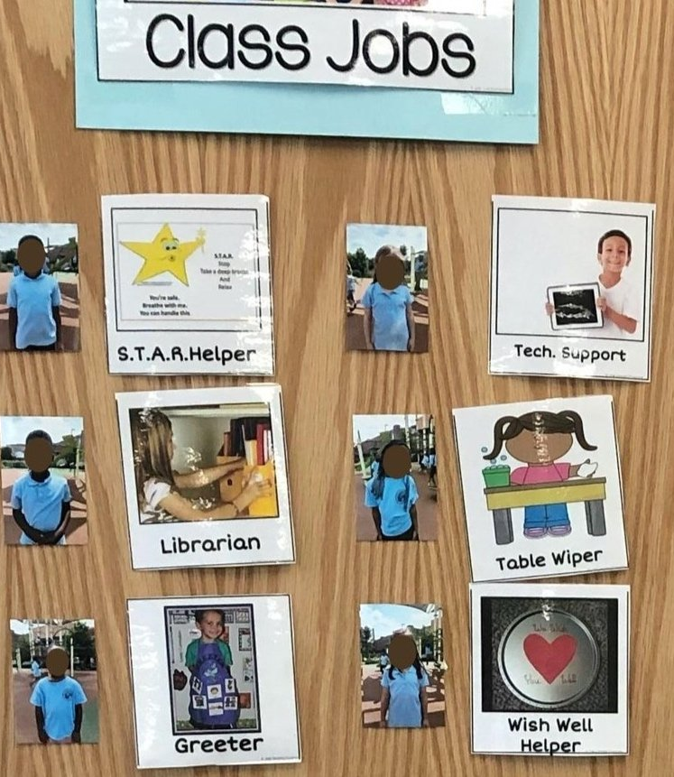
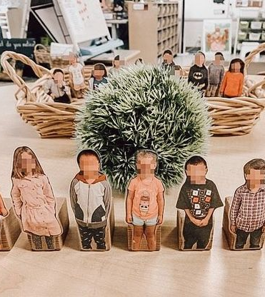
We feel Happy when we are included
Notes:
We feel Happy when we are included: Greeting Baskets
The children have a specific rock that is theirs it is identified with either their name or picture on it. The children use the rock to “sign” in or out of the classroom the children place the rock in the IN box upon arrival and they move their rock to the OUT box upon departure. Over time the children would notice who was or wasn’t in class that day – they would make connections as well if the child had been off for a length of time and would ask about that child opening space for discussions such as child A is sick, the children were mindful to say things like “I hope she feels better soon” or “welcome back are you feeling better” and even “Child B is on vacation, I hope he is having fun!” This built belonging, mindfulness and socialization in the classroom.
Assign the children classroom jobs – watch intentionally to see what the children really enjoy where they would take pride in helping. For example: One child enjoyed books he would get upset if another child ripped a book and this could cause his emotional state to dysregulate. His classroom job title was librarian.
He was in charge of making sure all of the books were put back properly and a repair box was made. If he noticed a book was damaged he would add it to the box. The educator made a specific time that she would go through the box with him and they would see how they could repair the book together.
Classroom visuals with Job titles and images works well to help children understand and own their role. Some jobs could be line leader, light helper, food helper, sweeper, gardener, calendar helper, table washer, chair stacker, door holder,

Slide 10
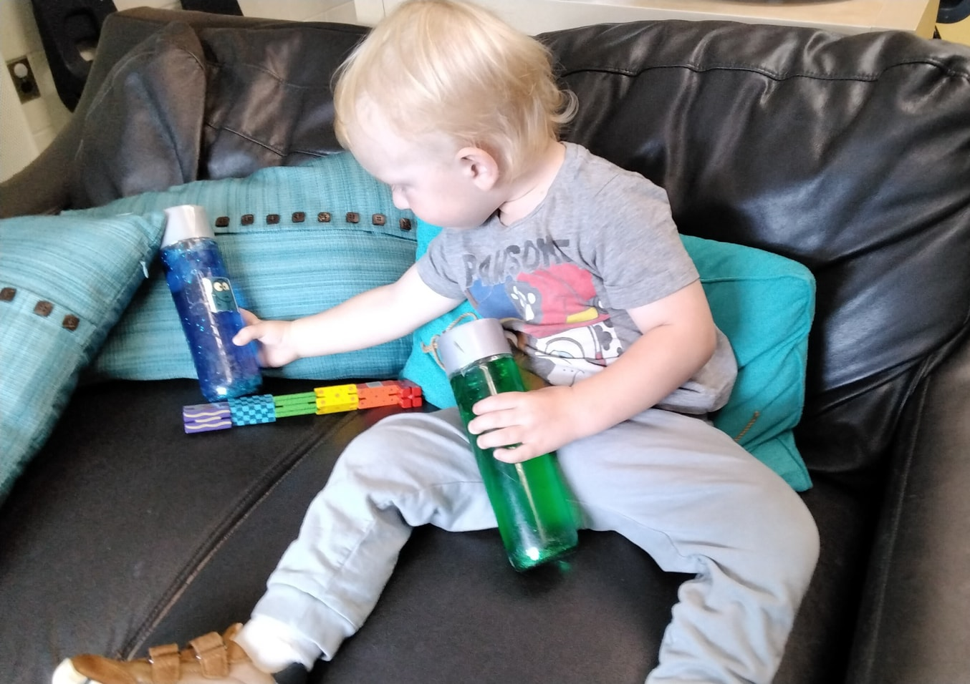
Concept 2: How to Calm Down
When children are calmly focused and alert, they are best able to modulate their emotions; pay attention; ignore distractions; inhibit their impulses; assess the consequences of an action; understand what others are thinking and feeling, and the effects of their own behaviours; or feel empathy for others.
Dr. Stuart Shanker, Calm, Alert and Happy 2013
Notes:
This means that when children are calm, focused, and paying attention, they can control their feelings better.
They can ignore things that might distract them, stop themselves from doing something impulsive, think about what might happen next, understand how others are feeling, and care about how their actions affect others

Slide 11
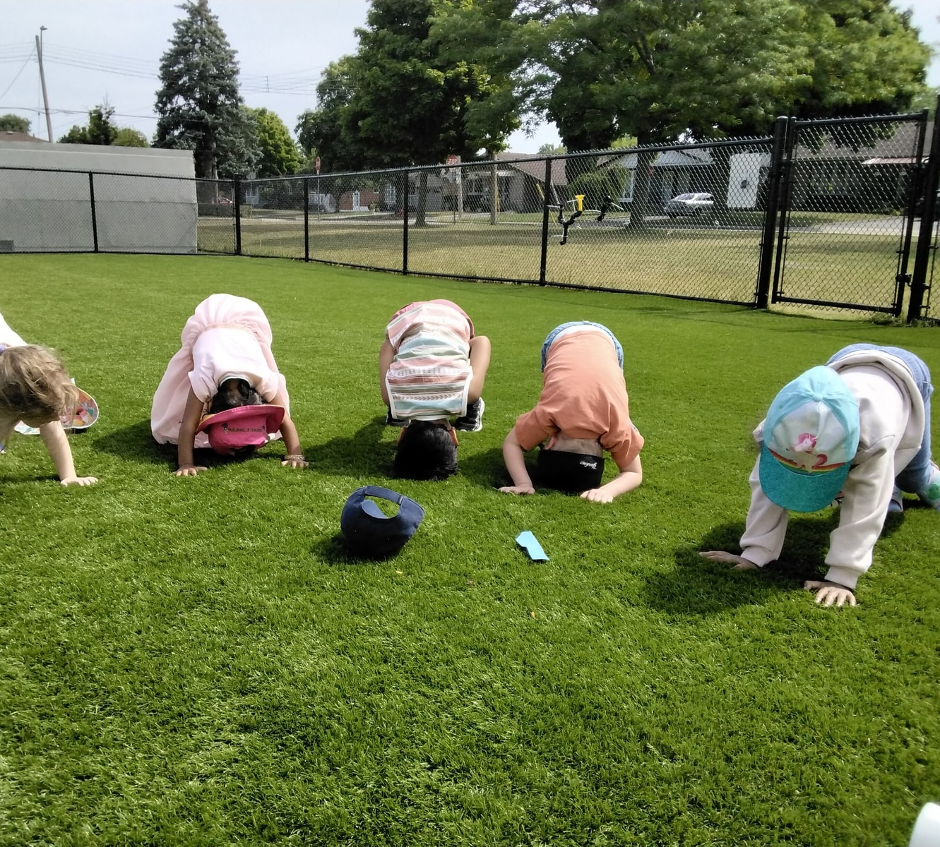
Informed Practice
Learning how to become calm has life-long benefits.
Sefl-Regulation
Defining the Five Domains of Self-Regulation
Biological
Emotional
Cognitive
Social
Pro-Social
Notes:
Learning how to become calm has life-long benefits – many of us, even as adults, can struggle with this and it is no different for a child, especially the children who are often overwhelmed.
Self-regulation – refers to the ability to stay calm, alert and focused on a daily interactions and play by managing emotions, behaviours and energy.
One of the most important strategies in this area is to have regular times of group calming. The children need opportunities in a safe environment to practice all calming strategies
Defining the Five Domains of Sefl-regulation
Biological – Children begin to feel good inside
Emotional – Children are happy when they play and having fun with other children
Cognitive- children build self-esteem and have positive thoughts
Social – Children develop positive relationships and enjoy being with other children
Pro-Social – Children are welcomed by a caring community and learn when to feel safe with others.

Slide 12
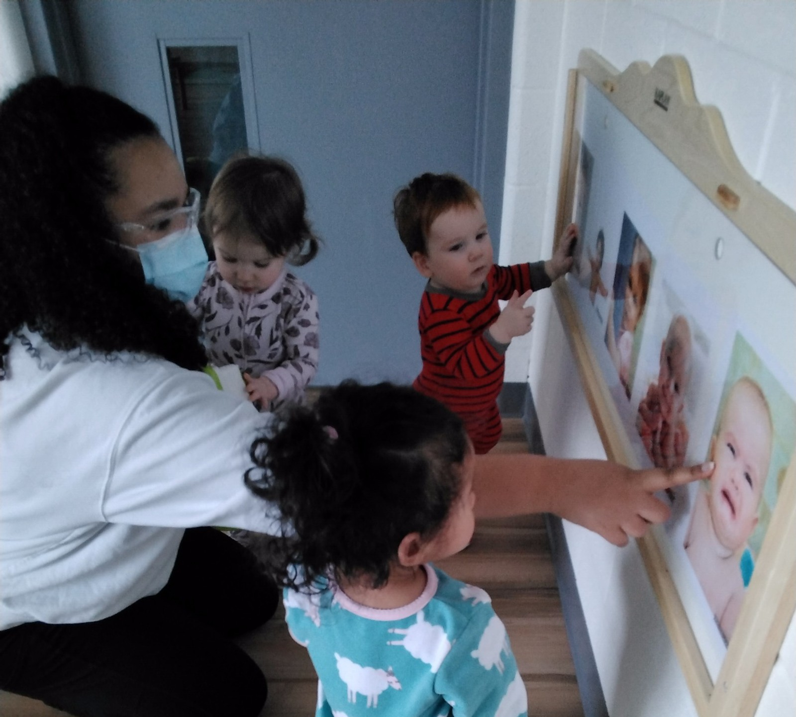
Relationships
Educators support children’s self-regulation skills by co-regulation with the children they care for.
Co-regulation is defined as warm and responsive interactions that provide the support, coaching and modelling for children.
Tips for Educators
Relationships matter because, for children, calming begins with co-regulating
Notes:
Educators support children’s self-regulation skills by co-regulation with the children they care for – educators help kids learn to manage their own behavior and emotions by guiding them and being a good example. So, instead of just telling children what to do, educators work alongside them to teach them how to control their actions and feelings.
Co-regulation is defined as warm and responsive interactions that provide the support, coaching and modelling for children – Educators give them guidance, teach them. So, instead of just telling children what to do, educators work with the children, showing care and understanding, to help them learn and grow.
Tips for Educators:
- Establish a warm and responsive relationship with each child
- Create a calm and structured environment
- Respond with warmth and structured during stressful moments. For older children, teach them how to solve problems.
- Work together with parents – establish that positive relationship
- Create a sense of community - creating a sense of community means making people feel like they belong. It's like being part of a big group where everyone cares about each other and works together

Slide 13
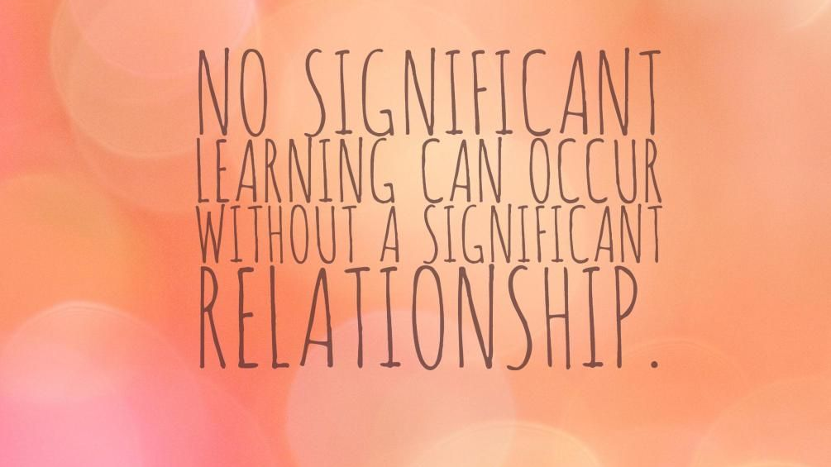
Notes:
for learning to happen well, there needs to be a strong and respectful relationship between the educator and the child. This means both the educator and the child should value and respect each other.

Slide 14
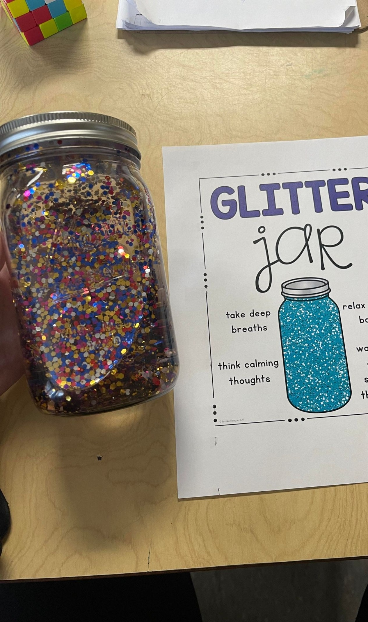
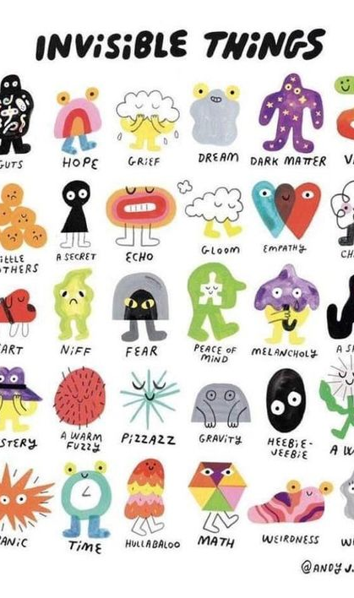
Setting up the Environment
Calm Down and Cozy Corners:
Comfy cushions
Squishy toys
Comfort items or items they can cuddle
Calm down cards/breathing techniques
Puppets, playdough, rain stick, glitter bottles
Mirrors and feeling books
Headphone and music
Notes:
A calm environment benefits everyone and creates a safe place for children to express their emotions without the fear of an educators reaction.
Children need a space where they can withdraw these feelings, where they can choose to come and go as they need to. It’s a quiet zone to self-regulate and return to calm.
Should ne located in a calmer area in the classroom, where they can go to alone, with a friend to unwind.
Cozy Corners is not a time out spot where educators put children to as a spot to force them to regulate.

Slide 15
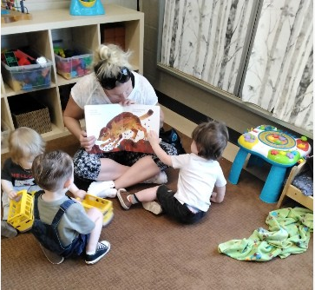
All Day…Every Day – Intentional Practices
TIME-IN.
Educators goes down to the children’s level
Listen attentively
Educators monitors the child for a period until they feel calm and ready to join the group
Work together to brainstorm possible scenarios.
Notes:
Whenever children are stressed or emotionally overwhelmed, or in a difficult situation, educators should offer the child a -
TIME-IN – is a one to one conversation that allows children to be heard, with time to identify their needs and express themselves.
- Educators goes down to the children’s level
- Listen attentively
- educators monitors the child for a period until they feel calm and ready to join the group
- work together to brainstorm possible scenarios.

Slide 16
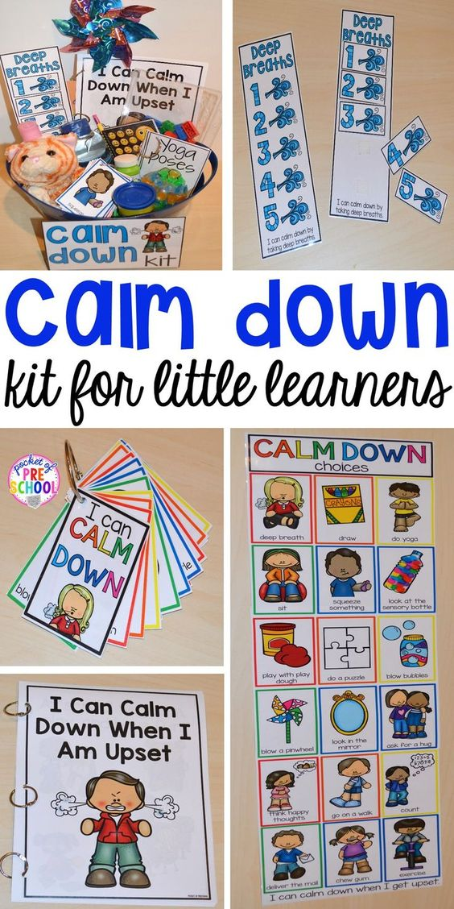
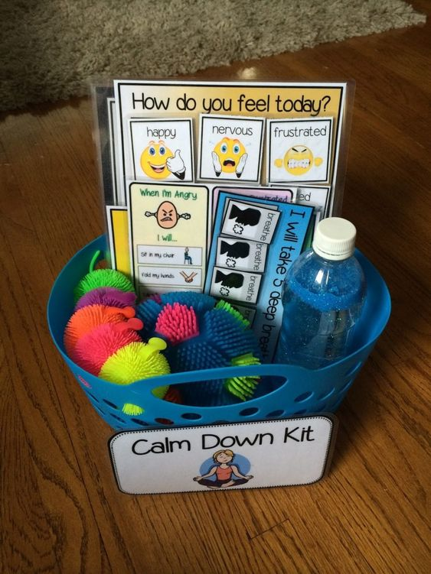
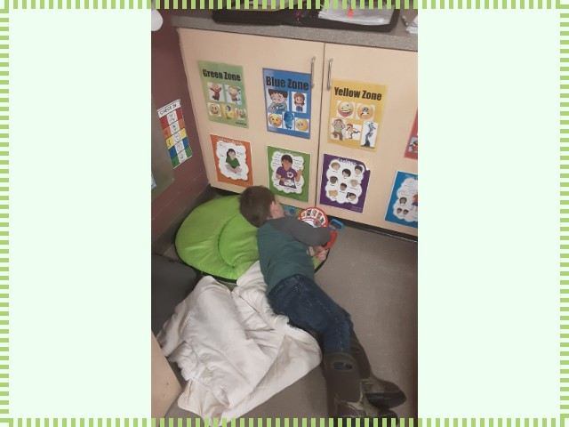

Slide 17
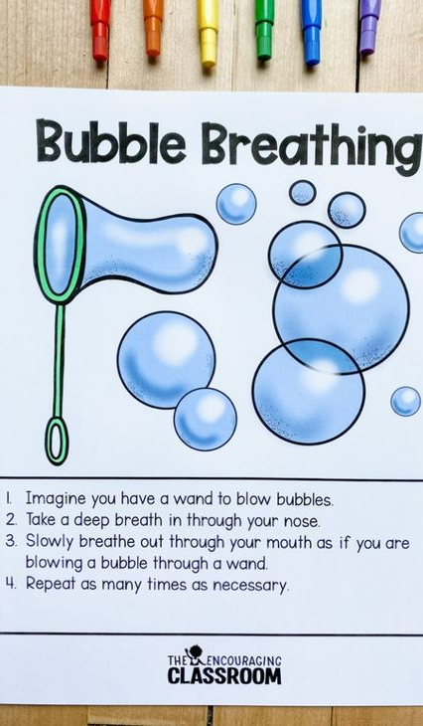
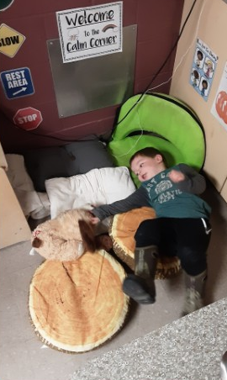
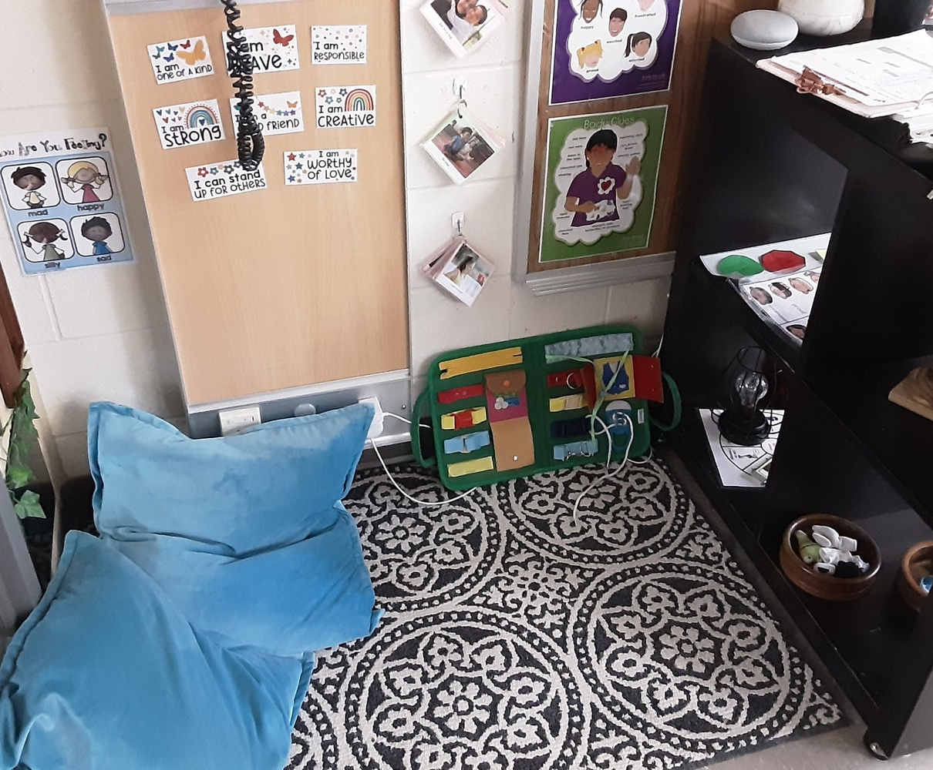
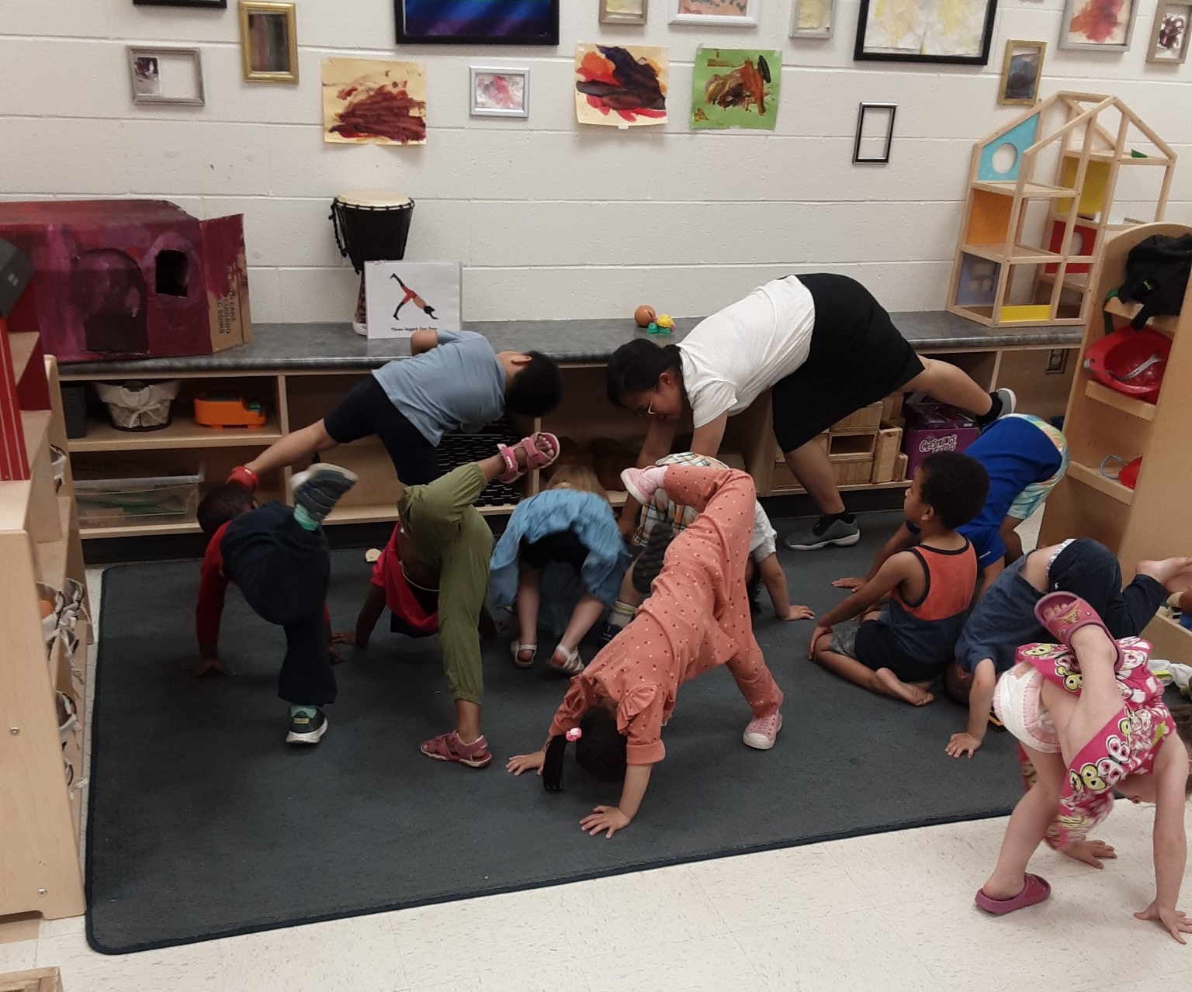
Notes:
Intentional activities and materials for the classroom:
Providing options for yoga to be implemented in the classroom with a group or they can do on their own.
Mindfulness cards present in the classroom

Slide 18
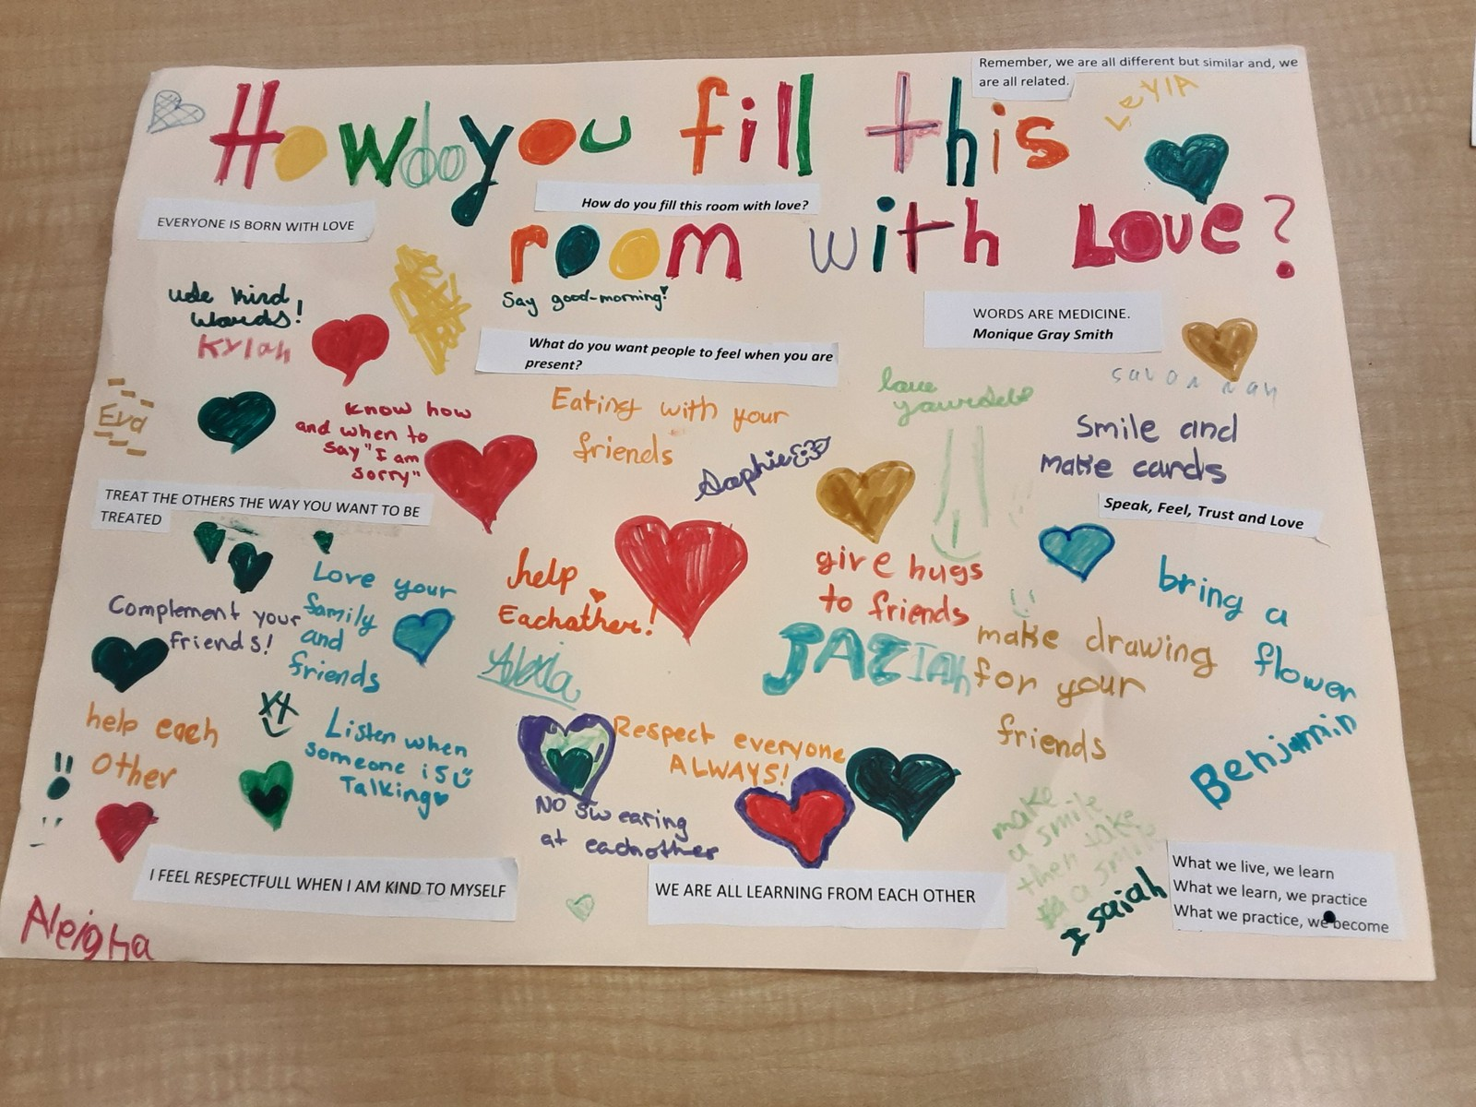
Concept 3: Communication Builds Connections
Serve and Return Interactions
Communication
Notes:
Serve and Return interactions – When babies are little, we play attention to the babies by listening to their cues, babbling, gestures and cries. We then tend to their needs with eye contact, holding them, a hug or even that they might need a diaper change.
Now think of a game of tennis, it is back and forth interaction, when one serves the other player returns, this is the connection and capacity building.
When you return a serve (acknowledge their feelings and who they are as a person), children then know that their feelings are being heard and understood. When you return a serve by naming what a child is seeing or doing, you make it important to them and they make that language connection.
Communication – includes non-verbal behaviours and gesturing. Listening is the way that children learn about the world, others and themselves, so it is important for all of us to listen.

Slide 19
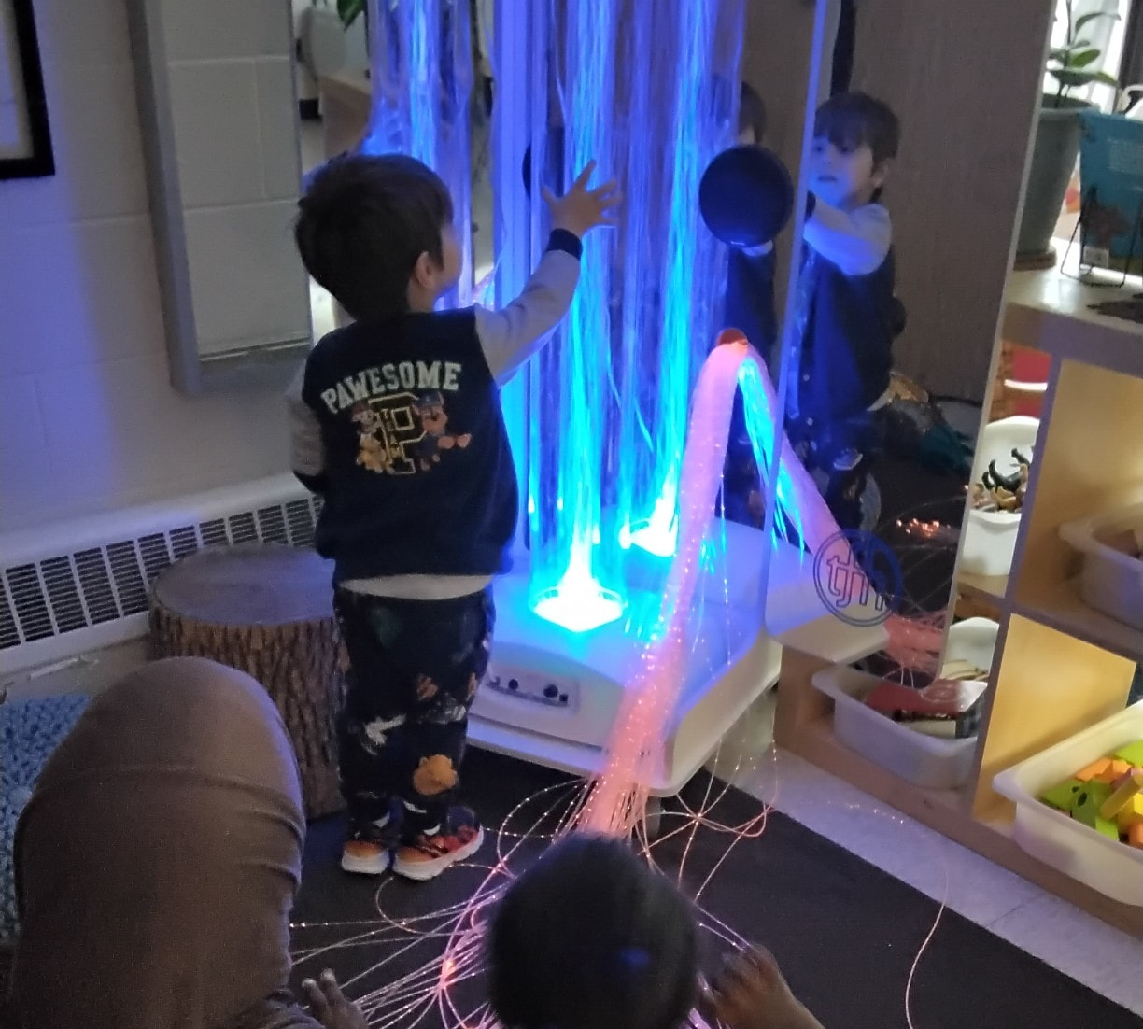
Relationships
By waiting, you give children time to develop their own ideas and build their confidence and independence.
Waiting also helps you understand their needs.
Conversations
Good Listening
Notes:
Educators develop and enhance relationships with children through sensitive and prompt responses to their communication behaviours, which include verbal and non-verbal messages.
When children struggle to get their messages across, it is important to be patient.
Conversations:
Successful communication is a two way street. It is active on both partnerships that involves using more than words to send or receive messages from children.
Remember communication is served several ways:
- tone of voice, eye contact, facial expressions and our words.
Good Listening:
Educators are encouraged to be good listeners ;
- Listening to children’s opinion, summarize what the children are saying, paying attention to their interest, language and social skills.

Slide 20
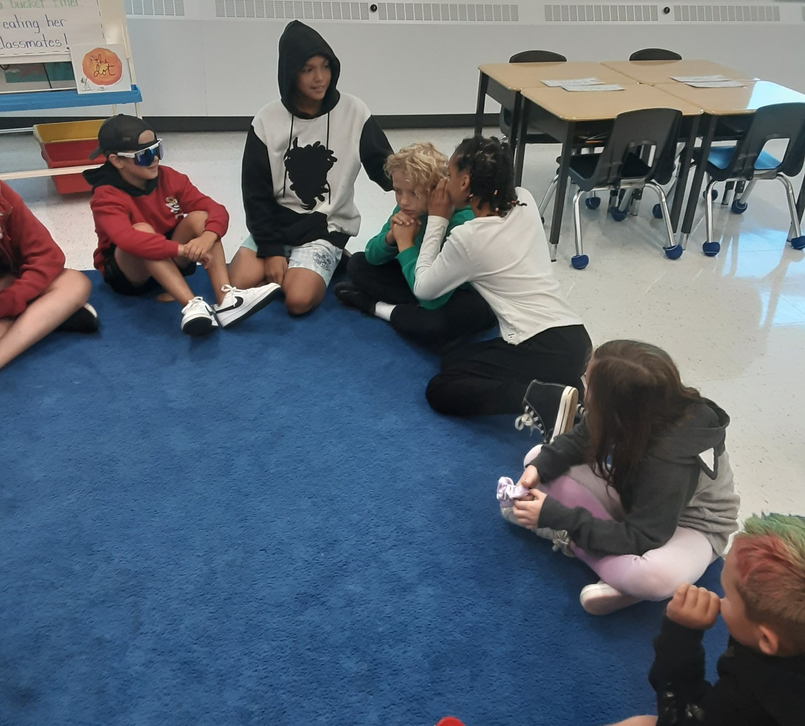
Setting up the Environment
Intentional Materials
Create opportunities for conversations
Set-up furniture and activities
Notes:
Intentional Materials – Phones, or those plastic plumbing elbows for self talk or communication with others
Create opportunities for conversations – such as open snack time, free play, at the creative table and especially outdoors.
Set-up furniture and activities - to promote face-to-face interactions or side-by-side - this can be done in a quiet area, set up cushions or tables with some chairs to promote these conversations between children.

Slide 21
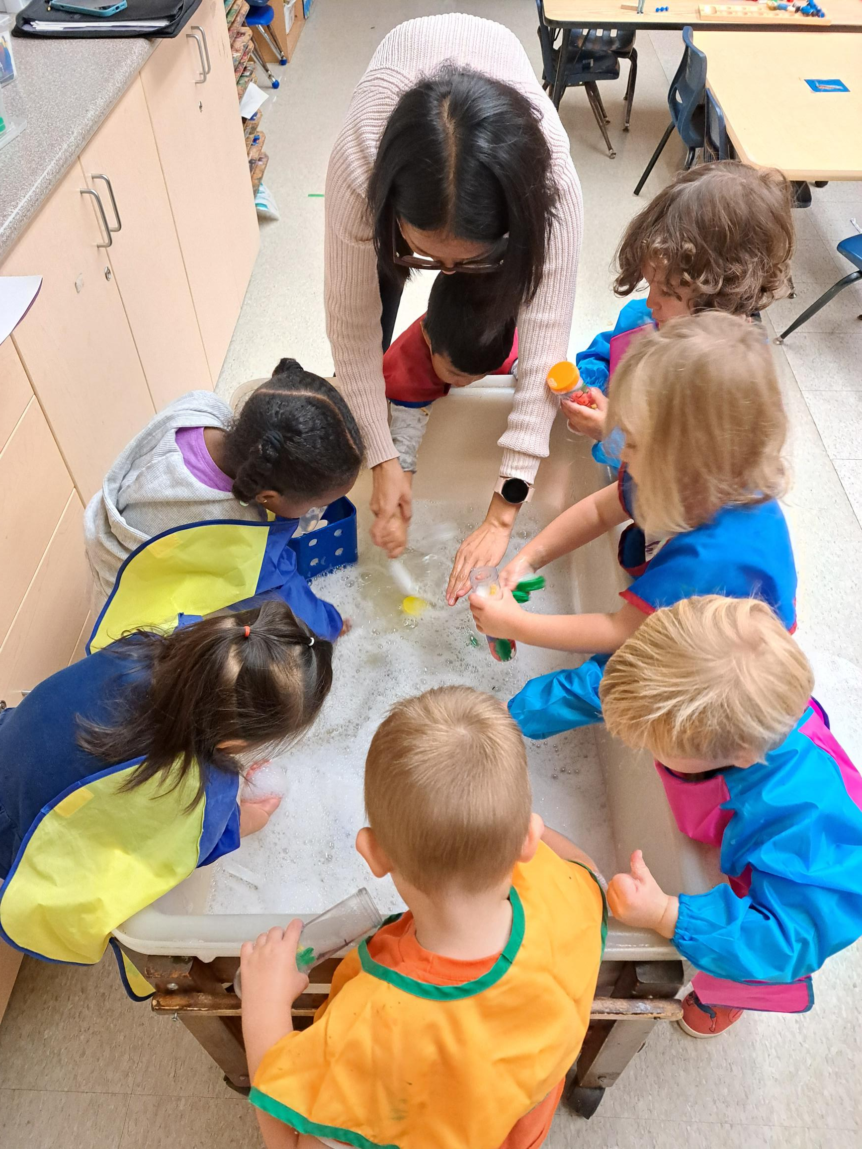
All Day…Every Day – Intentional Practices
Be accessible where children are gathered or playing. Make two-way conversations a priority.
During Play
During Routines
Guidance Interventions
Noticing and Naming
Ongoing Experiences
Notes:
Be accessible where children are gathered or playing. Make two-way conversations a priority.
- Interact with children one to one or with groups, but having those conversations are important. Observing is also another form of documenting what children do and say.
During Play –
- Show an interest in what children are saying
- Make eye contact when children are speaking
- Listen to the children, ask open-ended questions
During Routines
- Opportunities to model listening
- All routines of the day, including lunch, transitions
Guidance Interventions
- Visuals are great tools in responding to their feelings, problem solving
Noticing and Naming
- I could see the way your body was calm when I was talking to you
- How did that make you feel when your friend listened to you?
Ongoing Experiences
- Educators role model everyday
- Co-create a book/small group “How we listen”, clapping games, I spy games, co-ordination games.

Slide 22
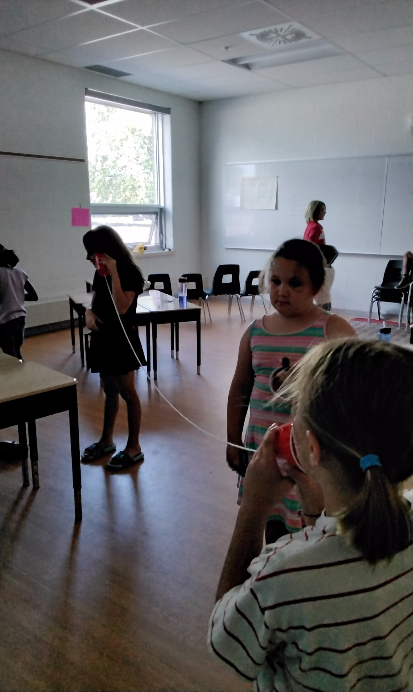
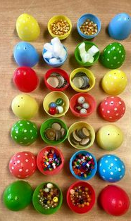
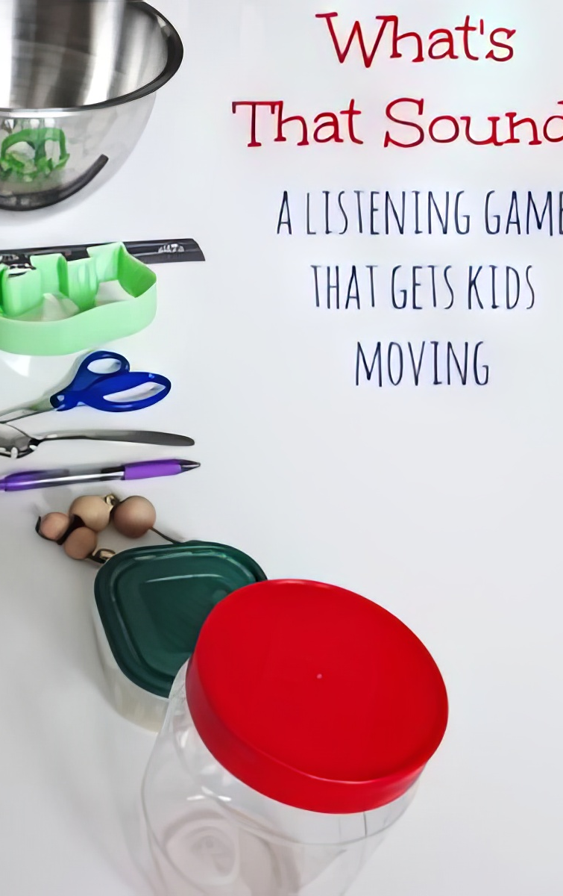
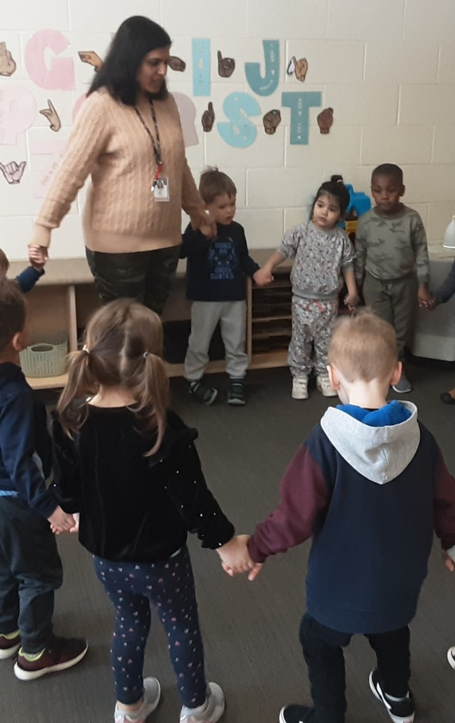
Activities
Notes:
An example from a preschool classroom on Listening:
Who has ears and how do we use them? The educator took pictures of the children’s side profile to show their ears. The pictures were posted and the children enjoyed identifying who’s ear belonged to who.
They also explored open ended conversations with the children inviting the children to share what they hear. The documentation was posted with the pictures of the children’s ears.
Other activity ideas:
Sounds in our neighborhood
Telephone
Sound bingo
Name that tune
Use documentation to talk about when we see children listening to others

Slide 23
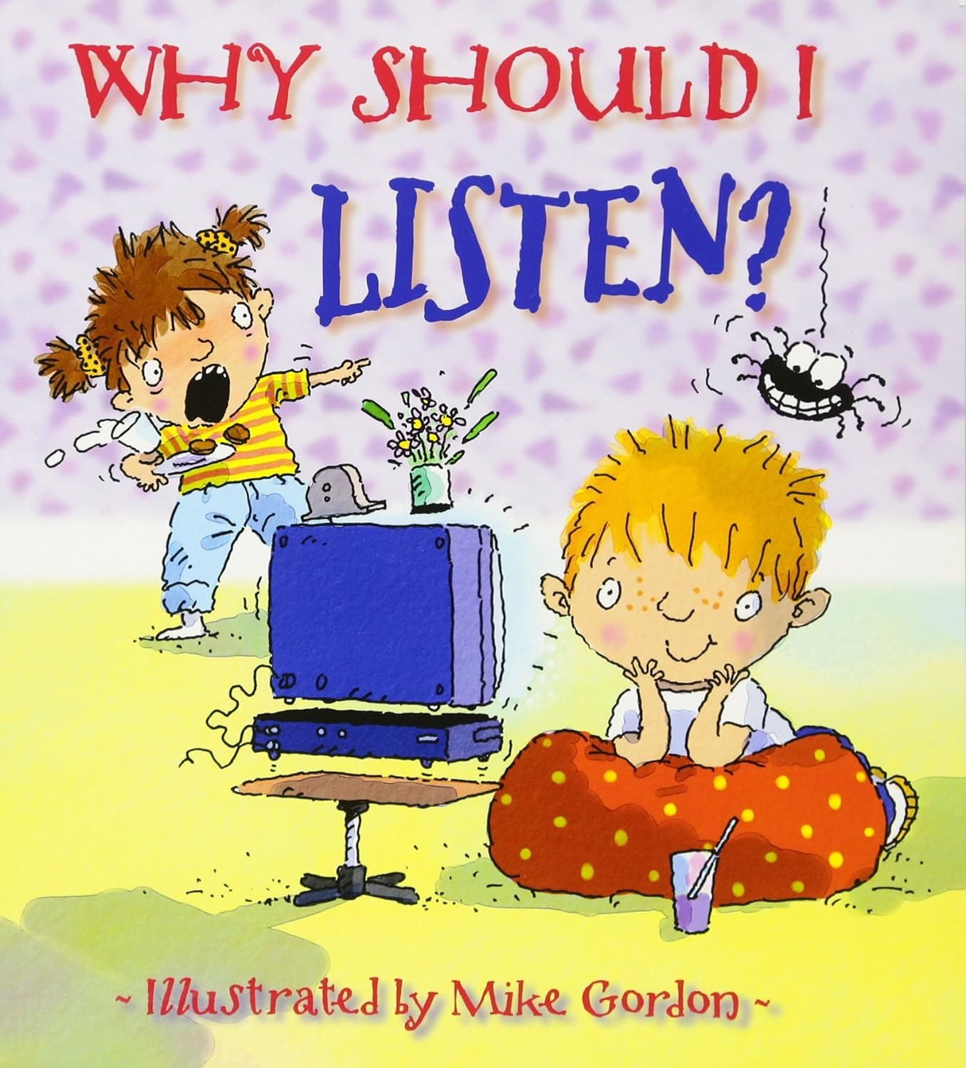
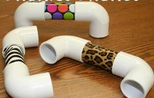
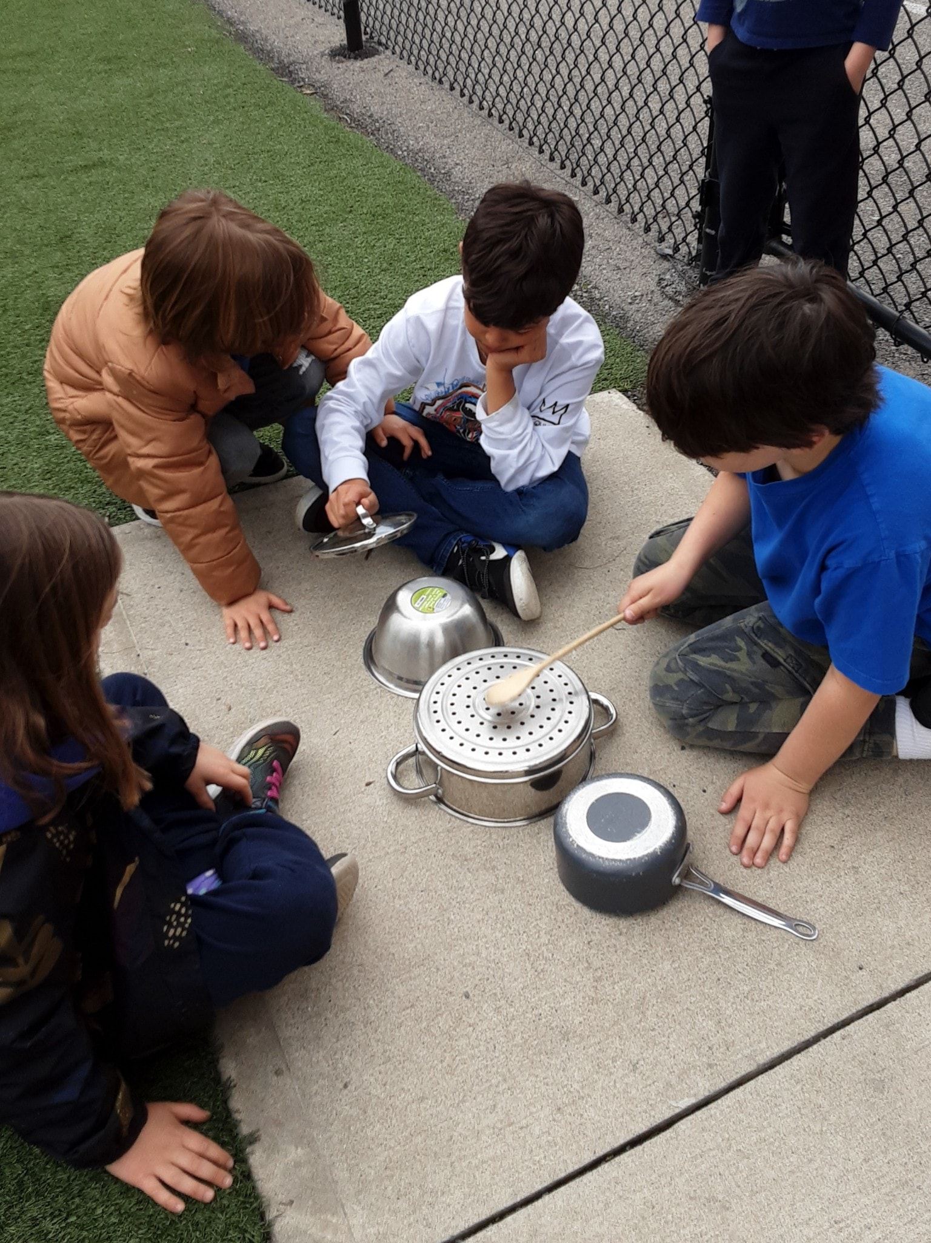
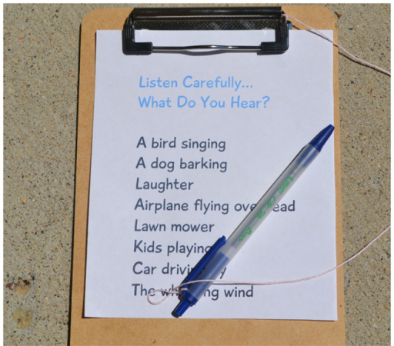

Notes:
Materials that promote intentional language and communication building connections.

Slide 24
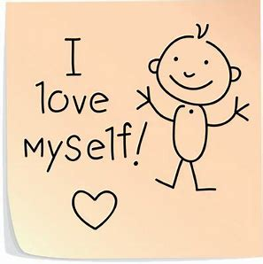
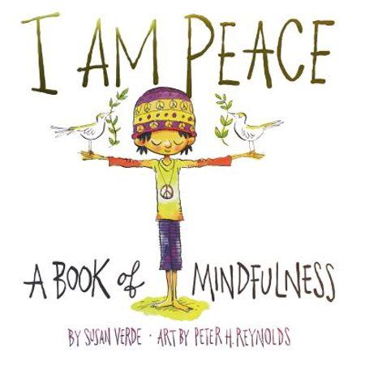
Concept 4 – Self-Esteem
I Like Myself
Friendly words I can say to myself that makes me feel good
Notes:
By the age of 5 children learn how they are viewed. Children hear adults and peers labelling them and talking about them. If they hear something about themselves repeated over and over again, they are going to believe that to be true about themselves.
Let’s make sure children are spoken about in a positive way.

Slide 25
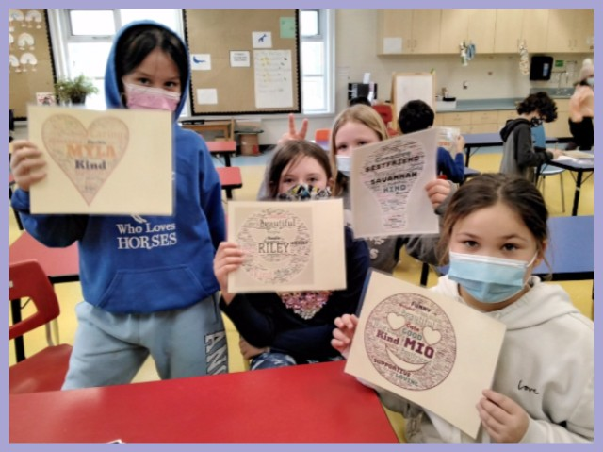
Informed Practices
Secure Relationships
Well-being
Educators can support children
Notes:
Secure Relationships –
- Feeling loved and secure leads to positive feelings as well as the confidence to explore and try new things. Self-esteem is feeling good about yourself
Well-being
- How you feel about yourself impacts how you act and react. think of us as adults, how we feel about ourselves makes the outcome of our day.
Educators can support children
- by recognizing the unique quantities that each child has, children then have the freedom to act upon their own interest

Slide 26
Relationships
Self-esteem is influenced much more through daily interactions and conversations than through group discussions.
Coming to value oneself occurs in many situations during the day.
For children self-esteem comes from:
Knowing that children are loved and that they belong and feel connected
Being encouraged to try new things, finding things they’re good at
Being praised for things that are important to them.
Notes:
Coming to value oneself occurs in many situations during the day.
- So if we don’t have the right Friendly words, children value themselves on what they hear, see and interact. finding those friendly words, Children then develop the habit of self-talk, which is when children say encouraging and kind words to themselves.

Slide 27
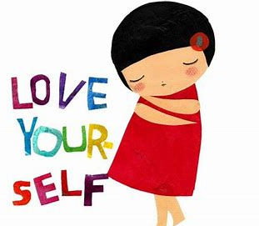
Spontaneous Experience and Interactions
What kinds of communication supports self-esteem?
What kinds of guidance supports self-esteem?
Notes:
What kinds of communication supports self-esteem?
- Following the children lead, which makes them confident in their choices
- acknowledging and describing children's efforts and achievements
- supporting children to make their own decisions, especially in play
What kinds of guidance supports self-esteem?
- providing options for children to have when they need to make choices
- offer TIME IN, so you can supporting children’s feelings.

Slide 28

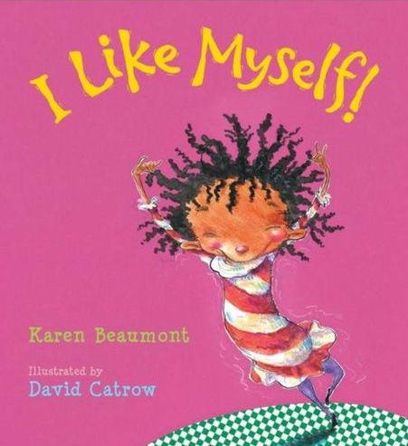
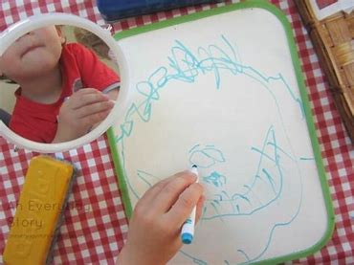
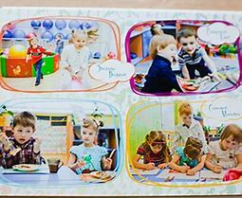
Setting Up The Environment
Ensure Personal Space
Adding Books To Your Learning Centres
Intentional Materials
Showcase each child as a unique and special individual
Notes:
Ensure personal space
- having a personal space like a cubby labelled with their name and photo, so everyone can identify that space belongs to the child.
- adding a favourite item that is special from home to provide comfort and connection to the family.
Adding books to your learning centres
- All about me book activity. Invite the children to think about things from the book that resonated with them. What do you like about you? What are you good at? Create an “I can…” Book or an “I’m good at…” book (taking photos of the children doing tasks)
- Help children to learn what they are good at (what’s your super power?)
Intentional Materials
- Collecting photos that celebrate each child, adding some personal touches and interests about the child
- group photo albums
- Mirrors and materials for drawing, making self portraits with other open ended materials.
- providing song that build self esteem – Jack Hartman
- Daily afirmations

Slide 29
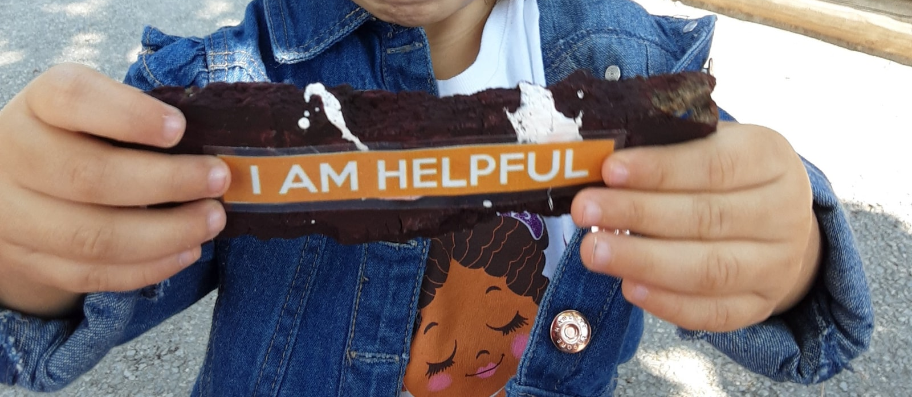
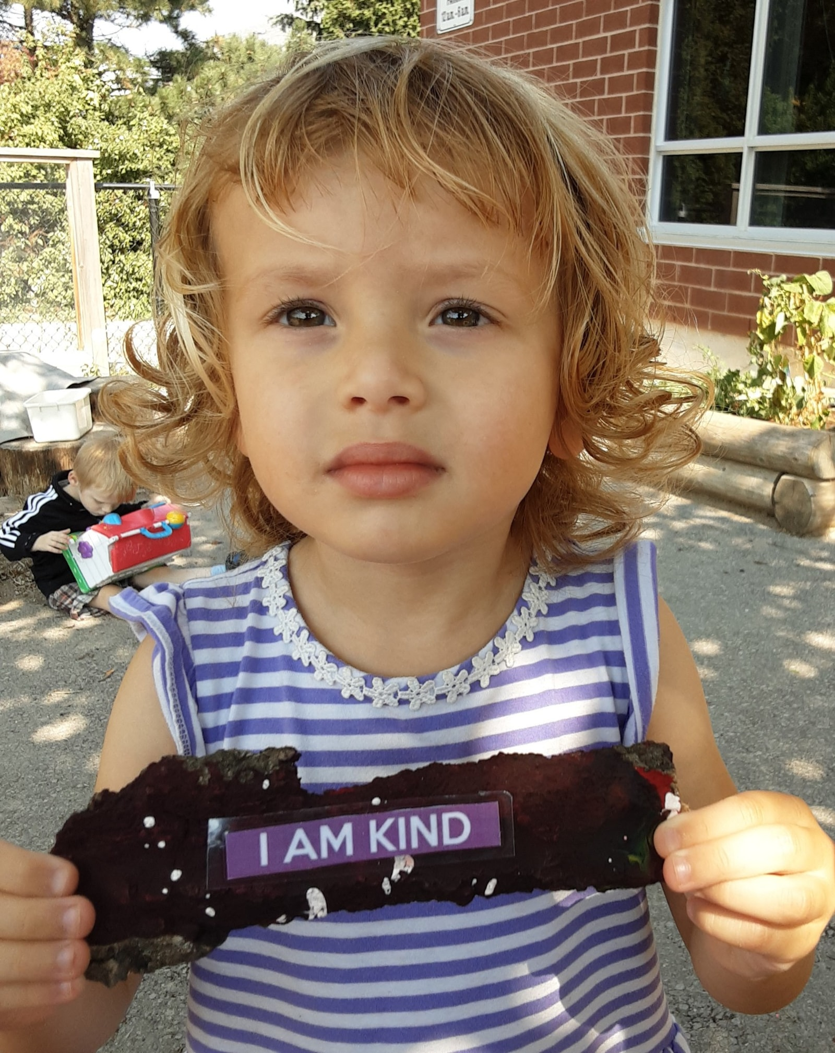
All Day – Everyday – Intentional Practices
Model your Acceptance
Observe and Verbalize
Plan and Engage
Celebrate each child as a valued play partner and group member
Notes:
Model your Acceptance
Model and show your acceptance to each child, so children can then see the value of their peers as valued play partners
Observe and Verbalize
- Observe and verbalize your observations about each child’s interest and strengths, so that everyone can hear the positive comments about the children. If you notice a child did something for another child or for themselves, vocalize it – make them be heard and noticed in a group of children.
Plan and Engage
- plan and engage in small groups interactions many times in the day with children, so that all children are engaged in plan and on one is left out.
-For example, “You can’t play” - you as an educator can sit by that child, engage with them in some sort of activity so that other children see that they are valued members and other children observe this positive interaction.
When children say, I am helpful, I am strong, I am kind - When children say it long enough it becomes a part of them…

Slide 30
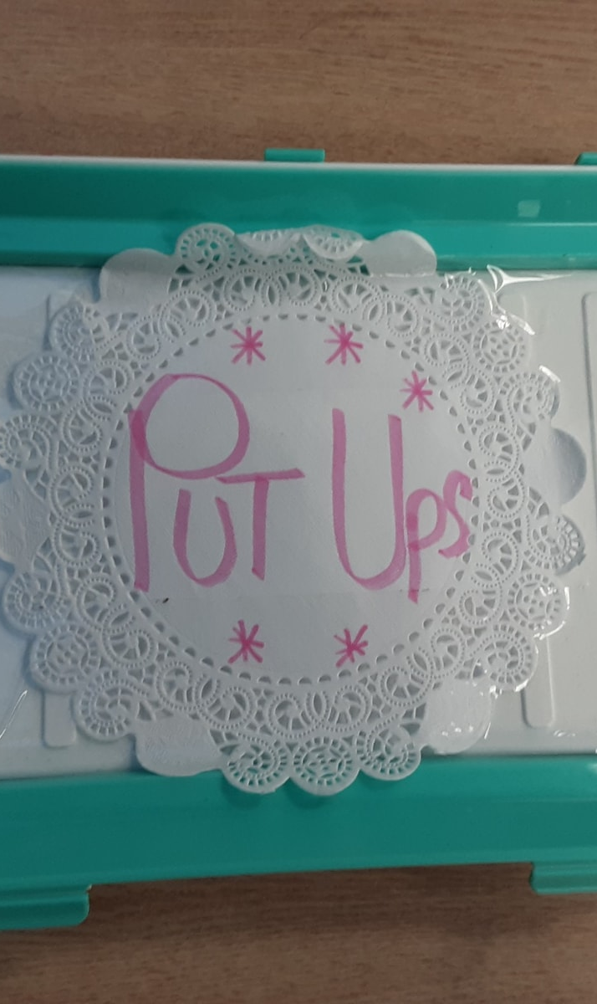
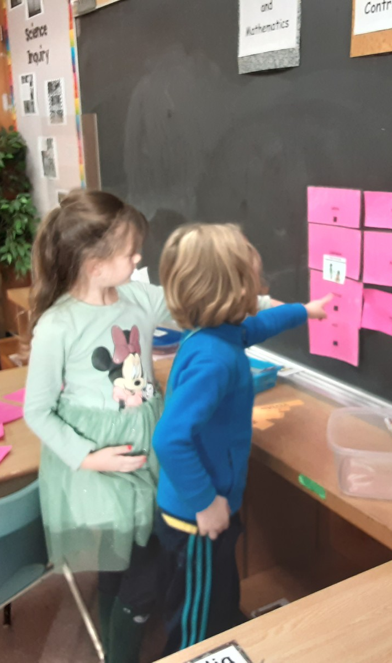
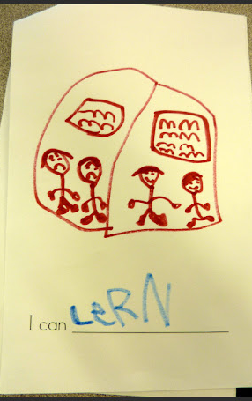

I CAN…
Notes:
Respect is a vital skill that helps students build strong relationships and create a positive learning environment. It involves treating others in a way that makes them feel valued and appreciated.
Related Skills
Teaching children about respectful language and behavior is just one aspect of Social-Emotional Learning.
Other related skills include:
Active listening
Empathy
Conflict resolution
Assertiveness
Collaboration and teamwork

Slide 31
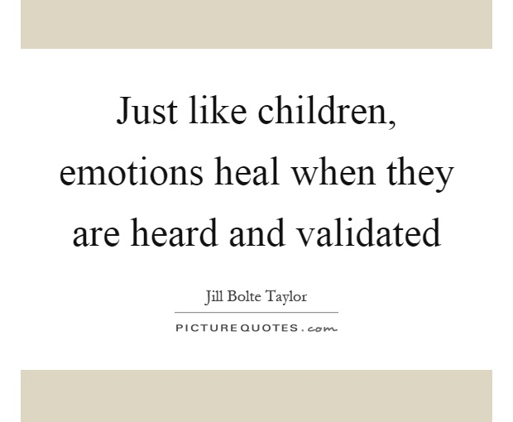
Mentimeter
Take a minute to read the quote together. Choose the following.
A phrase that moved, engaged, provoked or was meaningful to you?
A word that captured your attention or struck you as powerful.

Slide 32
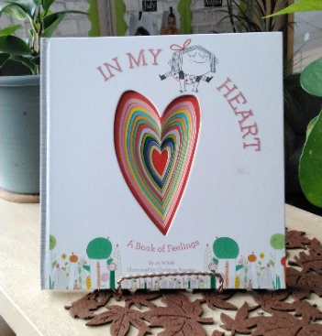
Concept 5: All Feelings are OK!
Naming emotions accurately helps children be clearer about what is going on inside – essential both to making clear head decisions and to managing throughout life.
Notes:
This means giving the right names to your feelings. For example, instead of just feeling "bad" or "angry," you can say, "I feel sad" or "I feel frustrated.“
"Helps children be clearer about what is going on inside": When you name your emotions correctly, it helps you understand your feelings better. It's like putting a label on a jar so you know what's inside.
Knowing how you feel helps you make better choices. It's like having a map to guide you in the right direction.

Slide 33

Activity - Emotion Channel Changers
Activity
Discussion Questions
Related Skills
Notes:
Emotion Channel Changers
This simple activity requires no preparation or materials from the educator, making it a perfect addition to any classroom. Here’s how to conduct the “Emotion Channel Changers” activity:
Ask children to sit comfortably and close their eyes.
Guide students to think about a recent situation where they experienced a big, negative emotion (e.g., anger, frustration, or sadness).
Encourage students to identify the emotion they felt and how it affected their body (e.g., clenched fists, tight chest, or rapid breathing).
Next, ask students to imagine they have a remote control in their hand, with the power to change the channel on their emotion.
Direct students to think about a positive or calming thought, action, or memory that can help them change the channel on their big emotion (e.g., taking deep breaths, counting to ten, or recalling a happy moment).
Finally, have students open their eyes and share their experiences with the class, discussing how they managed to change the channel on their big emotion.
This activity not only helps students recognize their emotions but also empowers them to take control of their feelings and find healthy ways to cope with challenging situations.
Discussion Questions
What are some other strategies you can use to change the channel on big emotions?
Can you think of a situation where changing the channel on your emotions helped you make a better decision?
How can practicing this skill improve your relationships with others?
Why is it important to identify and understand our emotions before trying to change the channel on them?
How can we support our friends or classmates when they are experiencing big emotions?
Related Skills
Developing the ability to change the channel on big emotions is just one aspect of Social-Emotional Learning. Other related skills that can be beneficial for students include:
Empathy: Understanding and sharing the feelings of others.
Self-awareness: Recognizing one’s emotions, strengths, and weaknesses.
Resilience: Bouncing back from setbacks and difficulties.
Conflict resolution: Finding peaceful solutions to disagreements and problems.
Effective communication: Expressing thoughts and feelings clearly and respectfully.

Slide 34

Informed Practices
Self-awareness is a prerequisite for understanding the feelings of others.
A child’s first steps in developing a sense of self-control is being able to recognize different feelings, in self and in others, and being able to express those feelings appropriately.
Using Books to support emotional literacy
Notes:
A child’s first steps in developing a sense of self-control is being able to recognize different feelings, in self and in others, and being able to express those feelings appropriately, it means that as children grow, one of the first things they learn about controlling themselves is understanding and expressing their feelings. This includes recognizing how they feel and understanding how others might feel too. They also start learning how to show these feelings in a way that makes sense and is okay. So, if they're happy, sad, or angry, they start to learn how to express those emotions without causing problems.
Using books for emotional support – Allowing children to be exposed to books that reflect characters in the book that have a range of emotions.
Thinking how characters feel and react help children better prepare to deal with their own range of emotions and behaviours.
We want to provide children with strategies to both accept and manage comfortable and uncomfortable emotions.

Slide 35

Permission to Feel
By Marc Brackett
Notes:
Using the RULER approach questions to help children explore feelings during shared reading and guide conversations with children throughout the day.
R – Recognize (how the characters are feeling) Can you show me a ______face?
U - Understand – What happened that made the character feel______? What happens that makes you feel______?
L – Label – What is the name of that feeling?
E – Express – How did the character act when he/she was feeling?
R – Regulate – What did the character do when he/she felt_______?What could you do to help a friend who is feeling______?

Slide 36

Notes:
10:50

Slide 37


Relationships
When a child comes to you with a problem, always respond. Educators need to encourage children to seek assistance when they are upset or anxious.
Worth the fuss
Important to check in
Notes:
Worth the fuss?
Even if you think the issue is not worth the fuss, these caring conversations with children will only build emotional awareness.
Important to check in
- When children don’t come to you at all, then check in, when facial expressions or body language from children alert you that they are not happily engaged. Then check in with them.
“I am wondering if you have a feeling or a problem that I can help you with?”
“You seem sad”

Slide 38



Setting Up The Environment
Intentional Materials
Notes:
Put pictures of these items:
Puppets, figures, dolls, doll care props, blankets, bottles, spoons and dishes.
Picture cards of various feelings
Photos of children's faces in card format
Books about feelings
Mirrors at multiple learning centres
Materials at creative art, water colours, muliticoloured markers and crayons.

Slide 39

All Day – Everyday –
Intentional Practices
Notes:
Emotion Coaching –
attend to the emotion with empathy,
name the emotion,
validate the emotion.
Meet the need of the emotion

Slide 40




Activities
Notes:
Activity ideas:
How am I feeling? How are you feeling?
Making faces with rocks, mirrors, loose parts.
Loose parts and stories for SEL *exploring emotions

Slide 41
Concept 6: Body Cues
One of the reasons that recognition of body clues is so important is that it creates the opportunity for children to enhance their innate empathy, from the initial level of responding to another's feelings, to understand why the other person is upset, and most importantly, to become motivated to help the other person to feel better.
Emotional
Cognitive
Compassionate
Notes:
This means that noticing how someone's body looks and moves helps children to better understand how they're feeling.
At first, they learn to react to those feelings.
Then, they start to figure out why the person feels that way.
And the most important part is they want to do something to make the person feel happier.
Emotional – feel the other person’s feelings
Cognitive – Understand why the person feels that way
Compassionate – Want to do something to make the other person feel better

Slide 42




Setting up the Environment
Intentional Materials
Notes:
Mirror Mirror….Set up unbreakable mirrors and post different I feel faces around the mirror to encourage children to look at themselves when they are showing s different feeling.
Feeling faces created or collected by the children placed around the room
Multiple copies of feeling faces to play a match card game, children can then determine which faces match.
Playdough centre, making feeling faces
Loose Parts table where children can create faces using materials like sticks, stones, shells, yarn, buttons and pipecleaners.
Cozy corner – Pictures of the children
TFL - Body clues posters

Slide 43

Relationships
Remember, body clues are cues outwardly expressing what is going on inside a person.
One of our roles as educators and co-regulator is to be the narrator and the interpreter of the body clues that tells us how children and others are feeling.
Approaching a child
Notes:
Introducing body clues -
This is my Happy Face – pointing out the children's body clues will allow the children to make sense of their body and the messages they are trying to show us. For example: Can you tell me how your body feels when you are happy? This is when an educator can point out clues that indicate happy faces and bodies – like:
Your mouth is smiling
Your eyes are open and sparkling
Hands clapping
Maybe jumping and moving around
- When an educator approaches an angry child, we need to remember that children are sensitive to much more than a person’s facial expression.
- As co-regulators, we need to model a sense of calm in our own body language and facial expression and tone of our voices.

Slide 44



Activities
Notes:
Use photos to label or explore how you feel when you are happy, sad, angry or sad.
Use videos without volume and help children identify what feelings they can see.
Body mapping – Where does your body feel these feelings?
Role play using dolls with children and prompting feelings responses.

Slide 45



Slide 46

Concept 7: Identifying Feelings of others
Establishing relationships with other children is one of the major developmental tasks of early childhood.
I feel…
Feelings of Others
Notes:
This means making friends and getting along with other children is a big part of growing up.
- Began to show empathy and concern and take action to help others.
- notice similarities and differences between self and others.
I feel…Children who become aware of their own and other people's emotions, desires and feelings are better able to understand their thoughts, wants and feelings.
Then children gain these skills to know how better to respond to others, become sensitive. These skills usually come out during pretend play where they learn to share and help others.
We will never be able to feel exactly the way another person feels, even if we have had a similar experience because everyone's perspective is different and their reaction is unique. But we continue to listen and pay attention to thoughts and feelings of others.

Slide 47


Slide 48


Relationships
Children are more likely to develop emotional empathy if they experience it from others and if they see educators model empathy in their interactions with other children.
Notes:
Educators need to be engaged in children’s conversations, play and conflict throughout the day. Educators need to build a relationship with children so they can feel secure and safe in their basic needs.
As adults when we are sad, angry or happy, we need to express these emotions and usually have that person that has given you the space to feel comfortable to express these emotions. So, you are able to talk, show excitement to share your emotions. Children need to feel the same way, you need to build that relationship with children, so they feel comfortable to express themselves.

Slide 49





Notes:
Setting up the environment with intentional materials
Feelings wheel
Puppets with expressed emotions
Mirrors in all area of the learning centres
Books about feelings
The feelings song – You tube
Jack Hartman songs about emotions

Slide 50


Educator-Led Experiences
Notes:
Children who identify feelings in themselves and others have a better chance of demonstrating appropriate social skills.

Slide 51

Concept 8: Friendly words for others
Friendly Words To Say To Make Others Feel Good
Notes:
Our biology as humans is based on a need to belong to a group of people who care about you and about whom you care in return.
Friendly words such as:
You can do this
Way to go
I like the way you
You really tried…
As children engage in various forms of social play and are supported to recognize the varied capabilities and characteristics of other children, they learn to get along with others, to negotiate, collaborate and communicate and to care for each other.

Slide 52

Relationships
Notes:
Teaching and modelling friendly words creates a supportive and inclusive social environment that encourages positive communication and interactions with friends.
As children acquire more self-esteem and confidence and engage in meaningful conversations with peers and adults to understand how they use friendly words can build a positive relationship with others.
If we wish our children to develop empathy and the desire to treat others with caring and sensitive responses, we need to ensure that we model these practices.

Slide 53

Setting up the Environment
Notes:
The words children hear and the words they is when they speak to themselves, and others define the social emotional environment.
- Words spoken by educators and children carry a great deal of power and can either support and protect or cause hurt.
You can have these kind words around the room so children can refer to them when they speak about their friends. Use pictures to associate these words for younger children.
Model positive and friendly words in your regular conversations with children.
- I really like the way you…
I noticed that you….
How did that make you feel when …..
Your actions with your friend showed me that you really want to play with him….
You made a beautiful picture….

Slide 54



Activities
Notes:
Activity Ideas:
Consider put-up idea and support children in expressing how they feel
Role model, name and notice when children are kind to one another.
Choose books and stories to highlight how and if friendly words were used
Model and coach through conflict
Put Ups

Slide 55

Concept 9: The Problem-Solving Light and Tools
STOP and CALM DOWN!
Developing and Supporting
Traffic Light
Three Step-Process
THINK!
DECIDE!
Notes:
Developing and supporting the understanding that there are many ways to solve problems
And that problems can have many solutions strengthens children’s ability to solve problems with independence.
The ability to solve a problem is a lifelong skill that will allow healthy relationships to flourish.
Solving problems helps children learn about their bodies and their world.
It builds stronger sense of self
Young children have a hard time working out how to get from one state to another making the transformation from a conflict to a positive solution. This requires skills as thinking about more than one thing at a time, planning in advance which children do not develop that skill yet.
The traffic light presents a visual aid that encourages children to begin to self-monitor their behaviour and begin to practice how to solve problems.
Children around this early year's age can learn a three-step process for problem solving”
Red - Stop and Calm Down! (together, chose a way to calm down, talk about how they are feeling)
Yellow - Think! (think about the tools, ways to solve your problem and who can help them)
Green - Decide! (Decide on the best tools to solve your problem and give it a try)

Slide 56



Setting up the Environment
Notes:
Intentional Materials:
Puppets, dolls, figurines
Problem solving cards
Calm Down Cards
Materials to make a class size stoplight
Materials at the creative centre to represent children’s ideas.

Slide 57

Notes:
What information is on a seed packet?
Most seed packets include a lot of information about the seeds and the plants they will one day become. While not all seed packets are created equal, most seed packets include the following information:
Plant type and variety
Seed type (open-pollinated/heirloom or hybrid)
Days to maturity/harvest
When and where to start seeds
Packaging date
Number of seeds
Seed depth and spacing
Every seed packet is different and includes slightly different information, although in general most seed packets available commercially will include the information listed above.

Slide 58



Notes:
Children usually give clues regarding their interests through their choices in play.
By simply observing them, you can find out a lot of information about their individual preferences and interests.
A child portfolio is a tool for us educators and for other children to get to know a person, their likes and dislikes, favoutite food, sports and their interest.
This will allow us to know more about the children especially when it comes to times of self-regulation and strategies to use when coping.

Slide 59


Notes:
We all have ways of coping
Children can identify and create their own tool box
Tool boxes vary from child to child
Have options available.
Visual of how to problem solve – easy to make and individualize with images of children in the class.
Toolbox – how to solve conflict
Shoe – to visualize walking away
Phone – to talk it out
Think about what you like to do when you get wound up? Do you go for a walk, listen to music, read or listen to a podcast. Observe where the children gravitate to. Is it water and sensory play items such as sand, water, playdough, or do the express in a more physical way? Do we need bean bags for throwing or something to kick?
We all have our own ways of coping. Children can identify and create their own tool box. Tool boxes will vary child to child. Have multiple options available for the children to choose the best items for their personalized tool box.

Slide 60
Conclusion
There are no scripts. The children can be successful with the use of the concepts in any order.
Transitional periods may take additional attempts, consistency over time is very important, implementation is important, and connection is key.
Tools for life offers flexibility and a scaffolding that supports educators and children with their implementation and learning.

Slide 61
Thank you
Certificate of Completion
Giveaway Winner
Jennifer Redmond
Pedagogy and Program Specialist
Umbrella Family
Progspecialist2@umbrellafamily.com

