Slide 1
Welcome…Introduce Myself..

Slide 2
HOUSEKEEPING
CERTIFICATE
EMPLOYEE PORTAL – POWERPOINT + HANDOUTS

Slide 3
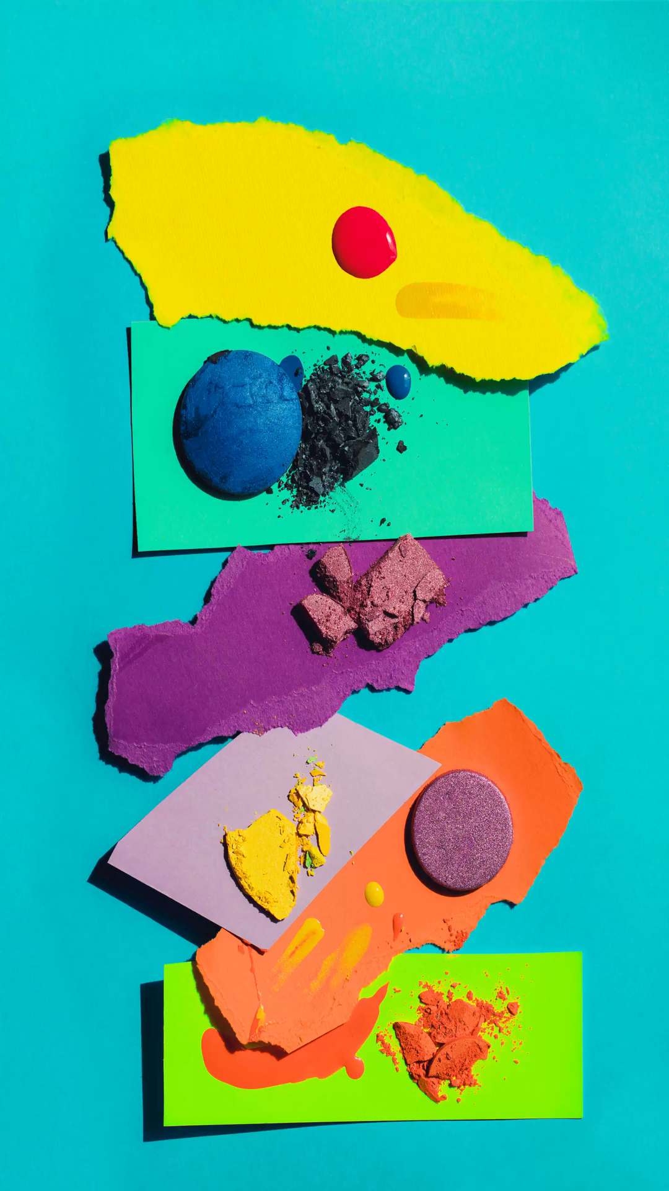
PRODUCT
VS.
PROCESS

Slide 4

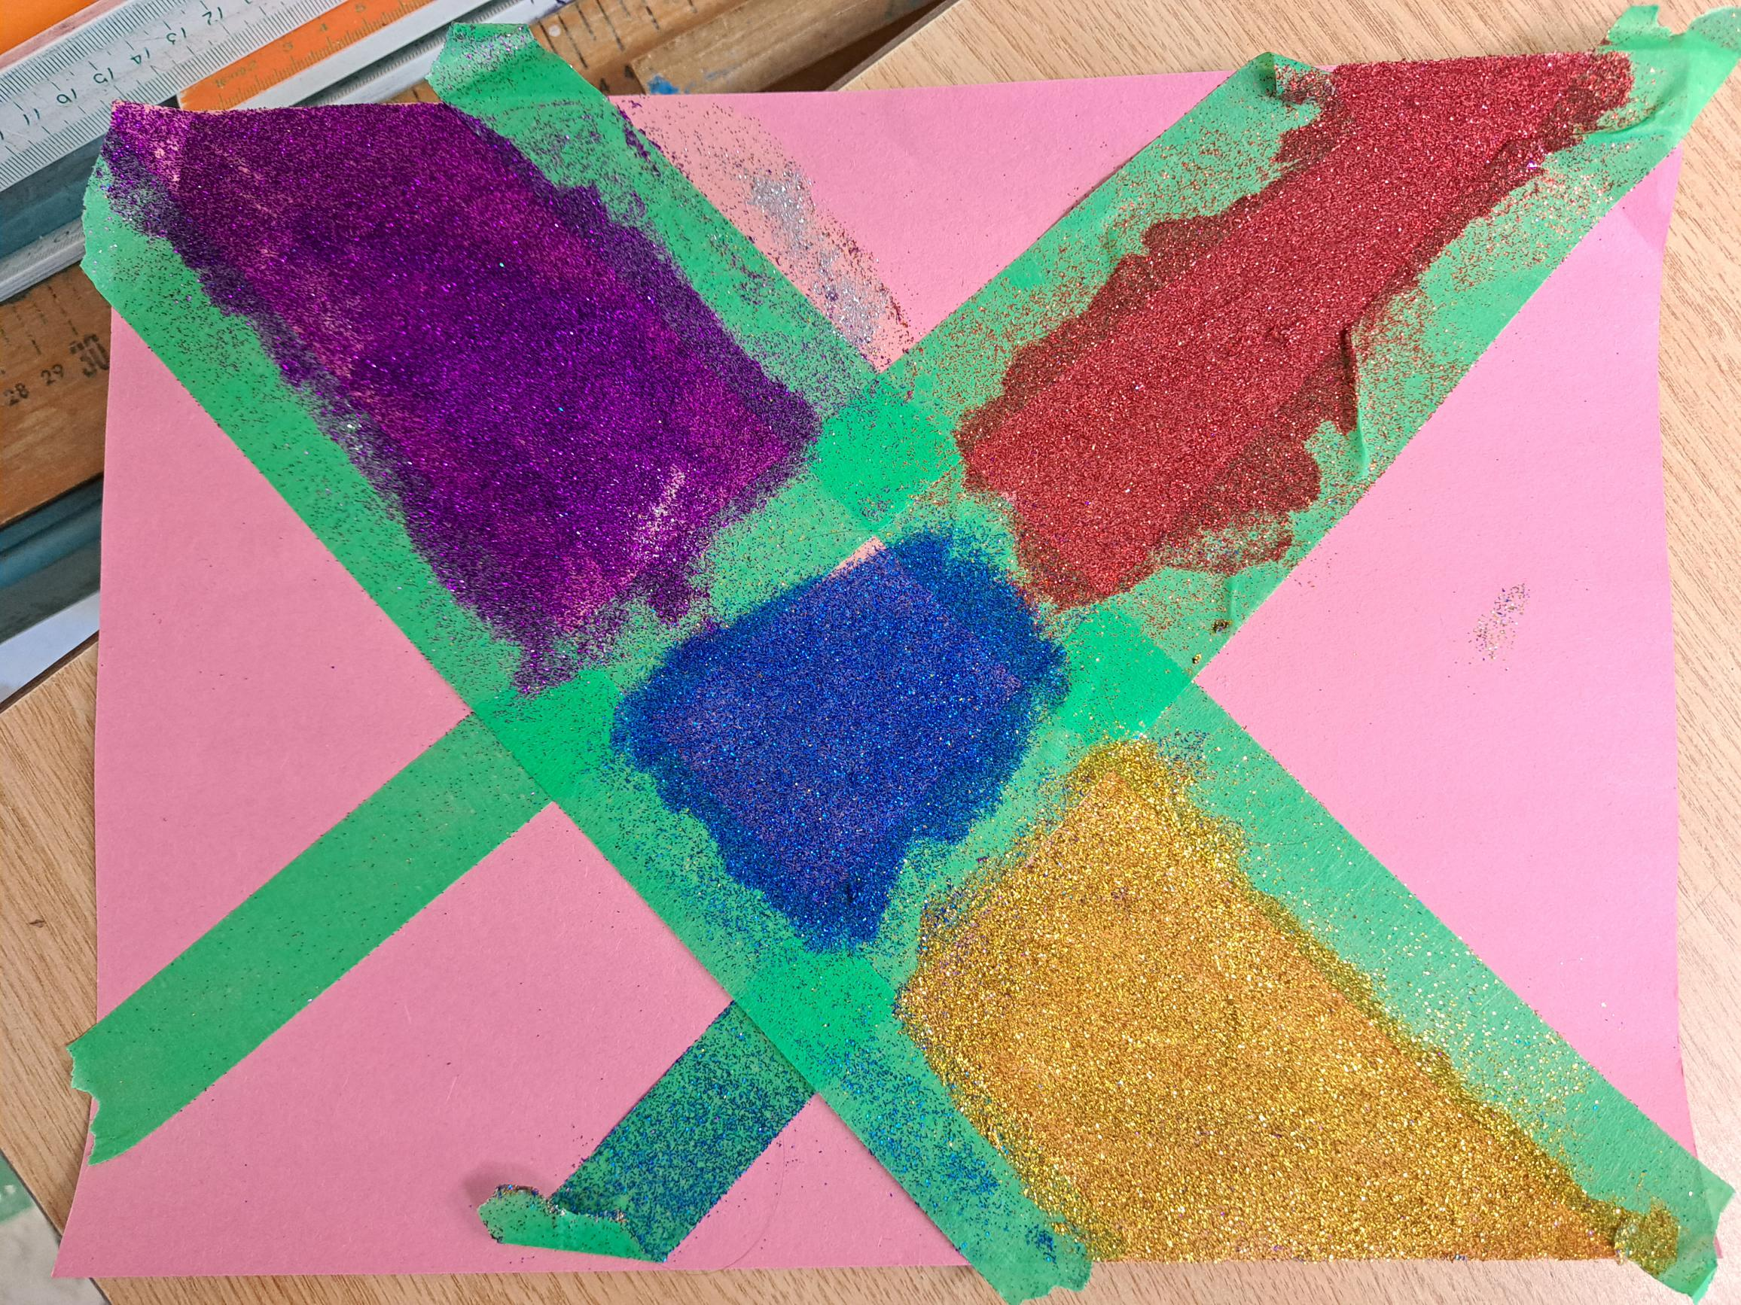
GOALS FOR TODAY:
Understanding The Difference between Process vs. Product art
What Are The Characteristics Of Processed Art and Product Art
Using processed art in your classroom
What children learn through the process
Making the transition to a more processed art in the classroom
Helping adults understand the information
What about special holidays and celebrations? Finding the happy medium.
Handouts

Slide 5

AGENDA
Group Activity #1
What Is Product Art? What Is Processed Art?
Understanding The Difference
Video - What does a processed art area look like?
Break – 10 minutes
Activity #2
Why Is It Learning? What children learn?
Activity #2
What Are The Characteristics Of Processed Art and Product Art
Using processed art in your classroom
What children learn through the process
Making the transition to a more processed art in the classroom
SHARING (OPTIONAL)

Slide 6
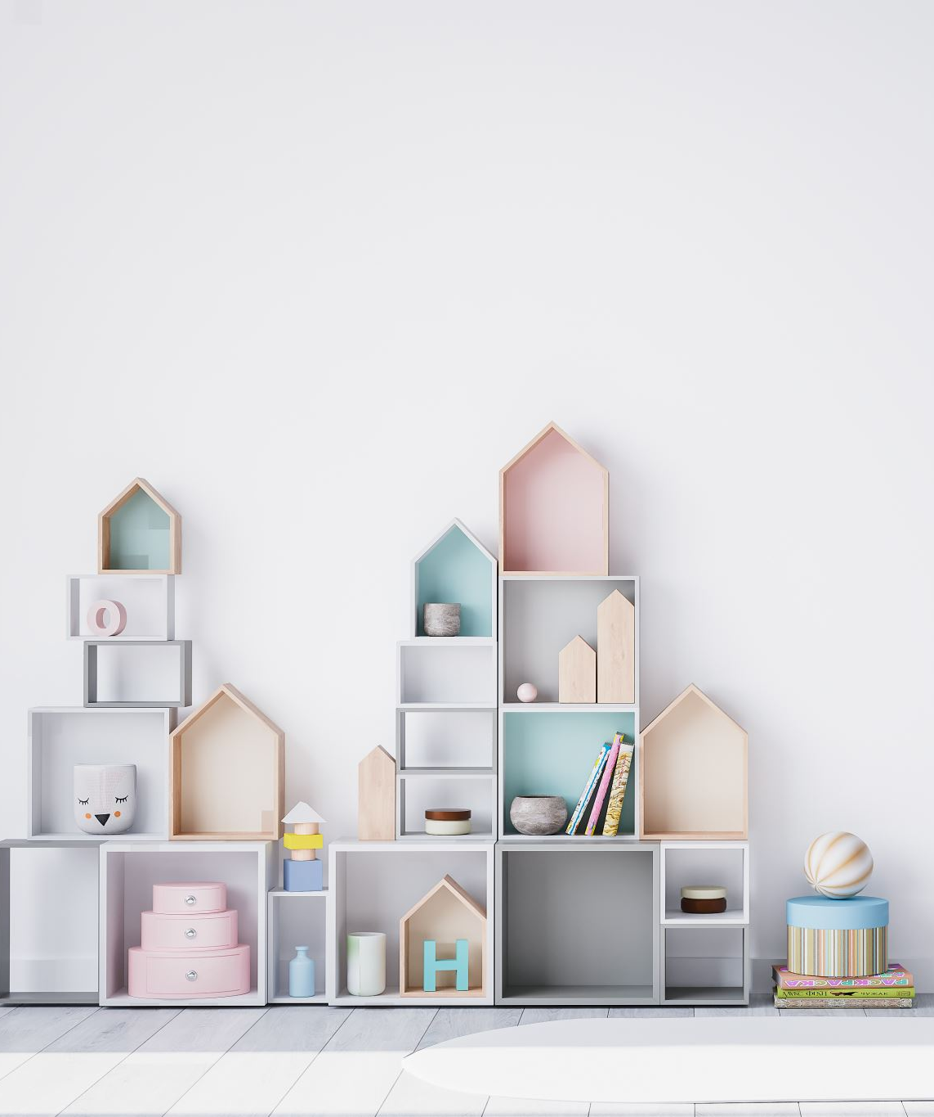
Activity #1
Draw anything of your choice
Add as many details as you would like (What makes it yours?)
Using any materials, you have
Let’s take about 5 minutes
Sharing (if comfortable) later
Notes:
Put the activity aside. We will come back to it after.

Slide 7

MENTIMETER
What do you feel the barriers are to having more process based art in your programs?

Slide 8

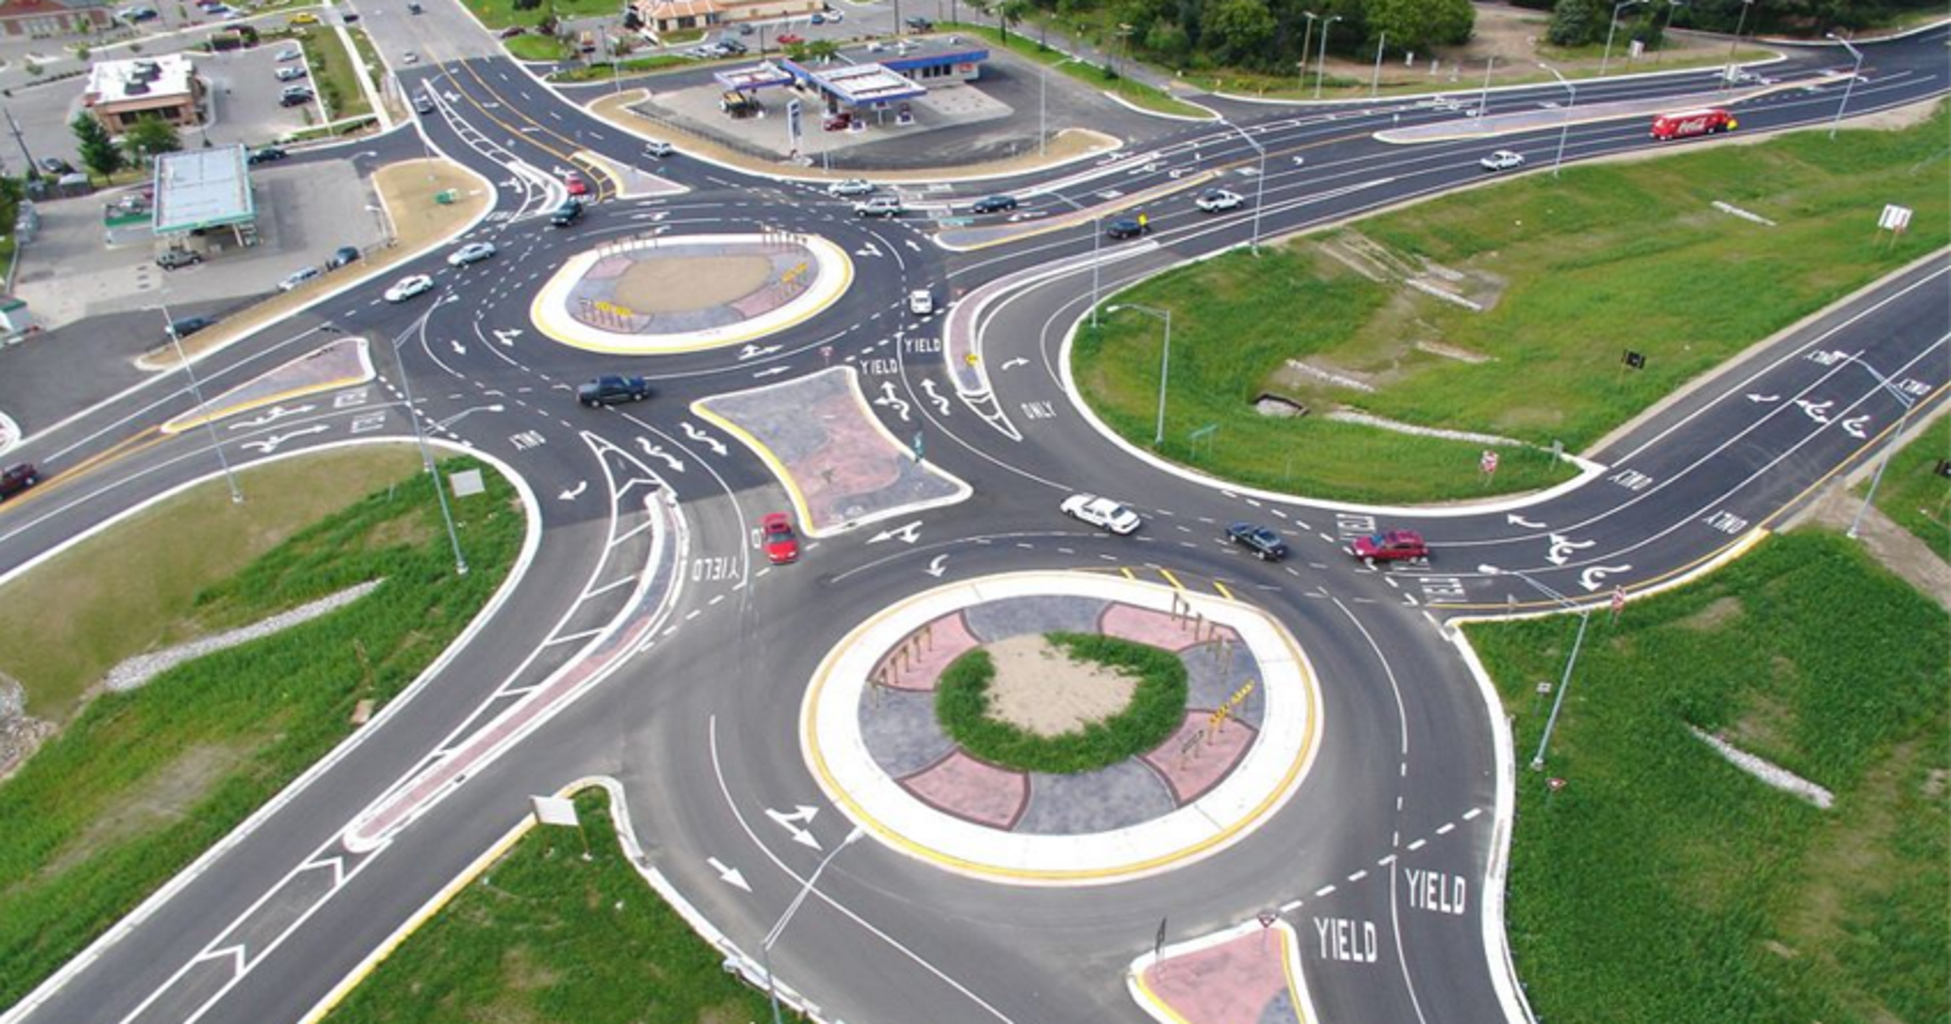

WHAT IS YOUR JOURNEY?
How would you describe your current learning journey towards
PROCESS ART?
Straight
Round abouts
Under Construction

Slide 9
MENTIMETER
Where are you in your journey?

Slide 10
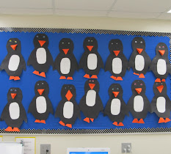
WHAT IS?
PRODUCT-FOCUSED
ART?

Slide 11
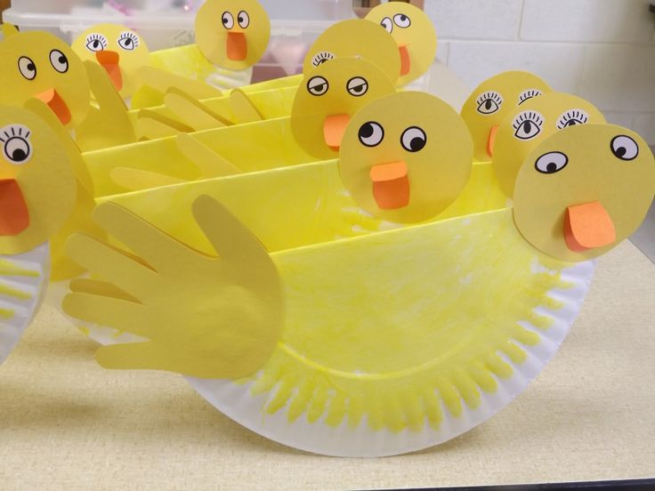
Certain result
“cookie cutter”
Focus on Final Product
Discourage creativity

Slide 12
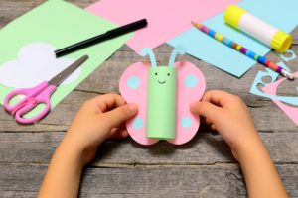
Expected outcome
“Do it this way”
Child not
actively engaged

Slide 13
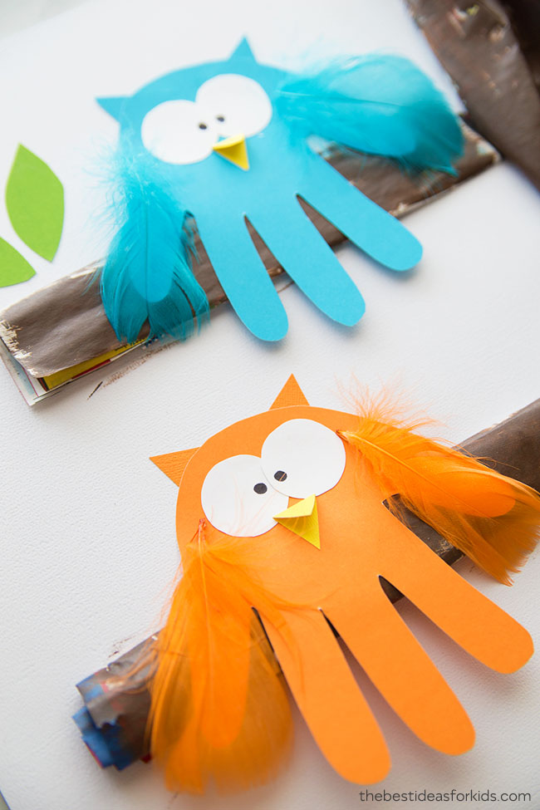
End result valued
Similar/identical
Follow certain
steps

Slide 14
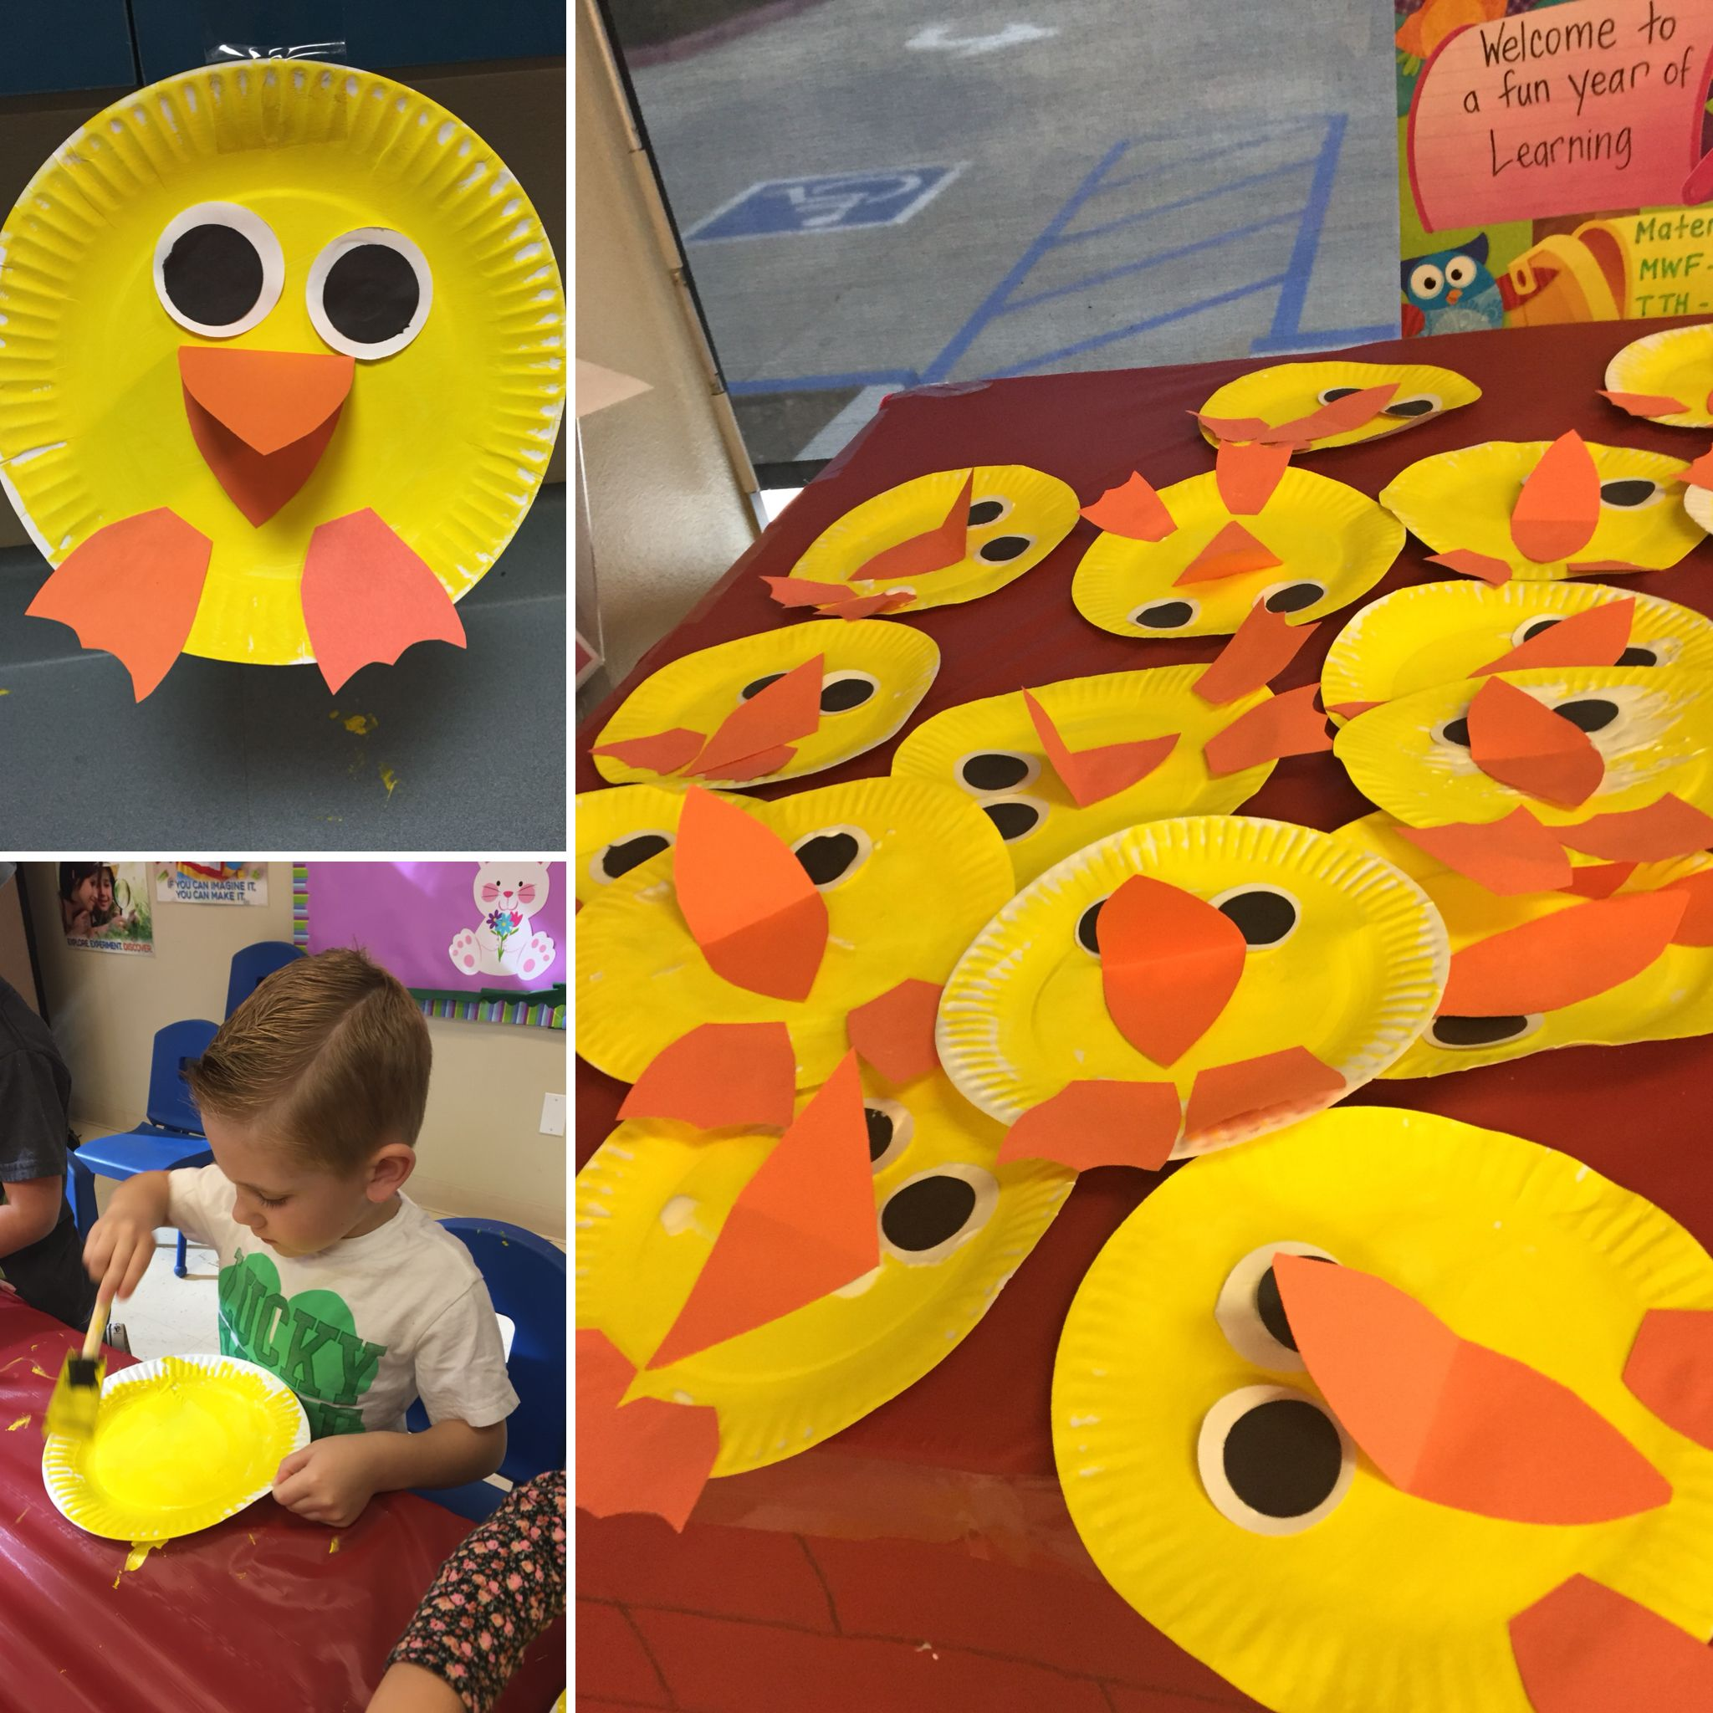
What children might say
“Can I be done now?”
“Is this right?”
“I can’t do it.”
“Mine doesn’t look like yours.”

Slide 15
CHARACTERISTICS
OF PRODUCT-FOCUSED ART EXPERINECES
The teacher created a sample for children to copy
There’s a right and a wrong way to proceed
There’s a finished product in mind
The children’s finished art all looks the same
The children experience frustration
The teacher might “fix mistakes”
Children have instructions to follow
The whole class took part in an art project at the same time
Patterns and examples are readily available online

Slide 16
Product Art
Teacher directed crafts involve following a set of instructions to create a predetermined outcome, such as handprints turkeys or tress, paper towel butterflies and pipe cleaner caterpillars.
The focus is on the end result, rather than the process of creating it.
While they may seem fun to an adult, they are limiting for children. They limit creativity and Self-expression, as children need to follow instructions to create a certain outcome.
This can lead to frustration and disappointment, as they are unable to achieve the desired result or their’s don’t look like the teachers.

Slide 17
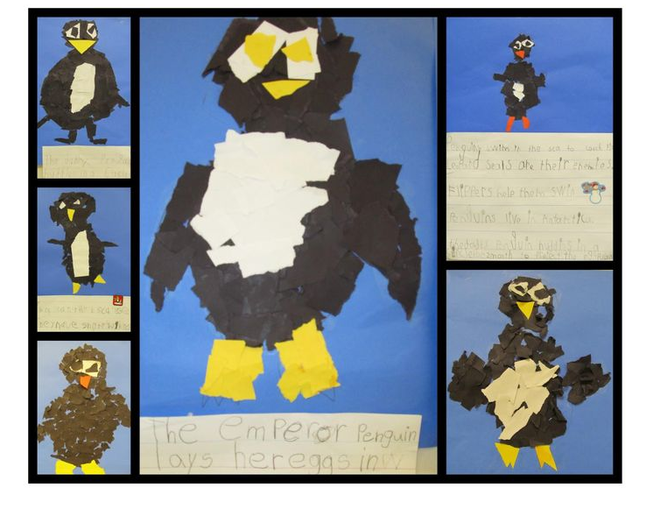
WHAT IS?
PROCESS-FOCUSED
ART?

Slide 18
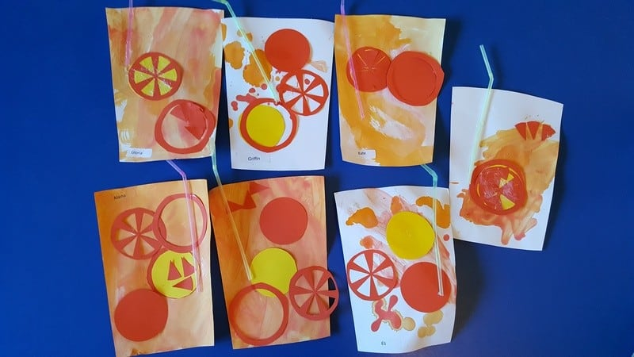
No
expectations
Open-ended
Self-Directed
Experiment

Slide 19
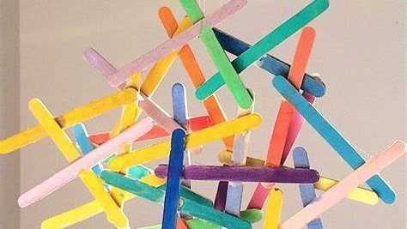
Discover
“I wonder”
Explore
Free

Slide 20
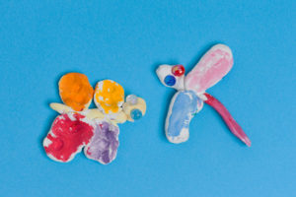
Unique
Creative
Focus on experience
Original
Self-expression

Slide 21
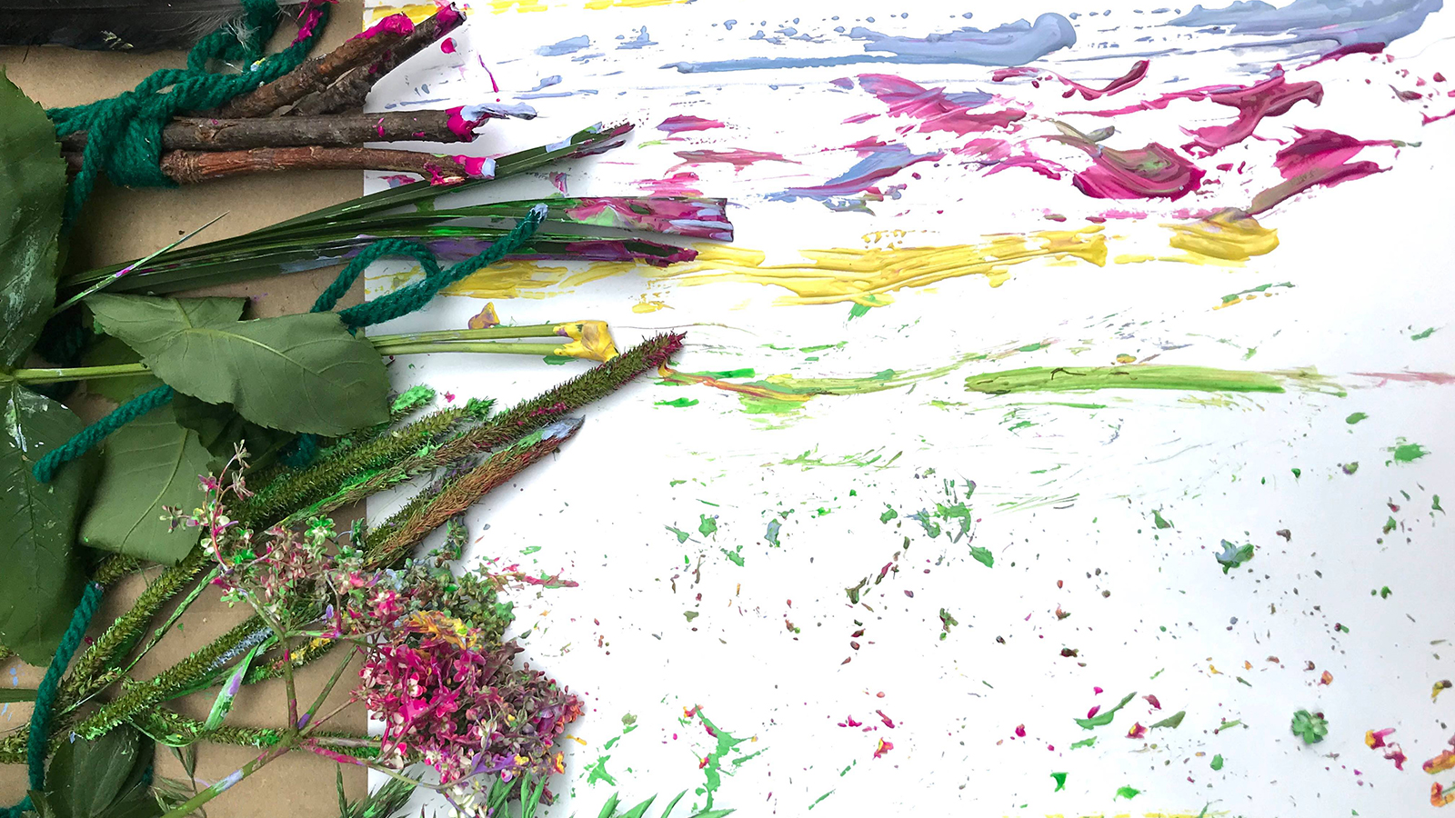
What children might say:
“Look what I made!”
“I’m going to do another!”
“Can I have more time?”

Slide 22

CHARACTERISTICS OF PROCESS-FOCUSED ART EXPERIENCES
There are no step-by-step instructions
There is no sample for children to follow
There is no right or wrong way to explore and create
The art is focused on the experience and on exploration of techniques, tools, and materials
The art is unique and original
The experience is relaxing or calming
The art is entirely the children’s own
The art experience is a child’s choice
Ideas are not readily available online

Slide 23
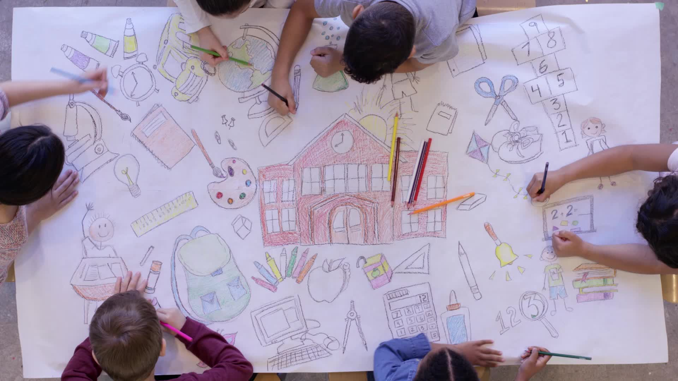
Process Art
Free process art is all about creativity. Children are encouraged to express themselves freely, without predetermined outcome or specific instructions
Children are given a wide range of art materials to choose from and are allowed to use them in any way they like.
Through process art Children can focus on the enjoying the process of creating artwork.
There is no "Wrong way" to do it.
The focus is the process of creating, rather than the final product.
Process art fosters imagination and self-expression and encourages them to take risks and experiment with different materials and techniques.
Helps children to develop fine motor skills, hand eye coordination, and cognitive abilities. Process art promotes a sense of joy without the pressures of achieving a specific outcome.

Slide 24
PROCESS ART IS…
It's easy to facilitate
Process Art can be made with different tools
Process Art can be a sensory experience
Process Art can go up!
Art can be made from collections of materials
Process Art can be temporary
Process Art can be made outside
Notes:
It's easy to facilitate
One of the nice things about incorporating process art throughout your week is how easy it is to set up. In most cases you just need to provide the materials
Process Art can be made with different tools
In process Art you can use a variety item from around the house, as well as items from nature to create with. Some of my favorite process art tools are Flyswatters, Forks, Spray Bottles, sponges, forks, and Marbles.
Process Art can be a sensory experience
You can create a sensory rich Art experience for children by providing opportunities for them to create Art with their fingers, and toes. Paint on unique textures such as Sandpaper, Foil or Natural Items such as rocks or branches.
Process Art can go up!
Don't forget to incorporate 3-Dimentional Art into your program. Sculptures can be made using a variety of materials such as Wood, Rocks, Foam, Boxes, Straws and many other loose parts.
Art can be made from collections of materials
Kids love glue! Incorporate Mosaics, Collage, and Mixed Media.
Process Art can be temporary
Not all Art needs to be hung on a wall to be appreciated. You can incorporate a variety of Transient Art projects. For children who might need something concrete, you can take a photo and share it on a Bulletin Board or give them the photo to take home to share.
Process Art can be made outside
Bring the Messy Art Outside! You can design a place outside to create.

Slide 25

WHAT DOES A PROCESS ART AREA LOOK LIKE?
https://www.instagram.com/s/aGlnaGxpZ2h0OjE3ODk4MDc1MDYyMjg1MDk1?igshid=MTc4MmM1YmI2Ng==

Slide 26
MENTIMETER
What did you notice?

Slide 27
PROCESS ART – WHY IS IT LEARNING?
Creativity and Imagination
Exploration and Experimentation
Sensory Engagement
Problem Solving
Fine and Gross Motor Skills
Self-Expression
Independence and Decision-Making
Appreciation of the Creative Process
Emotional and Social Development
Documentation of Learning
Reduction of Fear of Failure
Understanding Concepts
Notes:
Process art is considered a valuable and educational approach to art because it provides a unique opportunity for learning and development, especially in educational and childcare settings. Here are some reasons why process art is regarded as a valuable tool for learning:
Creativity and Imagination: Process art encourages children to use their creativity and imagination freely. They have the freedom to explore and express themselves without the pressure of creating a specific end product.
Exploration and Experimentation: Process art allows children to experiment with various materials, colors, and techniques. This hands-on exploration fosters curiosity and helps them understand cause and effect.
Sensory Engagement: Many process art activities involve sensory experiences, such as touching, feeling, and manipulating materials. This engagement with the senses is crucial for early childhood development.
Problem Solving: As children engage in process art, they encounter challenges and problems to solve. They learn to adapt and make decisions in response to the materials and their own ideas.
Fine and Gross Motor Skills: Process art often involves actions like cutting, gluing, and painting, which help develop fine motor skills. Some activities may also involve larger movements, promoting gross motor skills.
Self-Expression: Process art allows children to express their thoughts, feelings, and experiences. It can be a way for them to communicate when they may not have the words to do so.
Independence and Decision-Making: Children have the autonomy to make choices during process art activities, which helps them develop a sense of independence and decision-making skills.
Appreciation of the Creative Process: By engaging in process art, children come to understand that the journey and the act of creating are as important, if not more so, than the final result. This perspective can have a lasting impact on their appreciation of art and creativity.
Emotional and Social Development: The act of creating art can be emotionally fulfilling and can help children manage their feelings. Additionally, collaborative process art projects can promote social interaction and cooperation.
Documentation of Learning: Keeping a record of the process, such as through journals, allows children to reflect on what they've done and learned. This documentation can be a valuable tool for assessment and communication with parents and educators.
Reduction of Fear of Failure: Since there's no right or wrong way to create process art, children often experience less fear of failure, which can boost their confidence and willingness to take creative risks.
Understanding Concepts: Process art can be used to teach various concepts, from colors and shapes to science and math, in a hands-on and engaging way.
In summary, process art is considered learning because it engages children in a holistic educational experience that encompasses creativity, problem-solving, motor skills, emotional development, and more. It values the learning journey and the child's unique expression, making it a valuable approach in early childhood education.

Slide 28
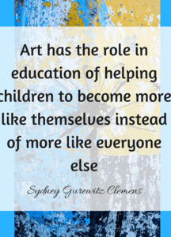
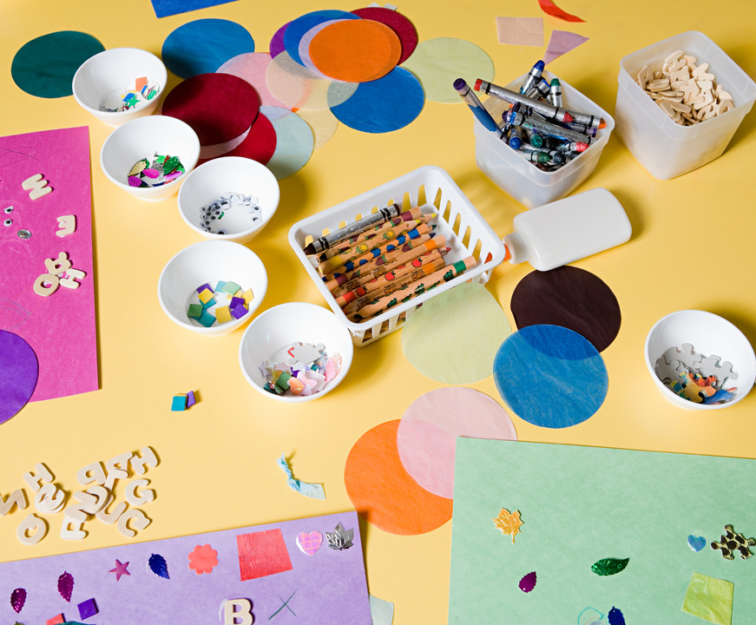

Slide 29
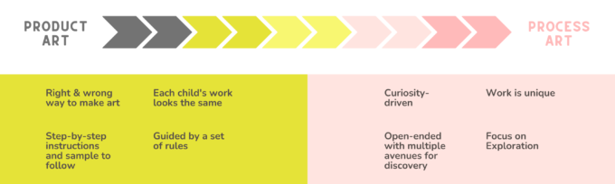

Slide 30
ENGAGE THE POWER OF PROCESS ART TO HELP CHILDREN THRIVE

Slide 31
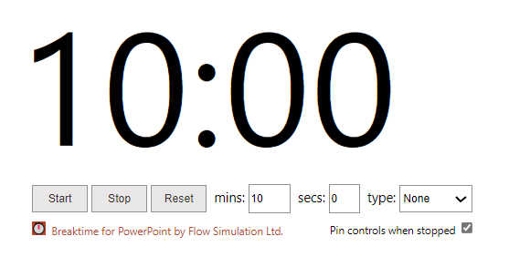
LET’S HAVE A BREAK!

Slide 32

Activity #2
Draw this house.
This Photo by Unknown Author is licensed under CC BY

Slide 33


Slide 34
ACTIVITY #2
Compare Activities
What did you notice?
What was it about the first activity where you got to produce your own house compared to the house, I gave you steps by steps.

Slide 35
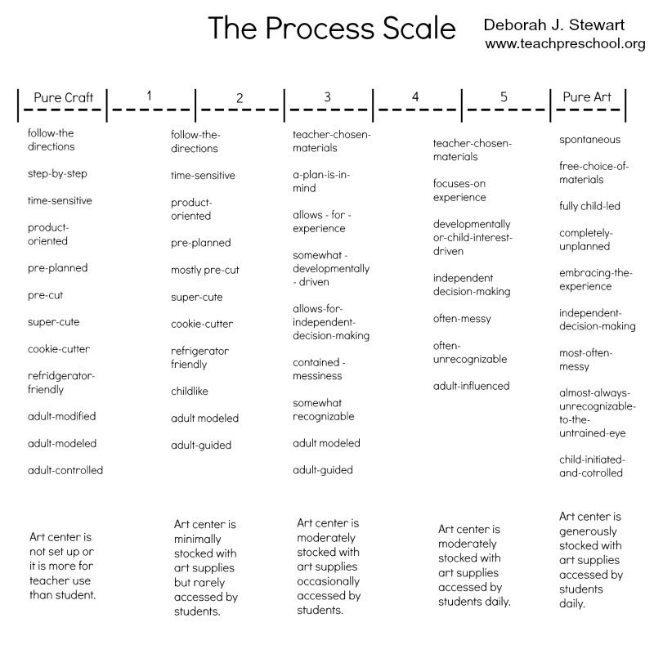

Slide 36
MENTIMETER
WHAT’S YOUR PROCESS SCALE – WHERE DO YOU FIT?

Slide 37
TIPS FOR LEADING PROCESS-FOCUSED ART
Approach art like open-ended play—for example, provide a variety of materials and see what happens as the child leads the art experience
Make art a joyful experience. Let children use more paint, more colors, and make more and more artwork
Provide plenty of time for children to carry out their plans and explorations
Let children come and go from their art at will
Notice and comment on what you see: Look at all the yellow dots you painted
Say YES to children’s ideas
Offer new and interesting materials
Play music in the background
Take art materials outside in the natural light
Display children’s books with artful illustrations, such as those by Eric Carle, Lois Ehlert, and Javaka Steptoe
Let the children choose whether their art goes home or stays in the classroom
Remember that it’s the children’s art, not yours

Slide 38
PROVIDE OPEN-ENDED, CREATIVE ART EXPERIENCES.
Easel painting with a variety of paints and paintbrushes (with no directions)
Watercolor painting
Exploring and creating with clay
Finger painting
Painting with unusual tools like toothbrushes, paint rollers, potato mashers
Printing and stamping (stamps purchased or made with sponges)
Creating spin art using a record player and paint, squirt bottles, paintbrushes, or markers
Stringing beads independently and creatively
Weaving cloth, yarn, or paper
Drawing with pencils, art pens, various sizes of markers, or crayons
Using homemade doughs
Making collages using tissue paper, various sizes of paper, glue, paste, glue sticks, scissors, and recycled materials

Slide 39
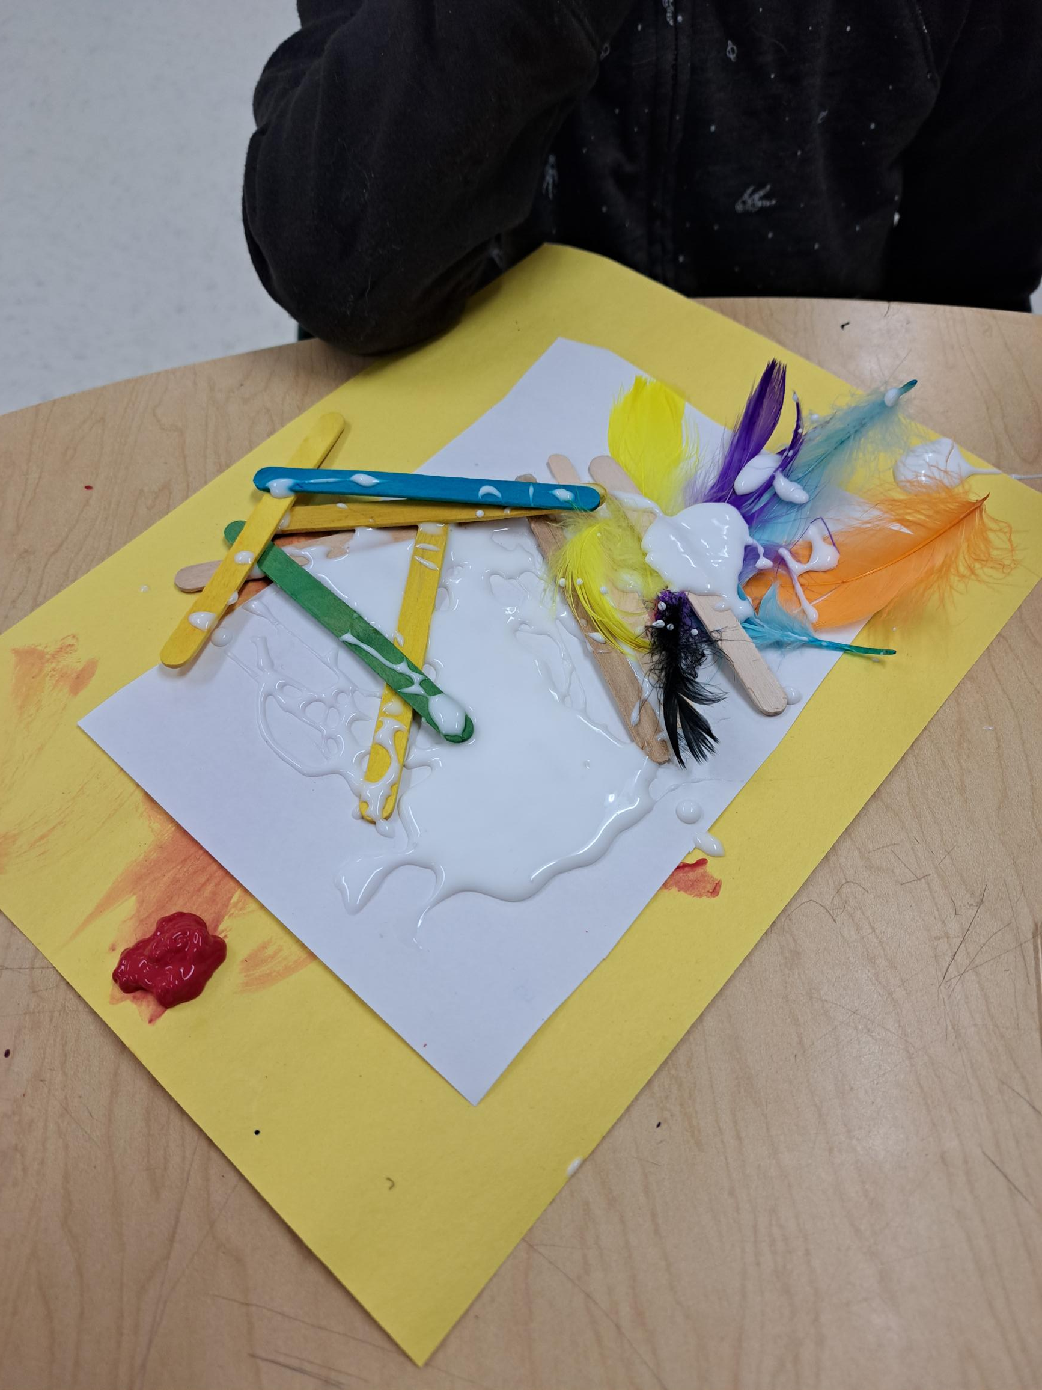
WHAT IS A GLUE TABLE?
A glue table is a place where you can say “YES” to glue play. Giving the children space to explore glue in many ways.
TIPS!
Use glue spreaders
Glue dilution
Glue in small containers
Portion control

Slide 40
WHY SHOULDN’T WE CORRECT CHILDREN?
They tell you everything you did was wrong and that it doesn’t look right.
How does that make you feel? Would it motivate you to do it again or would it suppress your desire to be creative?
You may even doubt or forget the things you learned.
While it is sometimes hard not to show a child “the right way” to do things, it’s important not to correct them.
Children take joy in creating and not about the end result.
We do not want to become their inner voice doubting themselves.
So, if they put an eye where a mouth “should” be, instead of correcting them say: “what a cool eye!”

Slide 41
MAKING THE TRANSITION
The internal struggle.
In order to transition from product to process-focused art, you have to start by reflecting on your own attitudes about the role of art in your classroom.
Is the art experience in your classroom about what you need or is it about what the children need?
Is the art experience in your classroom about what you love or is it about what the children love?
Is the art experience in your classroom guided by what you find easy to clean up and manage or is it guided by what will keep the children engaged, challenged, and interested....
Notes:
A lack of experience with process-focused art
For those who lack experience with process-focused art, it can seem overwhelming and non-productive at first. To provide quality process-focused art experiences for young children, you have to start at the beginning and invite the children to simply explore the materials you provide. As the children are given the freedom and time to explore the materials, their skills and abilities to constructively manage and creatively use those materials will build over time.
You also have to understand where your children are developmentally so you can plan processes that they will want to try. In order to keep young children engaged in the process, you have to come up with ideas that are age appropriate, inviting, and interesting. Coming up with successful process-focused art experiences takes commitment, effort, time, and lots of trial and error along the way.
The inability to justify the process
Another reason teachers struggle with transitioning from product to process-focused art is the inability to justify the process. Trying to explain to parents why most of the artwork coming home looks like one big blob after another can be difficult. One tip that will help with this is to start with the planning phase. When planning an art activity, answer the question; "what will the children do?" instead of "what will the children make?" This will help you focus on the process and then talk about the process with others.
The next time an adult walks in the classroom and says, "What did the children make today?" You will be prepared to say, "The children figured out that..." or "We are making great progress on..." or "We explored the use of..." Describing the process will naturally lead to a discussion on what the children learned or gained from the process and keeps the conversations open ended and focused on growth and development. Answering the question with "We made a tree today" pretty much wraps up any real potential for an exciting conversation about growth and development...
Another part of transitioning is recognizing and managing the internal struggle to control the art experience. Perhaps you like the artwork on your wall to look a certain way. Perhaps you have certain expectations about how the children should use the materials you set out. Perhaps you love something you saw on Pinterest so much that you want to reproduce the exact same artwork
Adults facilitate projects and act as co-learners, so they don’t have to hold all the answers. In fact, not knowing the answers can be a huge benefit because it gives adults room to play and experiment themselves.
Process-focussed projects don’t require a lot of fancy set up or unique materials that are hard to come by. This saves both time and money.
Because the goal of process art is to explore and discover, rather than achieve perfection, adults are also emotionally free to support whatever the child dreams up as an ideal solution or end result. No fighting, tears, or half-completed projects

Slide 42
SUPPORTING ADULTS TO UNDERSTAND
The next time an adult walks in the classroom and says, "What did the children make today?" You will be prepared to say,
"The children figured out that..."
"We are making great progress on..."
"We explored the use of..."
Describing the process will naturally lead to a discussion on what the children learned or gained from the process and keeps the conversations open ended and focused on growth and development.
Pick a topic of focus for a few weeks (ex, Process art)
Post on social media App that one thing for a few weeks with tips, info and some research.
Send a letter home about processed art
Concentrate your documentation around processed art for a few weeks

Slide 43
QUESTIONS WE CAN ASK OURSELVES WHEN PLANNING…
WHAT AM I DOING?
WHY AM I DOING IT?
WHO IS IT FOR?
When we ask these questions, we get intentional about these experiences we provide in our classroom. We need to get beyond, “this is how it has always been” or “the parents want” or “its’ so cute”
Rule of thumb about art:
If it takes YOU longer to get it ready than it takes THEM to do it…it’s probably not process art.

Slide 44
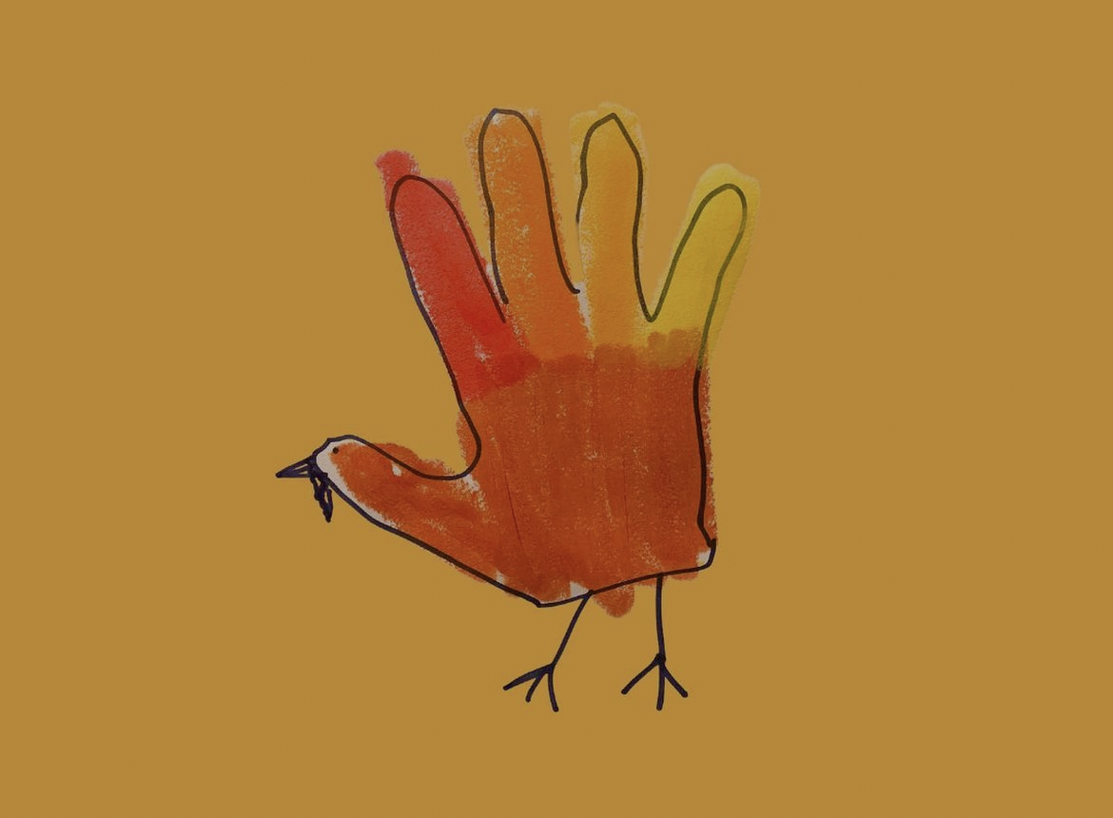
Let’s take this turkey handprint
WHAT AM I DOING?
turkey handprint
WHY AM I DOING IT?
because its thanksgiving and we always do them, and they are so cute!
WHO IS IT FOR?
the parents loveeee it!

Slide 45
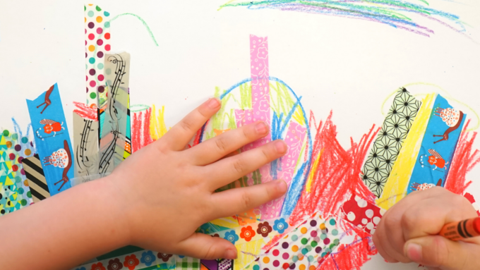
CHANGE IN THINKING…
We/I always….
Cute…
No more than 2 goggle eyes
We always make handprints
It would be cute if….
I saw this craft project on Pinterest…I think I will try it.
I will precut shapes, count out google eyes, and make a model…

Slide 46
Now we realize that there is more developmentally appropriate ways to create learning experiences, and those experiences should always have the children at the forefront. Not the parents.
WHAT AM I DOING?
Giving children time to play and create art on their own terms.
WHY AM I DOING IT?
Because I know children learn through play and motivation.
WHO IS IT FOR?
The children
Now, let’s answer the question like this….

Slide 47

SHIFTING THE FOCUS
Provide a selection of materials that are interesting, and they can use independently
Follow their lead
Emphasize the process, not the product
Celebrate their unique creations
Keep the focus on open-ended activities that don’t have just one outcome
Ask open-ended questions and make objective comments about the child’s artwork
It’s ok if a child’s art looks messy
It’s ok if a child’s art doesn’t look like anything to you
It’s ok if a child’s art can’t go home in a backpack because they dismantle it afterwards
It’s ok if a child’s art doesn’t look like the teacher's example
It’s ok if a child doesn’t want to create a lookalike craft for their grown up

Slide 48
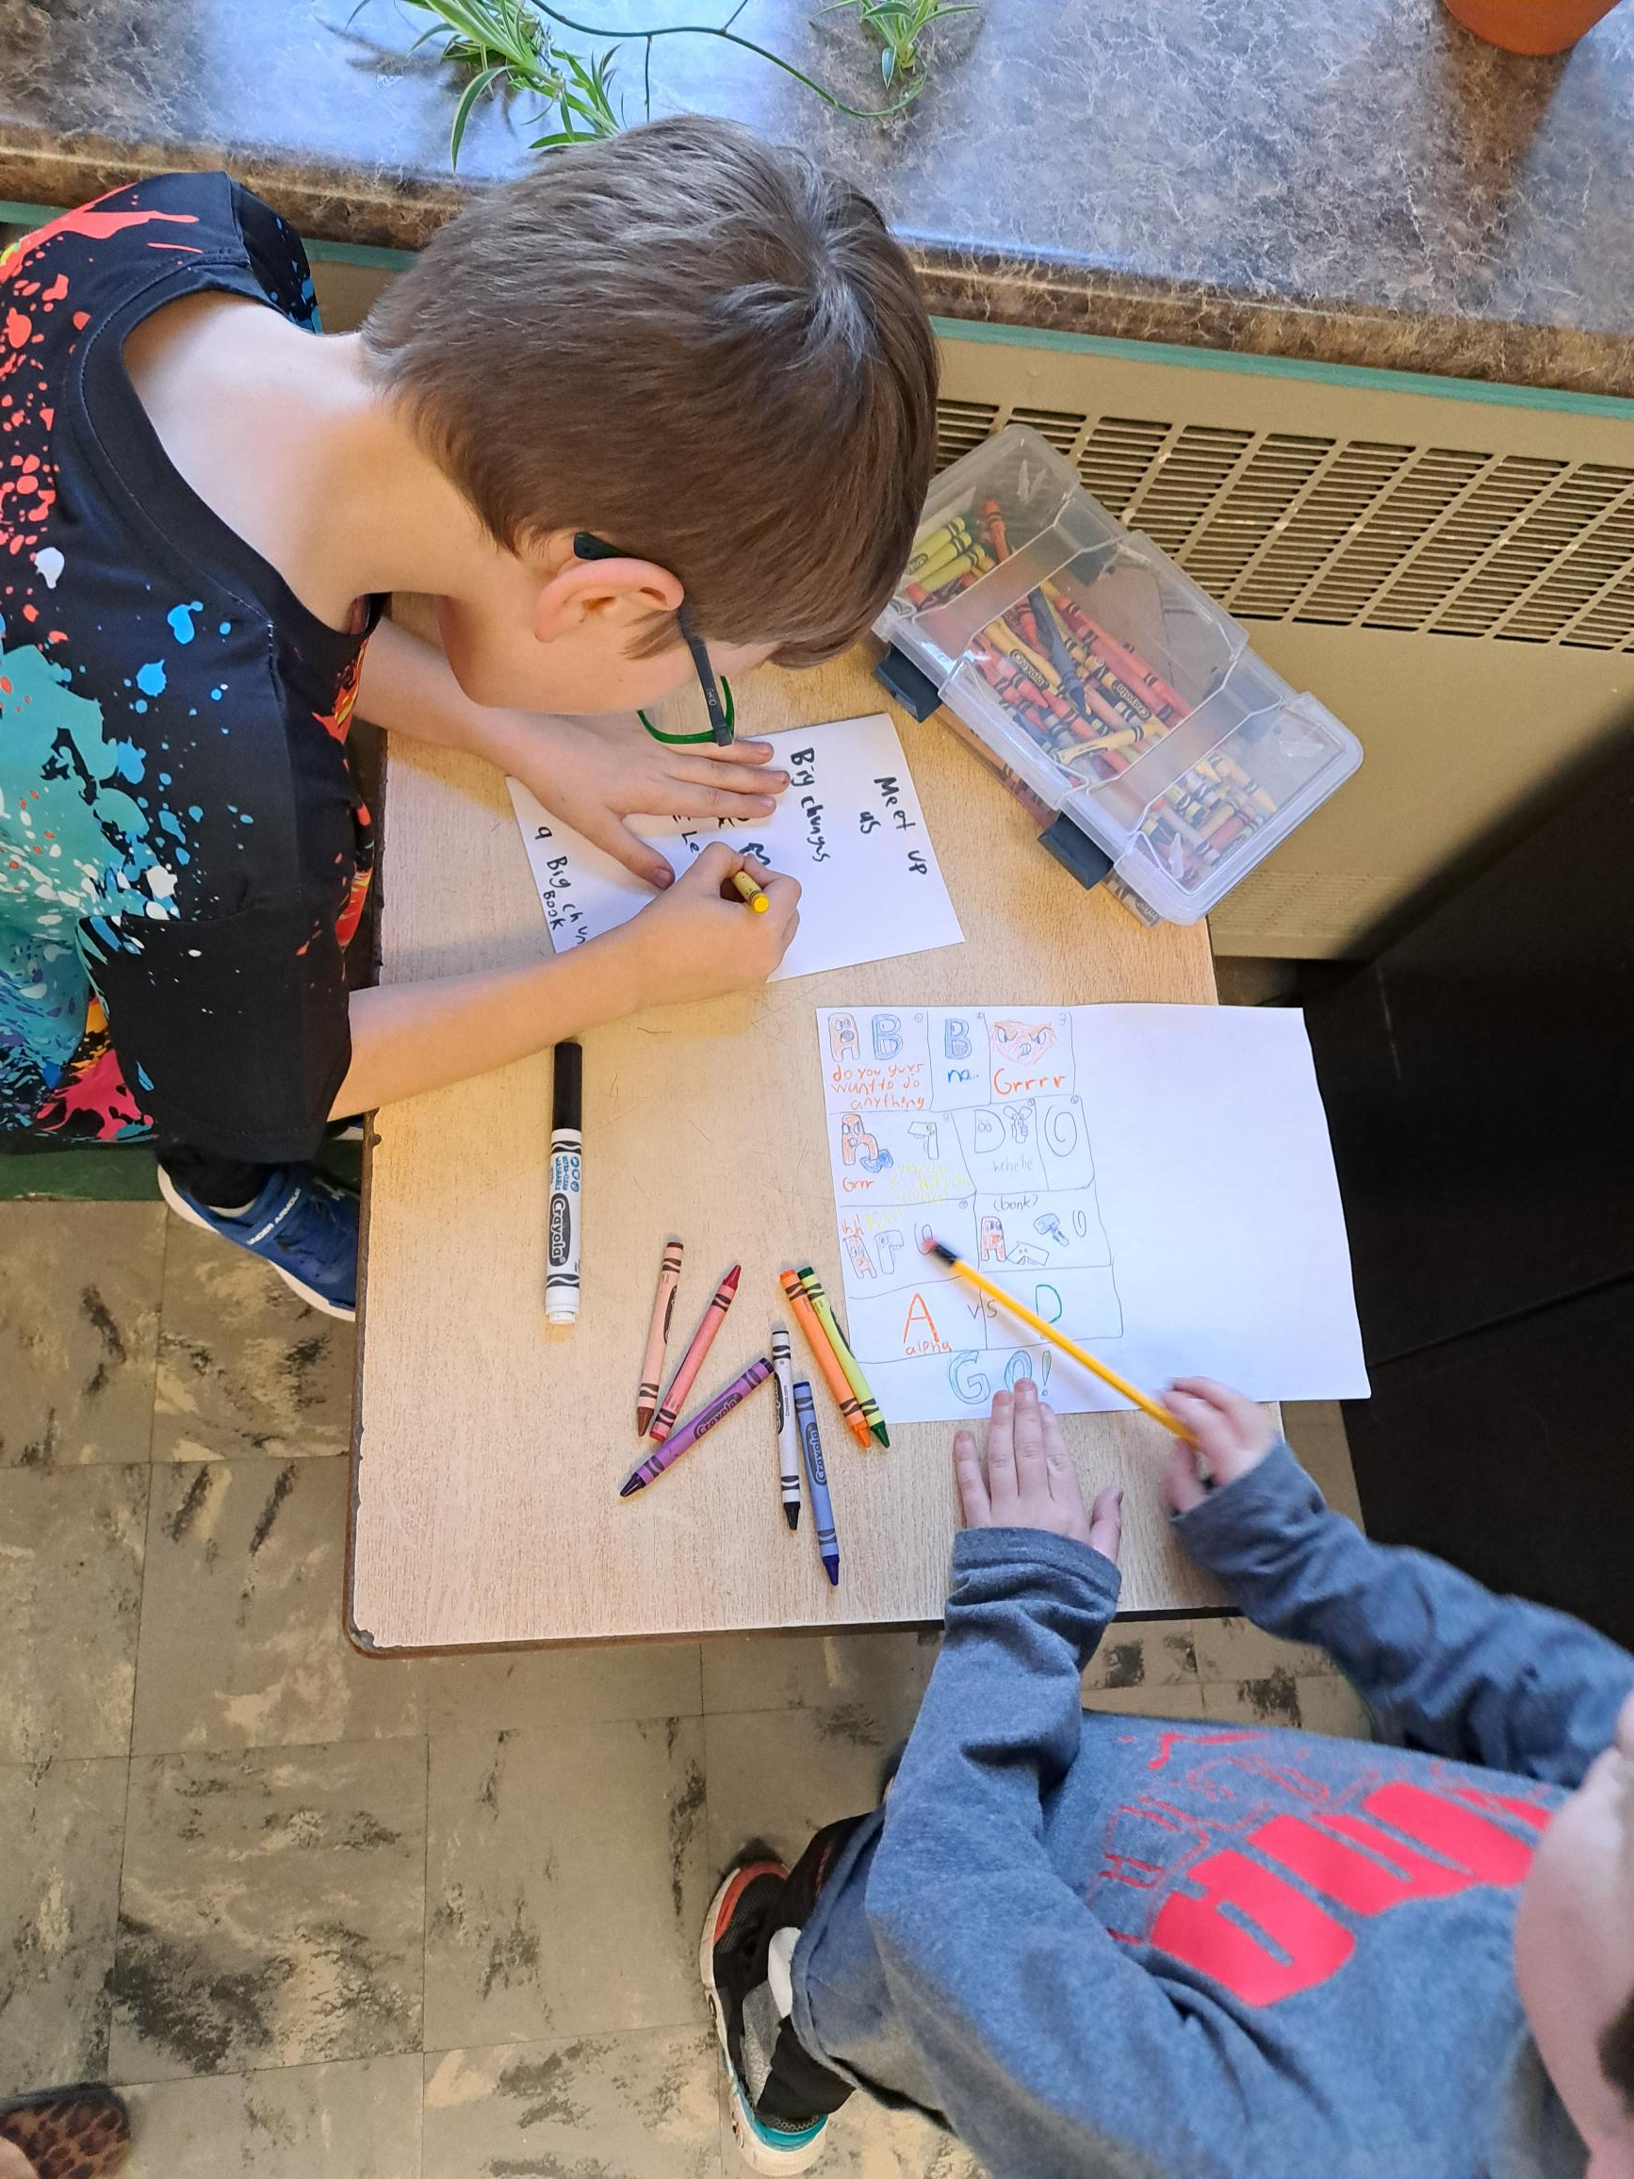
The art center should be a place where children have opportunities to independently participate, engage, and experiment using a wide range of textures of materials.
It is almost important that the materials in the art center are rotated on a regular basis to maintain engagement. The type of art guidelines is process art, not product art.

Slide 49
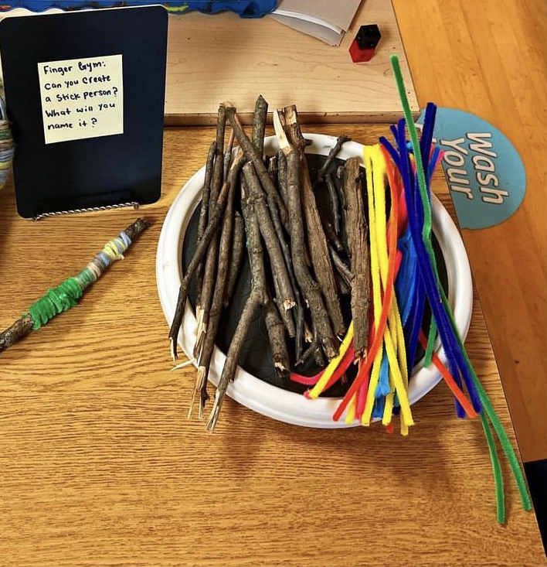
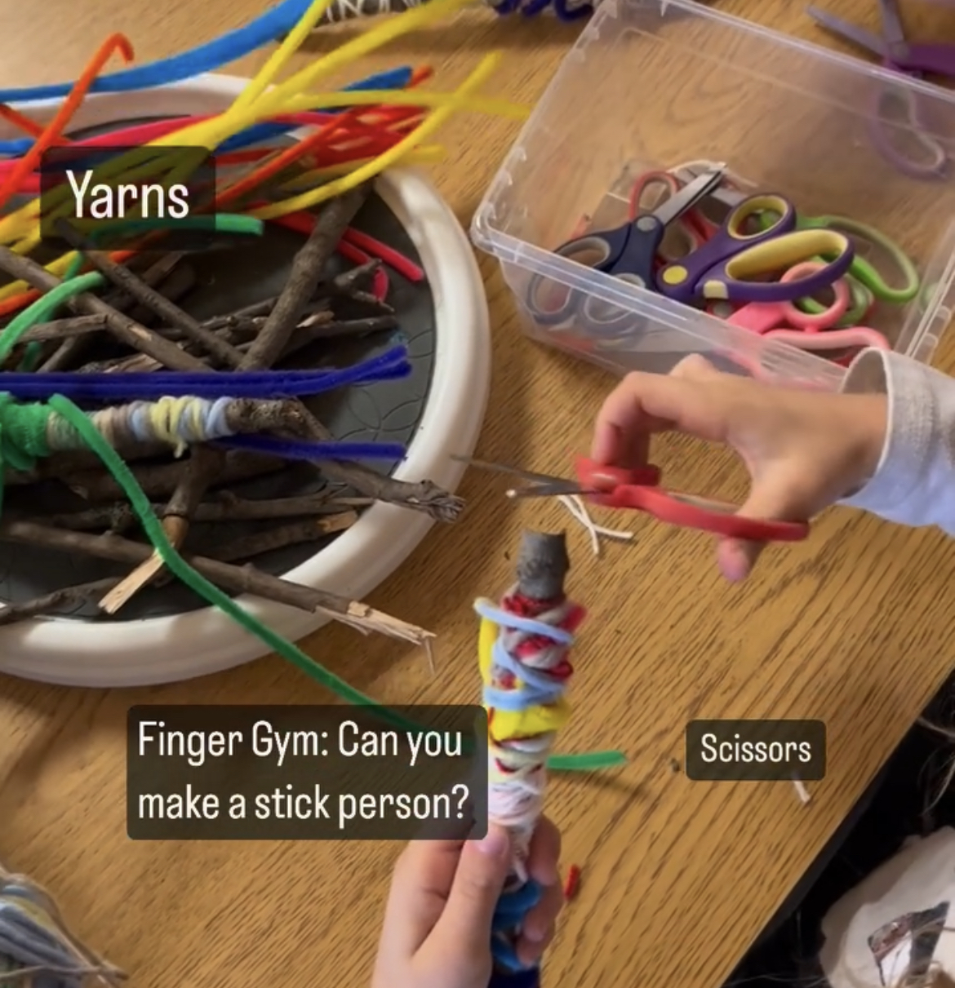

Slide 50
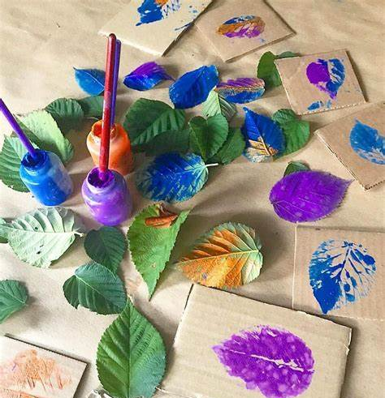
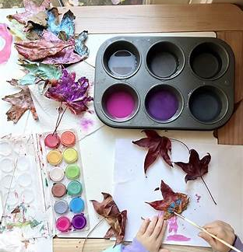

Slide 51
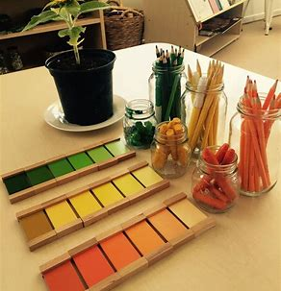
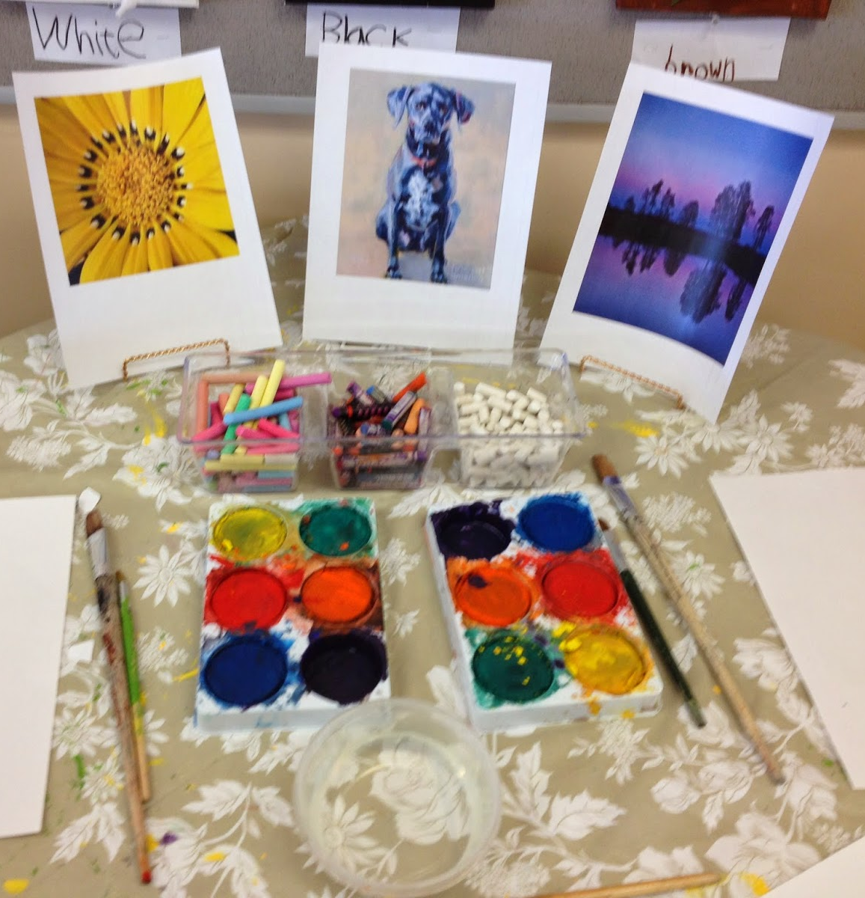

Slide 52
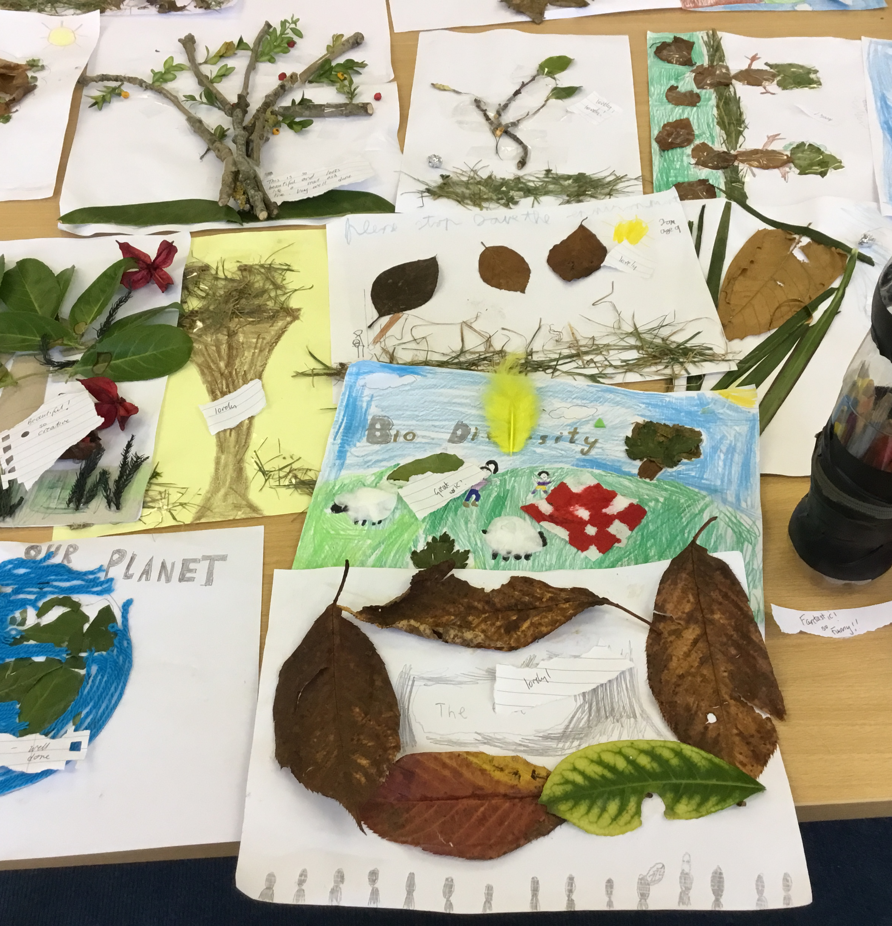
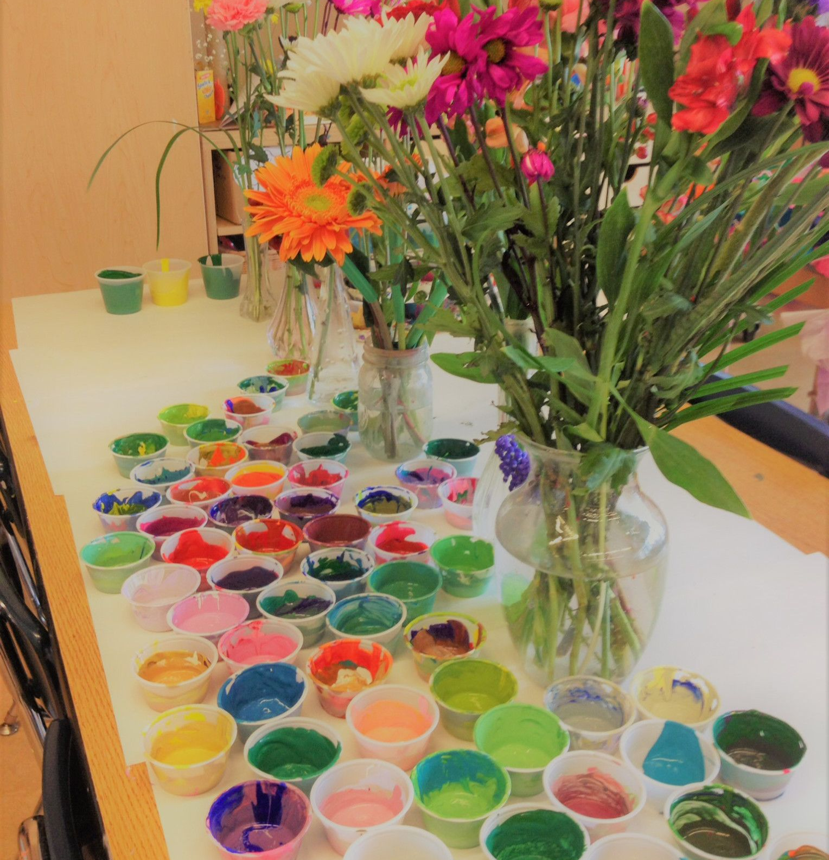

Slide 53
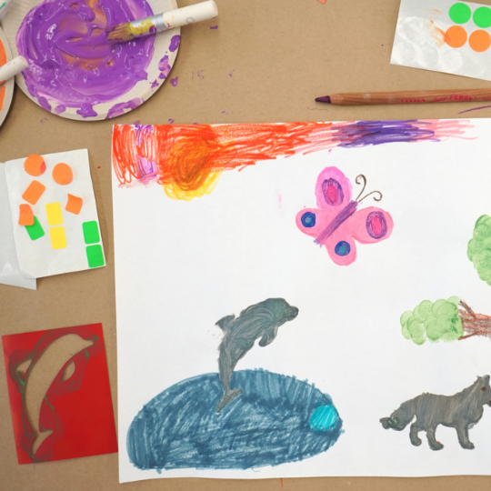
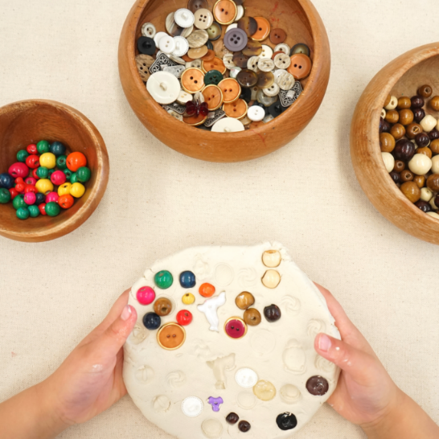
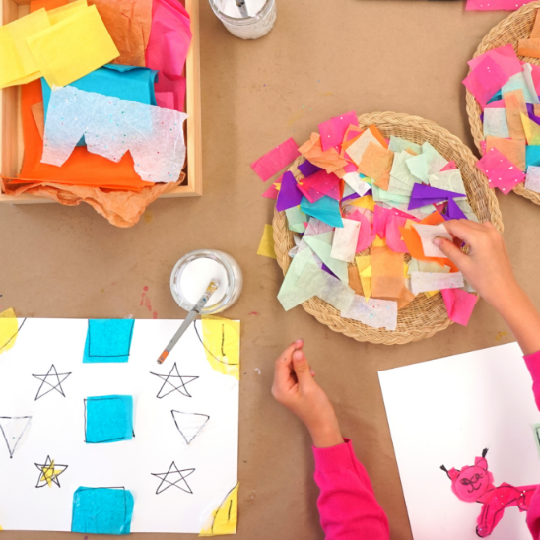
Heavy paper (base) + White glue and paint brush (connector) + Tissue paper (treasure), Marker (tool)
In this example, notice how two children used the same materials to create two entirely different outcomes. On the left, an organized design with symmetrical balance. On the right, a whimsical animal is taking shape.
Paper (base) + stencil (tool)+ office stickers (connector and treasure)+ markers (tool)+ paint brushes with paint (tool) colored pencils (tool)
*Although this is a semi-realistic illustration inspired by the stencil, the child was not guided to do anything specific, and this is the direction they chose to take this in.
Clay (base and connector) + Beads and Buttons (treasure and tool)
Notice how the beads double as a treasure and mark-making tool. The child decided to pull all the beads and buttons out when they were done, returning the clay to its original state. There was literally no product with this creation, as it all got returned to the art shelf when they were done.

Slide 54
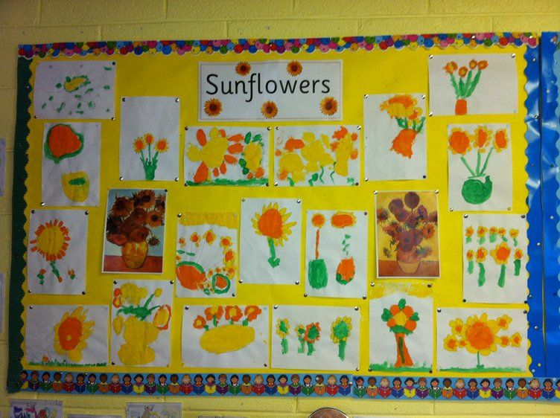
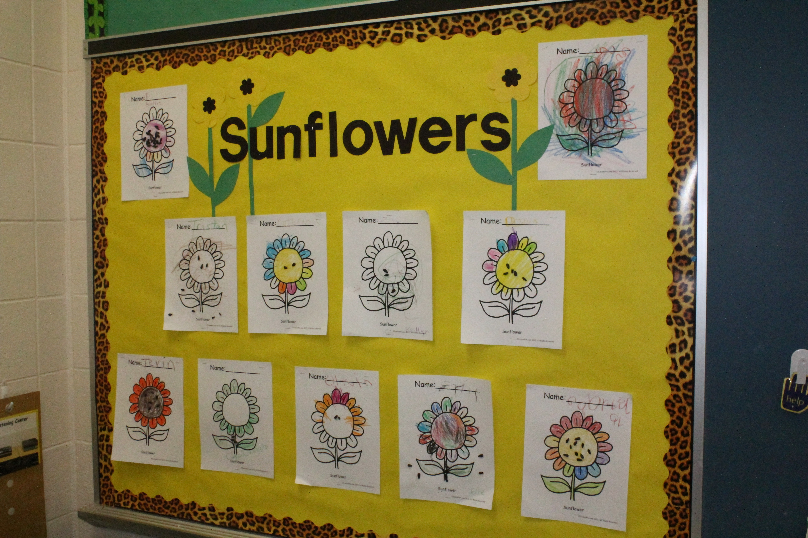

Slide 55
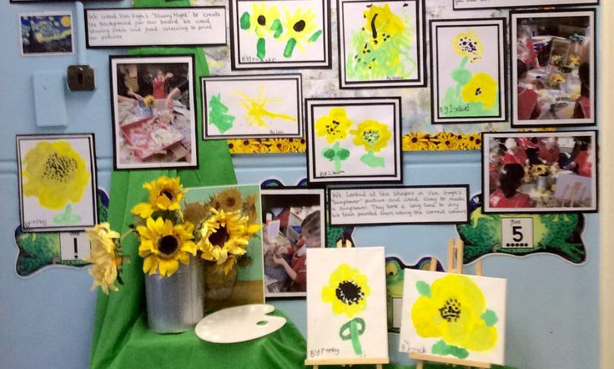
Document their learning
Take pictures
Write down observations and conversations
No two art looks the same!
Provocation was set up for open, creative exploration.

Slide 56

FINDING A HAPPY MIDDLE GROUND…
ADULT GIFTS…
HOLIDAYS ARE COMING UP…
Both Product and Process Art can be used to support children’s learning in different ways. They can also be combined to create a structured, yet open-ended art experience for children.
For example, if you are doing a clay activity with children, you could start off creating product-driven artwork to start such as a pinch pot or snail. This first part of the activity may allow children to learn new techniques, skills and vocabulary connected to the ‘medium’.
Give the children the materials and model how to work with clay, discuss things that we can make that “an adult” would enjoy.
Following this, you could allow children to freely explore and create new artworks with the clay without instructions.

Slide 57
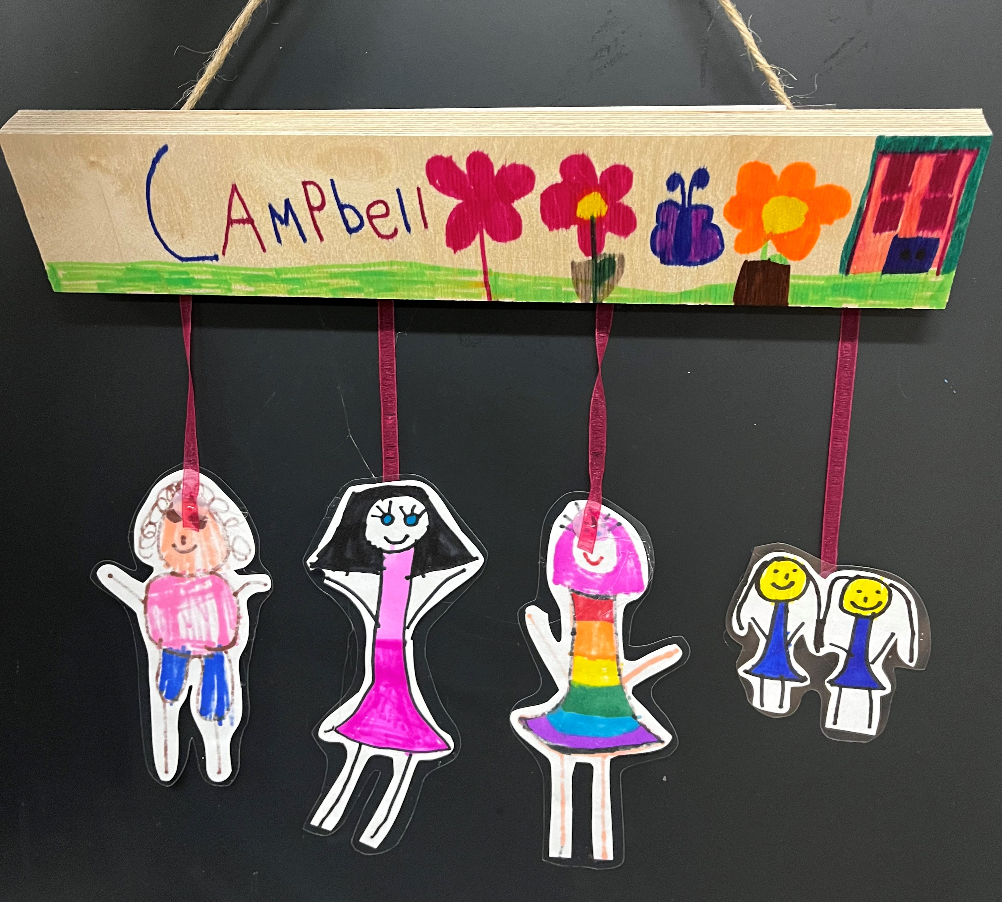

Slide 58
What made you think of creating your painting/art?
What does your art remind you of?
How did you decide to use those colours?
What else can you do to make _________work?
What can you tell me about your picture/art?
How were you feeling when you did this?
What do you like about your art?
What do you think we can do with _________ ? (any art supplies that are near the child)
Can you tell me how you made all those colours?
What can we do with this when we’re done making it?
What is your favourite part?
I see you…
I noticed you…
I wonder about…
What materials did you use?
OPEN-ENDED QUESTION TO ENCOURAGE
CREATIVE EXPRESSION.

Slide 59

LET’S BUILD CREATIVE THINKERS WITH PROCESSED ART!
Believe art should be very process oriented. It’s most important that we allow children to be creative and encourage creativity.
That means everyone might use materials differently, and every piece of art looks different. As with anything we do or offer to children, it should be developmentally appropriate.

Slide 60
According to Rhoda Kellogg, there are 80 Stages of Scribbling before they can WRITE
Here are what a few of the scribbles might look like!

Slide 61
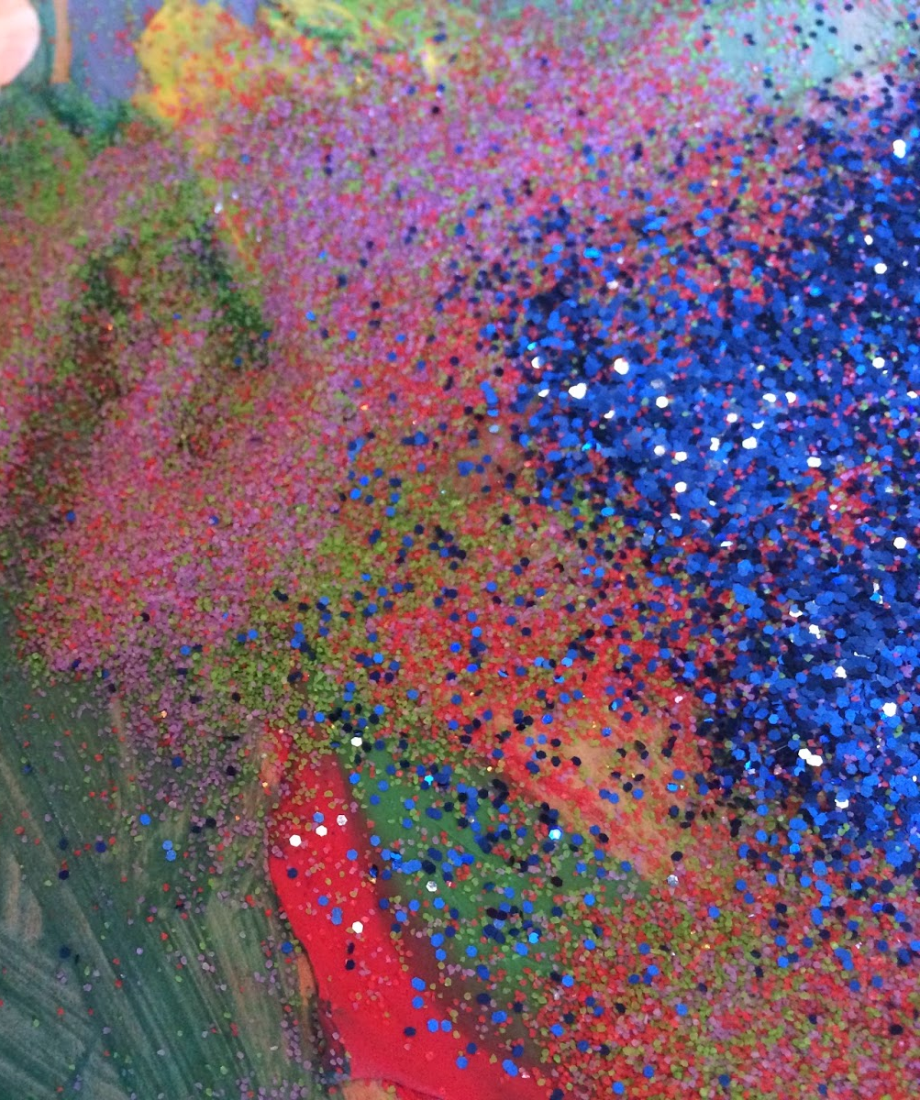
SO, WHAT DOES “PROCESS NOT PRODUCT” REALLY MEAN???
It means NOT having bulletin boards covered with 24 identical penguins and
you saying, “But I let them glue the eyes wherever they wanted.”
It means not “making” the kids do art
It means seeing the possibility of painting with things other than brushes
It means no more patterns and cut out art
It means you aren’t PHOTOCOPYING anything
It means it doesn’t have to look like anything. Ever. Even if it is “fish week”
it took you four days to plan and prep!
It means being aware of the stages of scribbling
It means not making models or examples for the children
It means not drawing for the child
It means refraining from over commenting
It means making peace with your possible addiction to cuteness
It means art materials are always freely available to children at all times

Slide 62
MENTIMETER
List some words that comes to mind when you think process art?

Slide 63

CONCLUSSION
Children are natural explorers who are forever curious about the world around them, and it’s this curiosity and thirst for knowledge that propels them to figure out how things work. When children are motivated to ask and answer their own questions rather than adult-driven questions, their newfound knowledge has a far better chance of sticking.
By giving children the freedom to explore and experiment with different art materials and techniques, we are fostering SO MUCH MORE LEARNING than limiting their creativity
We have children following our instructions ALL DAY, get your shoes on, get your jacket on, wash your hands, lets tidy up. They can follow instruction, so when it comes to process art, let them explore!
The next time you teach a lesson, set up a provocation, or present your classroom with art materials, ask yourself if more emphasis is placed on following directions or exploring materials and ideas. What will it be…the product or the process?

Slide 64
SURVEY

