Slide 1
OUTDOOR PEDAGOGY
Notes:
On behalf of Umbrella and the PE Team, we wanted to thank you all for participating in tonight's community of practice. We appreciate you taking the time after work from your busy schedules, some time away from your families, but your participation does no go unnoticed. We are all here for a common goal to explore the learning opportunities for our little kiddos in the program – So, again we thank you for joining us today.

Slide 2
OUR GOALS FOR TODAY:
What Is Outdoor Play?
The Benefits Of Outdoor Pedagogy
The Importance Of Physical Play
Role Of An Educator
Designing Your Outdoor Play Spaces
Risk Play
Nature Materials And Provocations
Sit Spots
What Can Parents Do?
Prize Draw

Slide 3
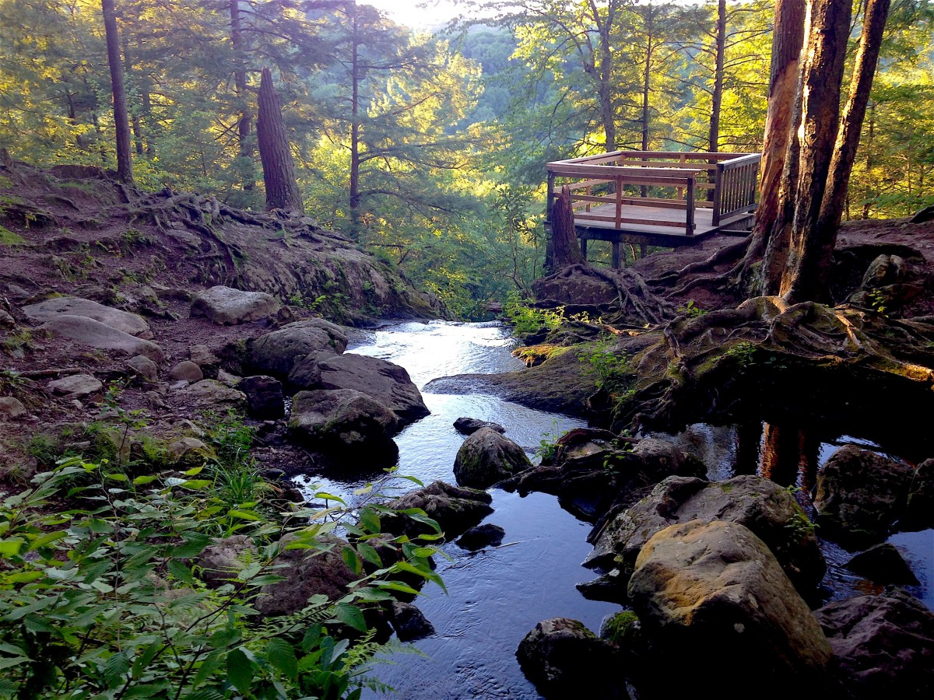
THINKING ABOUT YOUR OWN CHILDHOOD
Think about your favourite place to be as a child, where you most loved to play outdoors.
What was it about this place that you loved?
Notes:
What was it about this place that you loved?
Take yourself there for a few moments… notice everything you can about that place – its size, its shape, what the light was like, any special smells, any sounds that remind you of it, any special features of it that you treasure…
Very often, adults remember and draw inspiration from magical experiences in natural outdoor settings as their strongest, most powerful memories.
The outdoors was, for many of us, an invaluable place for learning.
It provided opportunities for us as children to explore, to discover and to develop an understanding of the nature around us.
Along with an instinctive drive to play,
Even as adults we know that Young children have particularly deep connections with nature and the outdoors. Think about the potential learning outcomes you as a kid were experiencing – Your problem solving, emotional regulation, sensory patterns and even the weather conditions.

Slide 4
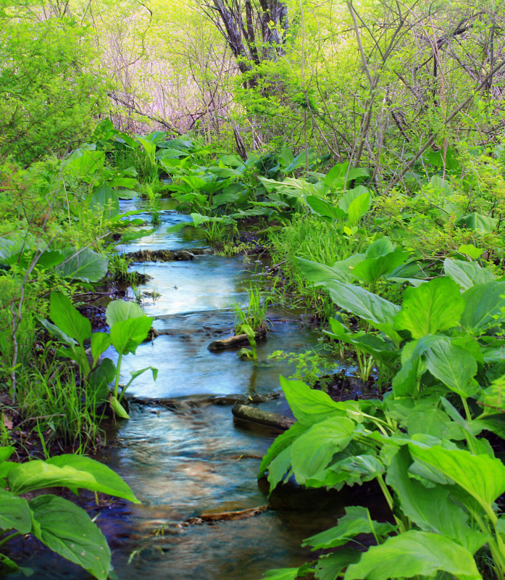
WHAT IS
OUTDOOR PEDAGOGY?
What is Outdoor Pedagogy?
The outdoors gives children unique opportunities:
Experience with all their senses
Observations
Art, science, mathematics, language
Developing social skills
Building and constructing with sand, water and mud
Notes:
Outdoor pedagogy can be simply defined as experiential learning in, for, or about the outdoors.
The term 'outdoor pedagogy', however, is used broadly to refer to a range of open-ended activities that take place in a variety of ways in outdoor environments.
The outdoors gives children unique opportunities for:
Experience with all their senses, the way they feel the grass, I’m sure we’ve all seen children take off their shoes at one point. When it snows, they open their mouths to try and catch a snowflake or two. Notice how children don’t care if there is sand all over them? In their hair? In between their toes in the summer? Those are all feelings that they need to experience.
Observations – Outdoor play allows children to experience their connection to the world differently then they would outdoors. They have more space to explore and observe the wonders of nature. The know water play outside is going to be a different experience than it would indoors. Children get the observe differently.
Art, science, mathematics, language – Art outdoors looks different than art inside. Manipulating playdough against nature and the textures, what patterns they made. The language children used outdoors, run, jump, sprint, the language to describe something that is happening “The clouds turned into like a cat”
Developing social skills - most of the time children stick to their groups inside based on the interest of the children. For example, children who love art would be in the same learning area as another friend who loves art. But more this outdoors, their interest changes, maybe some art by drawing a spider they saw, might ignite another children who just loves bugs. Where these two children indoors has two different interests.
Building and constructing with sand, water and mud – The opportunity to explore in a much grand scale with building with blocks might take up most of the playground and different areas of the playground, where inside some of the furniture might take away from the expansion of these ideas. Mud and water is in different areas of the playground then in a sensory bin that most of the time is individual.

Slide 5
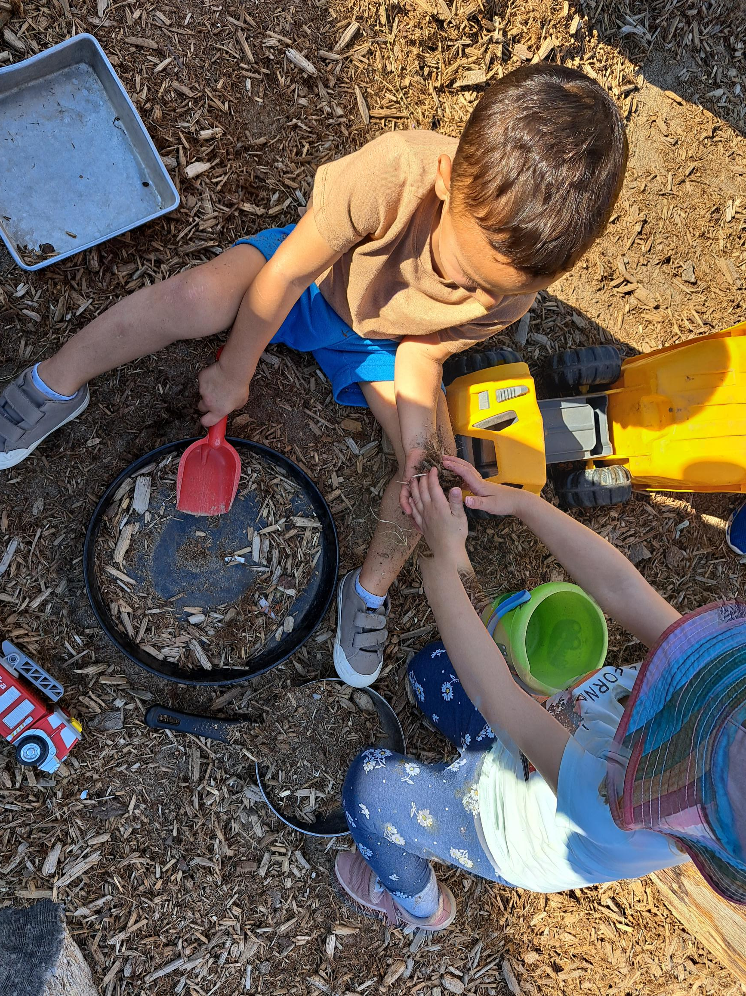
THE BENEFITS OF OUTDOOR PEDAGOGY
How Does Learning Happen?
Developing engaging outdoor environments can support children in creating meaningful play experiences.
Notes:
How Does Learning Happen? states that “children thrive in indoor and outdoor spaces that invite them to investigate, imagine, think, create, solve problems, and make meaning from their experiences – especially when the spaces contain interesting and complex open-ended materials that children can use in many ways” (pg. 20). - so, adding mud to any area of the playground is far more interesting than creating a small designated area on the tables in bins.
Developing engaging outdoor environments can support children in creating meaningful play experiences that are beneficial to their overall development. - When children are outside, children have the freedom to shout and make noise, the space to be more expansive in their physical movements, which sparks their imaginations, and more places to hide in and explore.
Children can also be messier outdoors, which encourages them to be more creative and to try things out and experiment.
Outdoor environments allow children to explore animals and insects and investigate what they do in their natural habitats.
Allows children the opportunity to explore plants and trees to see how they grow.
Outdoor play also promotes mathematical learning. Children can count rocks, sort leaves or identify numbers through a game of hopscotch.
Being creative and thinking outside of the box will help to create outdoor learning experiences all year long.
Consider the children’s interests in the indoor environment and transfer them outside to help make the learning experiences more enticing—even when the weather is not warm and sunny.

Slide 6
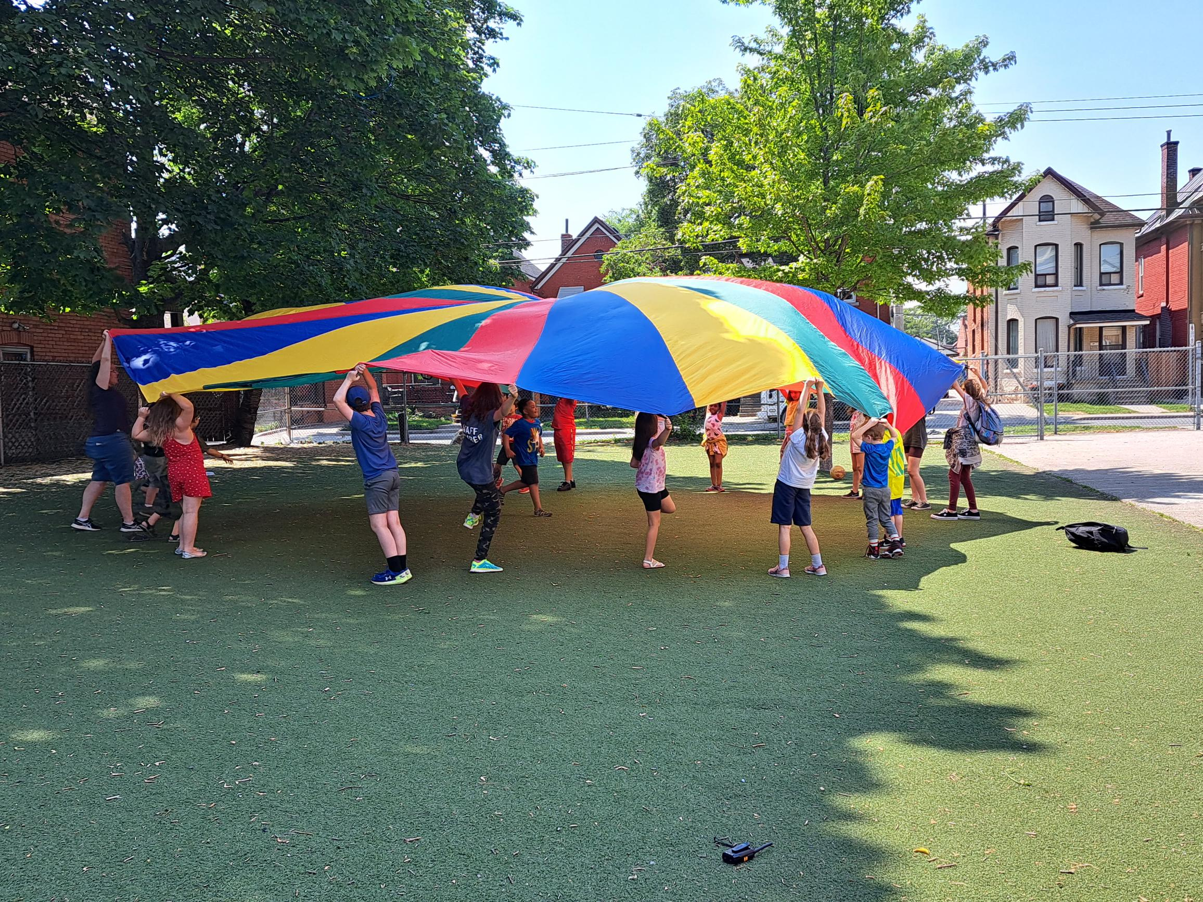
Physical Health:
Outdoor activities promote physical exercise, helping children develop gross motor skills and overall fitness.
Notes:
Outdoor activities promote physical exercise, helping children develop gross motor skills and overall fitness.
- Gross motor skills involve the coordination and control of large muscle groups, leading to activities that require whole-body movement.
Running and Racing
Jumping Games
Obstacle Courses
Nature Yoga - simple yoga poses into outdoor activities to improve flexibility, balance, and body awareness.
Nature Scavenger Hunt: - Create a scavenger hunt that involves walking, running, and searching for items, promoting exploration and movement.
Tree Climbing: Climbing trees enhances balance, coordination

Slide 7
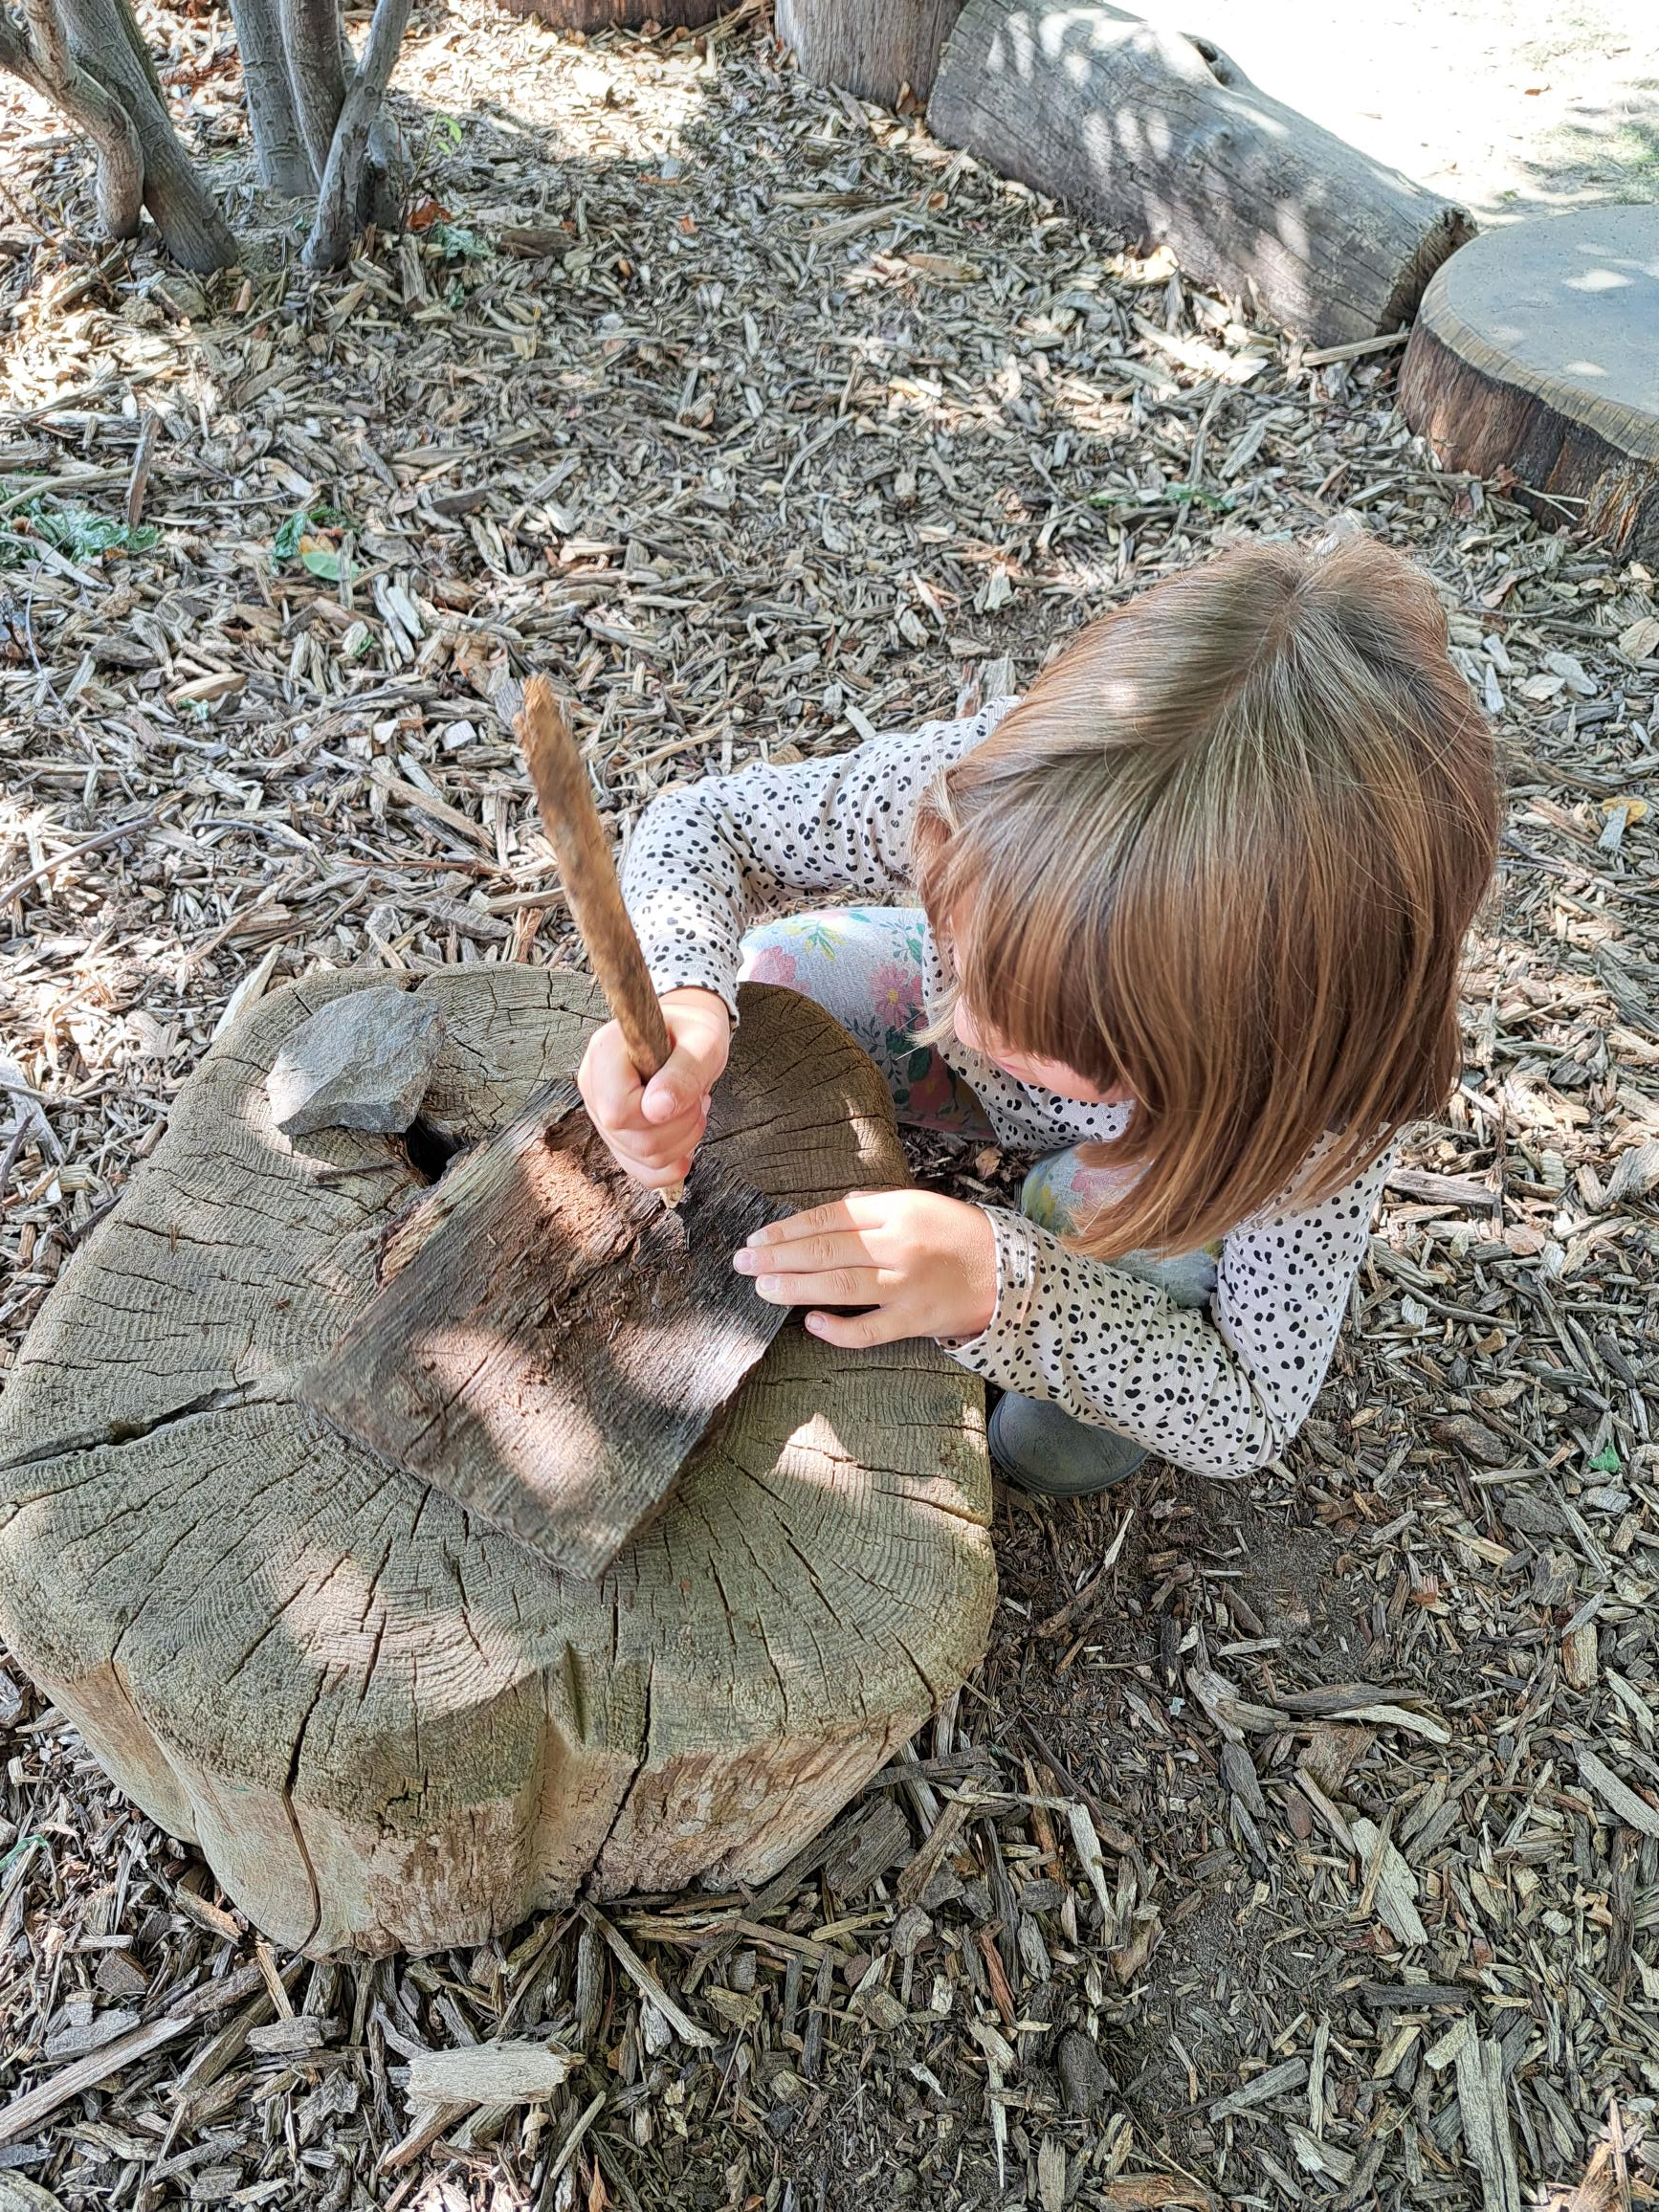
EMOTIONAL WELL-BEING:
Outdoor learning can reduce stress and anxiety levels in children.
Connection with nature promotes emotional resilience and mental well-being
Notes:
Spending time in nature has been shown to reduce stress levels. Natural environments offer a break from the constant demands and stimuli of modern life, allowing individuals to relax and unwind.
Improved Mood:
Nature exposure is associated with an improvement in mood and a reduction in feelings of anxiety and depression. The sights, sounds, and smells of natural settings can have a calming and uplifting effect.
Enhanced Creativity:
Time in nature has been linked to increased creativity and problem-solving skills. The relaxed state of mind achieved in natural surroundings can foster a more open and imaginative mindset.
Increased Attention and Focus:
Nature has a restorative effect on attention and cognitive function. Spending time in green spaces has been shown to improve concentration and reduce mental fatigue.
Mindfulness and Presence:
Nature encourages mindfulness, helping individuals become more present and engaged in the moment. Observing the natural world promotes a sense of awe and wonder, leading to a more mindful and appreciative mindset.

Slide 8
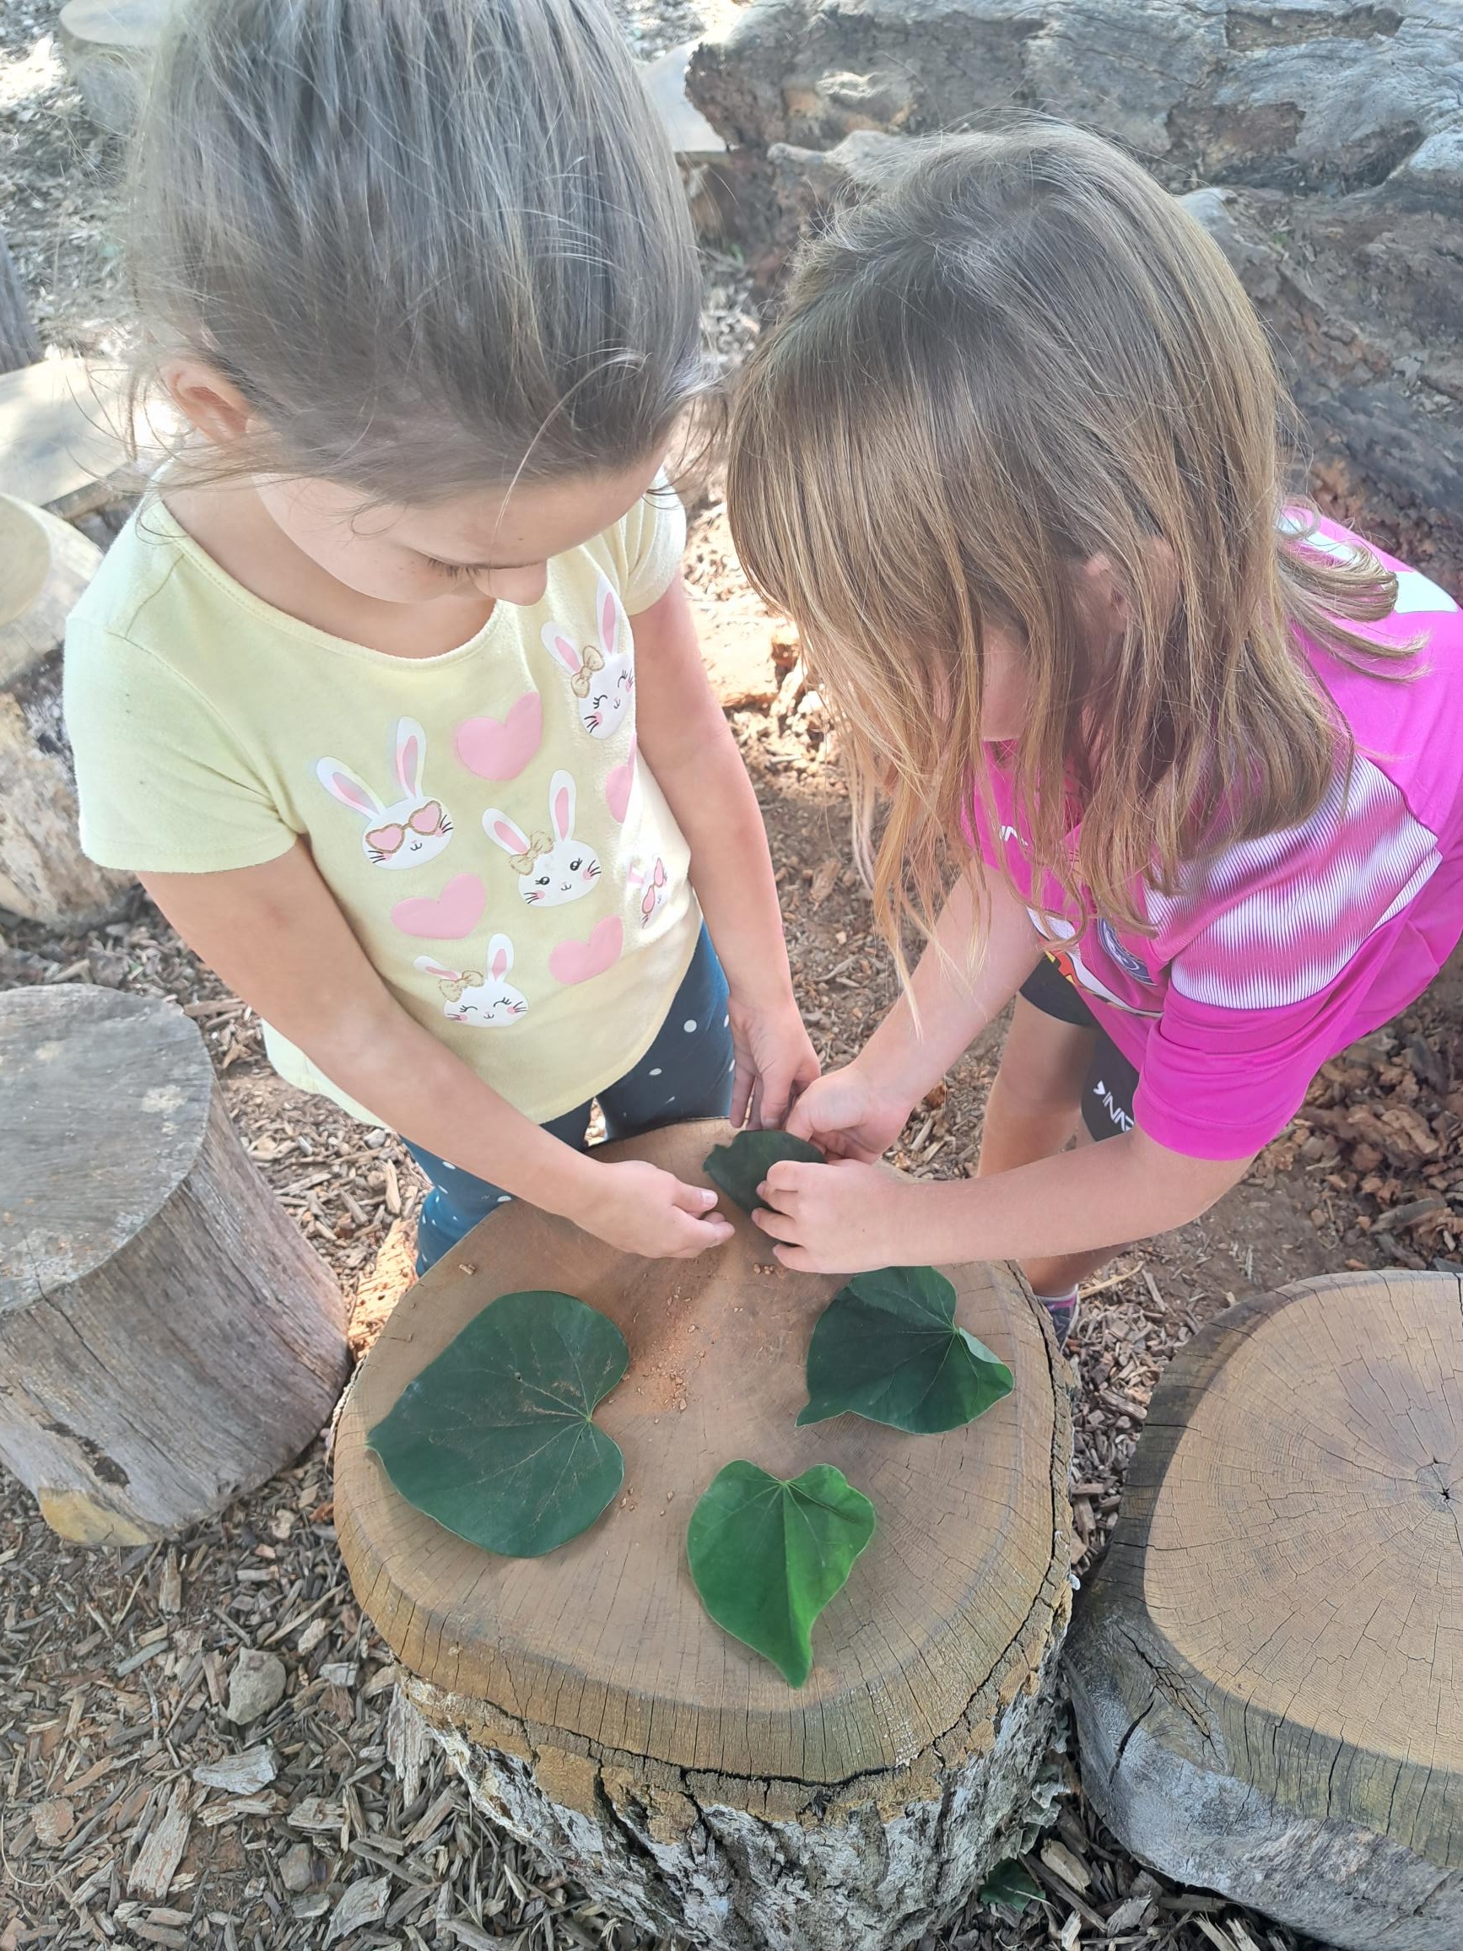
COGNITIVE
DEVELOPMENT:
Outdoor Environments
Problem Solving
Creativity and Imagination
Spatial Awareness
Observations Skills
Multisensory Stimulation
Notes:
Outdoor environments - activities stimulate various aspects of cognitive functioning, including problem-solving, creativity, memory, attention, and spatial awareness.
Problem-Solving:
Outdoor settings often present challenges that require problem-solving skills. Activities like navigating through an obstacle course, finding a hidden treasure during a scavenger hunt, or figuring out how to climb a tree can enhance problem-solving abilities.
Creativity and Imagination:
Outdoor environments stimulate creativity and imagination. Children, in particular, benefit from unstructured play in natural settings, allowing them to invent games, create stories, and explore their surroundings.
Spatial Awareness:
Outdoor activities often involve navigating spaces, estimating distances, and understanding spatial relationships. This helps in the development of spatial awareness and visual-motor skills.
Observation Skills:
Nature walks, bird watching, and other outdoor activities encourage keen observation skills. Children learn to notice details in their environment, enhancing their ability to focus and pay attention.
Multisensory Stimulation:
Outdoor environments engage multiple senses simultaneously. This multisensory stimulation enhances cognitive development by providing a diverse range of sensory inputs.

Slide 9
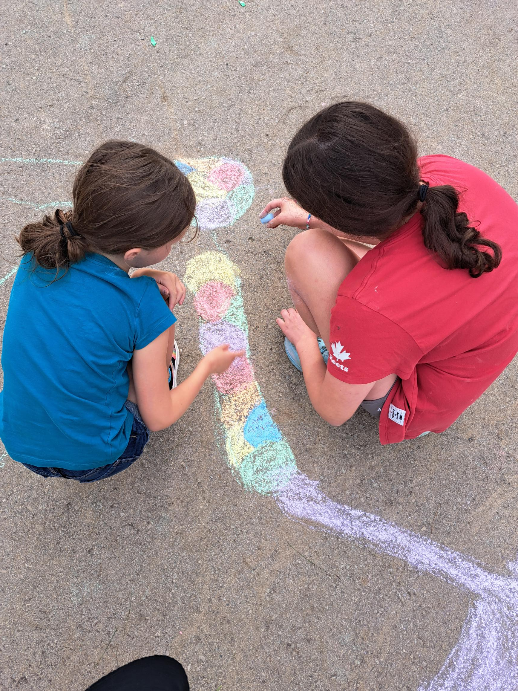
SOCIAL SKILLS:
Teamwork and Cooperation
Communication Skills
Conflict Resolution
Building friendships
Notes:
Teamwork and Cooperation:
Outdoor activities often involve teamwork and cooperation, like playing on team sports. These experiences help children learn to collaborate and communicate effectively with others.
Communication Skills:
Outdoor settings provide a relaxed and open atmosphere, making it easier for children to engage in conversations. Either small talk with other children or working together for a common purpose.
Conflict Resolution:
Interactions in outdoor environments may present challenges or conflicts, providing opportunities for individuals to develop conflict resolution skills. Learning to navigate disagreements and find solutions is an important aspect of social development.
Building Friendships:
Outdoor activities often facilitate the formation of friendships. Shared experiences in nature create strong bonds, and the informal setting can make it easier for children to connect.

Slide 10
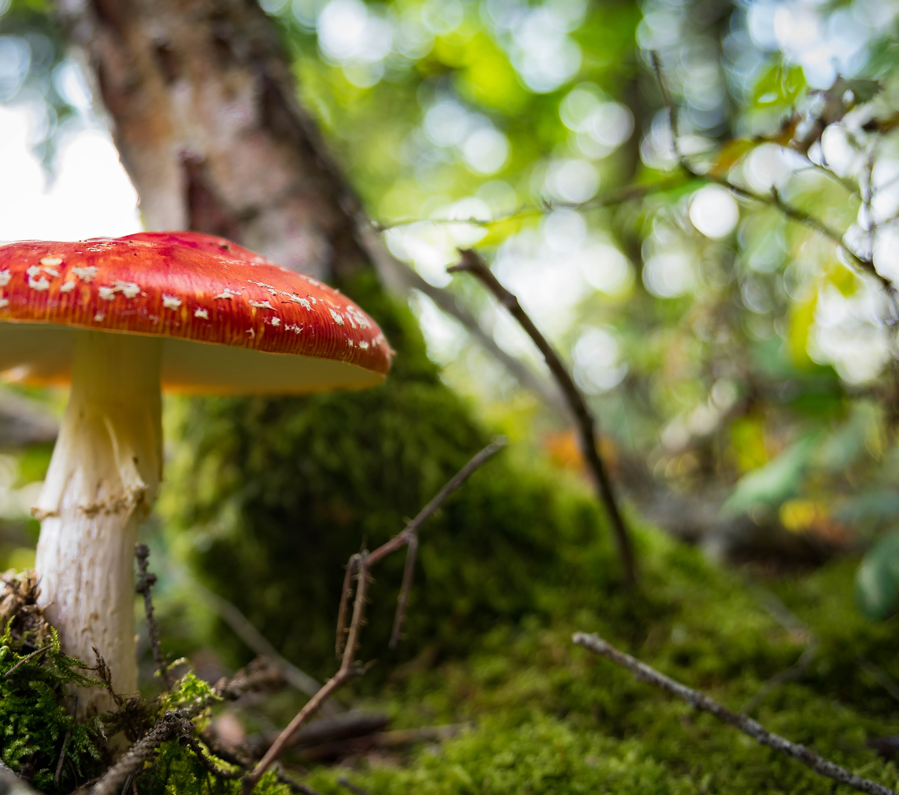
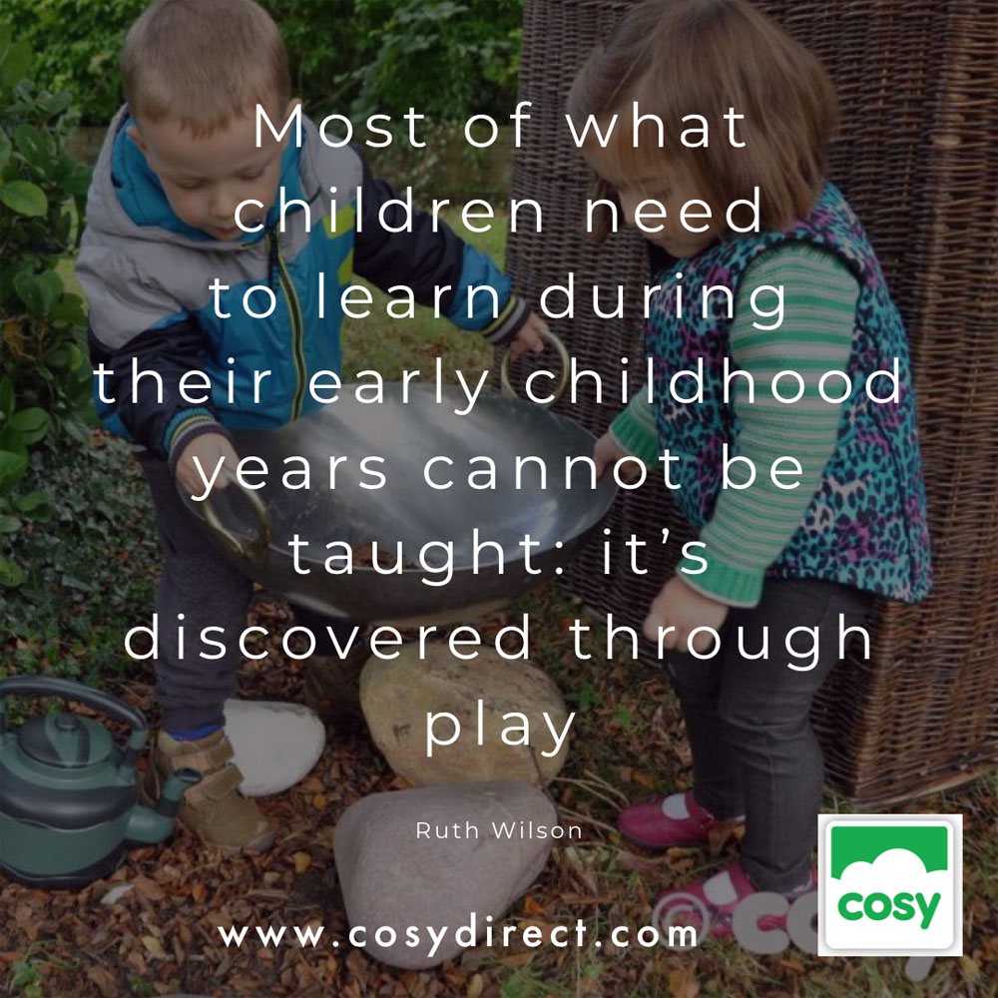

Slide 11

WHAT ACTIVITIES OR FEATURES DO YOU ENJOY MOST IN YOUR OUTDOOR SPACE?
https://www.menti.com/almq1hdx5dxk

Slide 12
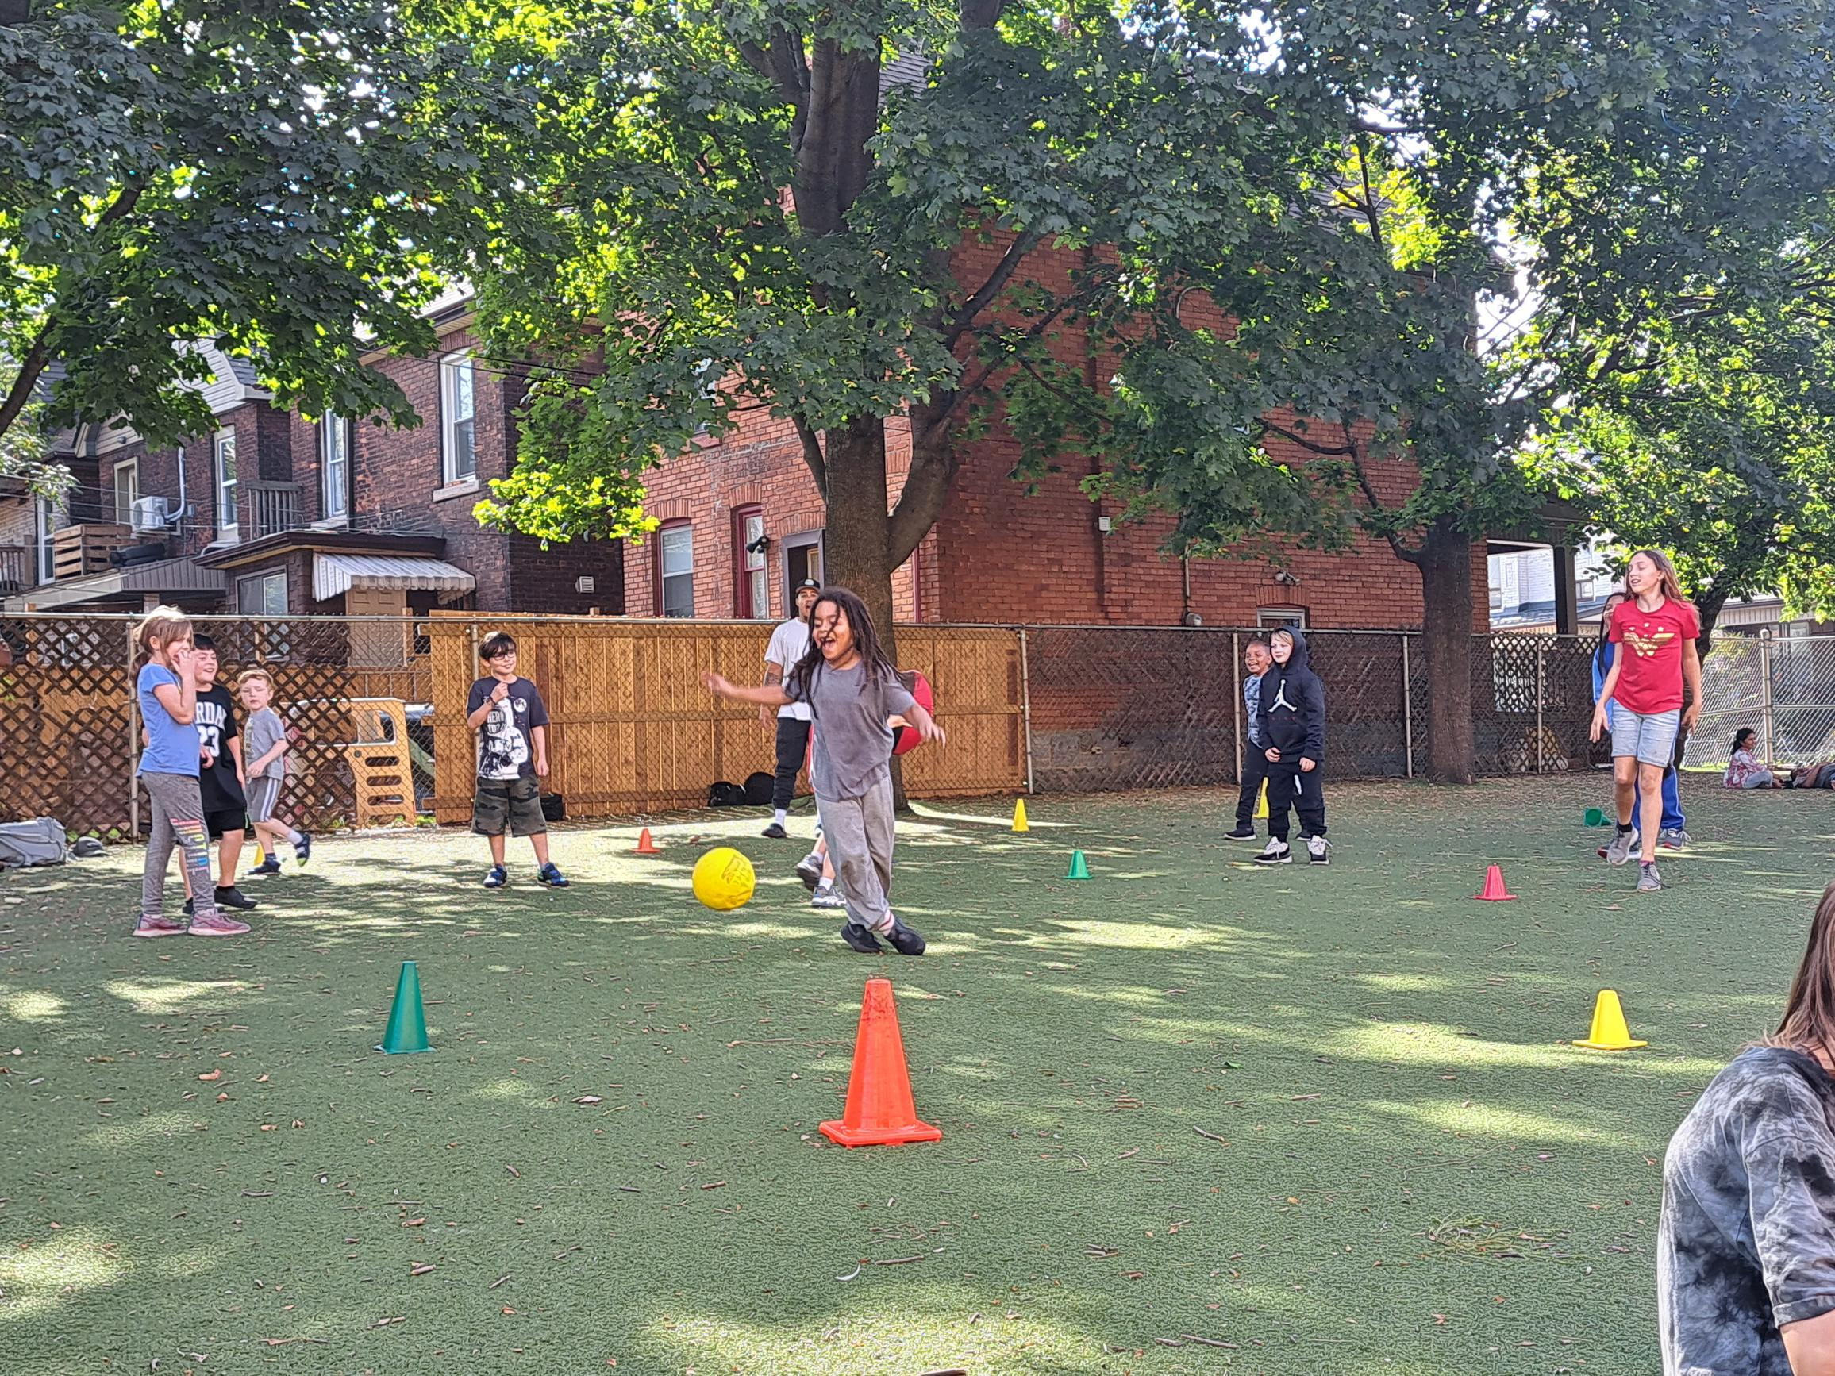
THE IMPORTANCE OF PHYSICIAL PLAY
Difference between outdoor play and physical play
How Does Learning Happen?
Time and tools to be physically active
Educators as co-learners
Notes:
The terms outdoor play and physical play are often interchanged, however, there is a difference between these two types of play. Outdoor play involves playing with materials or engaging in play while outdoors. It can be any type of play: sedentary, imaginative, social, cognitive, etc.
Physical play relates directly to the act of being physical. Being physical involves children learning how to use their large muscle groups to explore the different ways their bodies work.
As highlighted in How Does Learning Happen?, "through active play and physical exploration, children gain increasing levels of independence, learn to persevere and practice self-control, and develop a sense of physical, emotional, and intellectual mastery and competence."
Time and tools to be physically active
- As educators, we must be offering children the time and tools to be physically active. Children are more likely to engage in physical play when they have access to developmentally appropriate physical play equipment.
Co-Learners - when educators engage in physical play as co-learners, they are modeling positive ways to keep our bodies healthy for children.

Slide 13
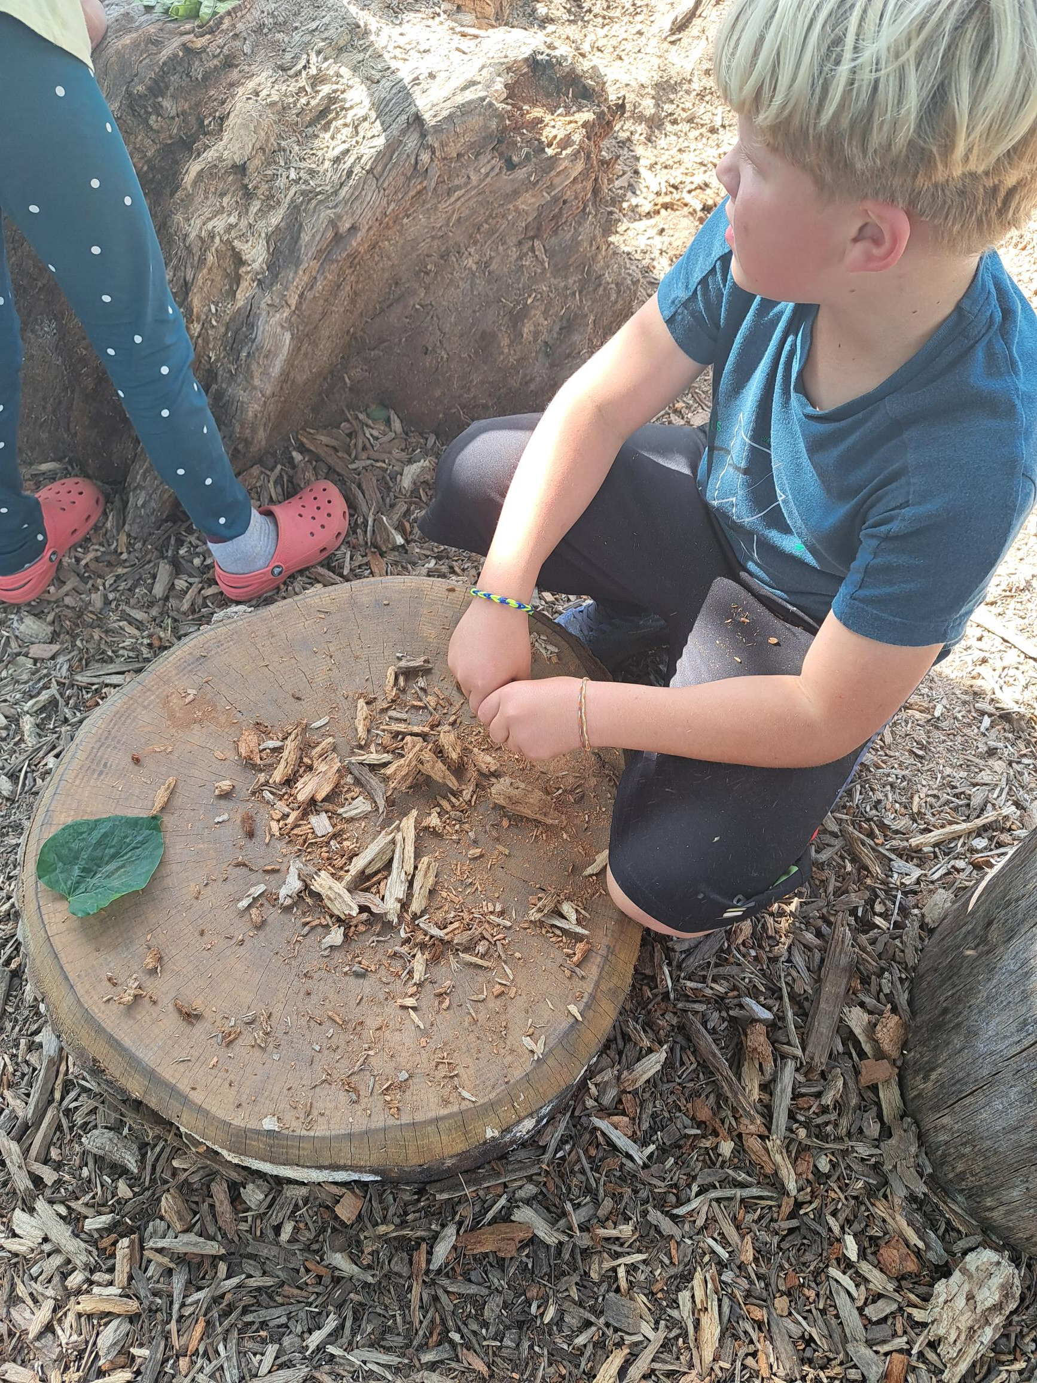
EXPLORING THE EFFECTIVENESS OF OUTDOOR LEARNING
Opportunities for play-based learning experiences
Children’s cognitive and physical development
Natural outdoor environments
Notes:
Opportunities for play-based learning experiences
- Outdoor environments provide opportunities for play-based learning experiences across all areas of learning and development – through nature exploration, imaginative play, sensory learning, social skills, math and science exploration, problem solving challenges, risk play, environmental awareness..
The effectiveness of Children’s cognitive and physical development
Outdoor learning environments have the potential for promoting children’s cognitive and physical development, communication, social development., gross motor skills, fine motor, balance coordination, sensory stimulation and emotional well-being
And the effectiveness of natural outdoor spaces allow children to make sense of their immediate and wider worlds through open-ended interactions, exploration, discovery, and close connection with nature. Children become curious, sensory stimulation with nature, hearing the birds, watching the clouds go by, give children some independence and self regulation to make choices, regulate their behaviour in an unstructured environment.

Slide 14
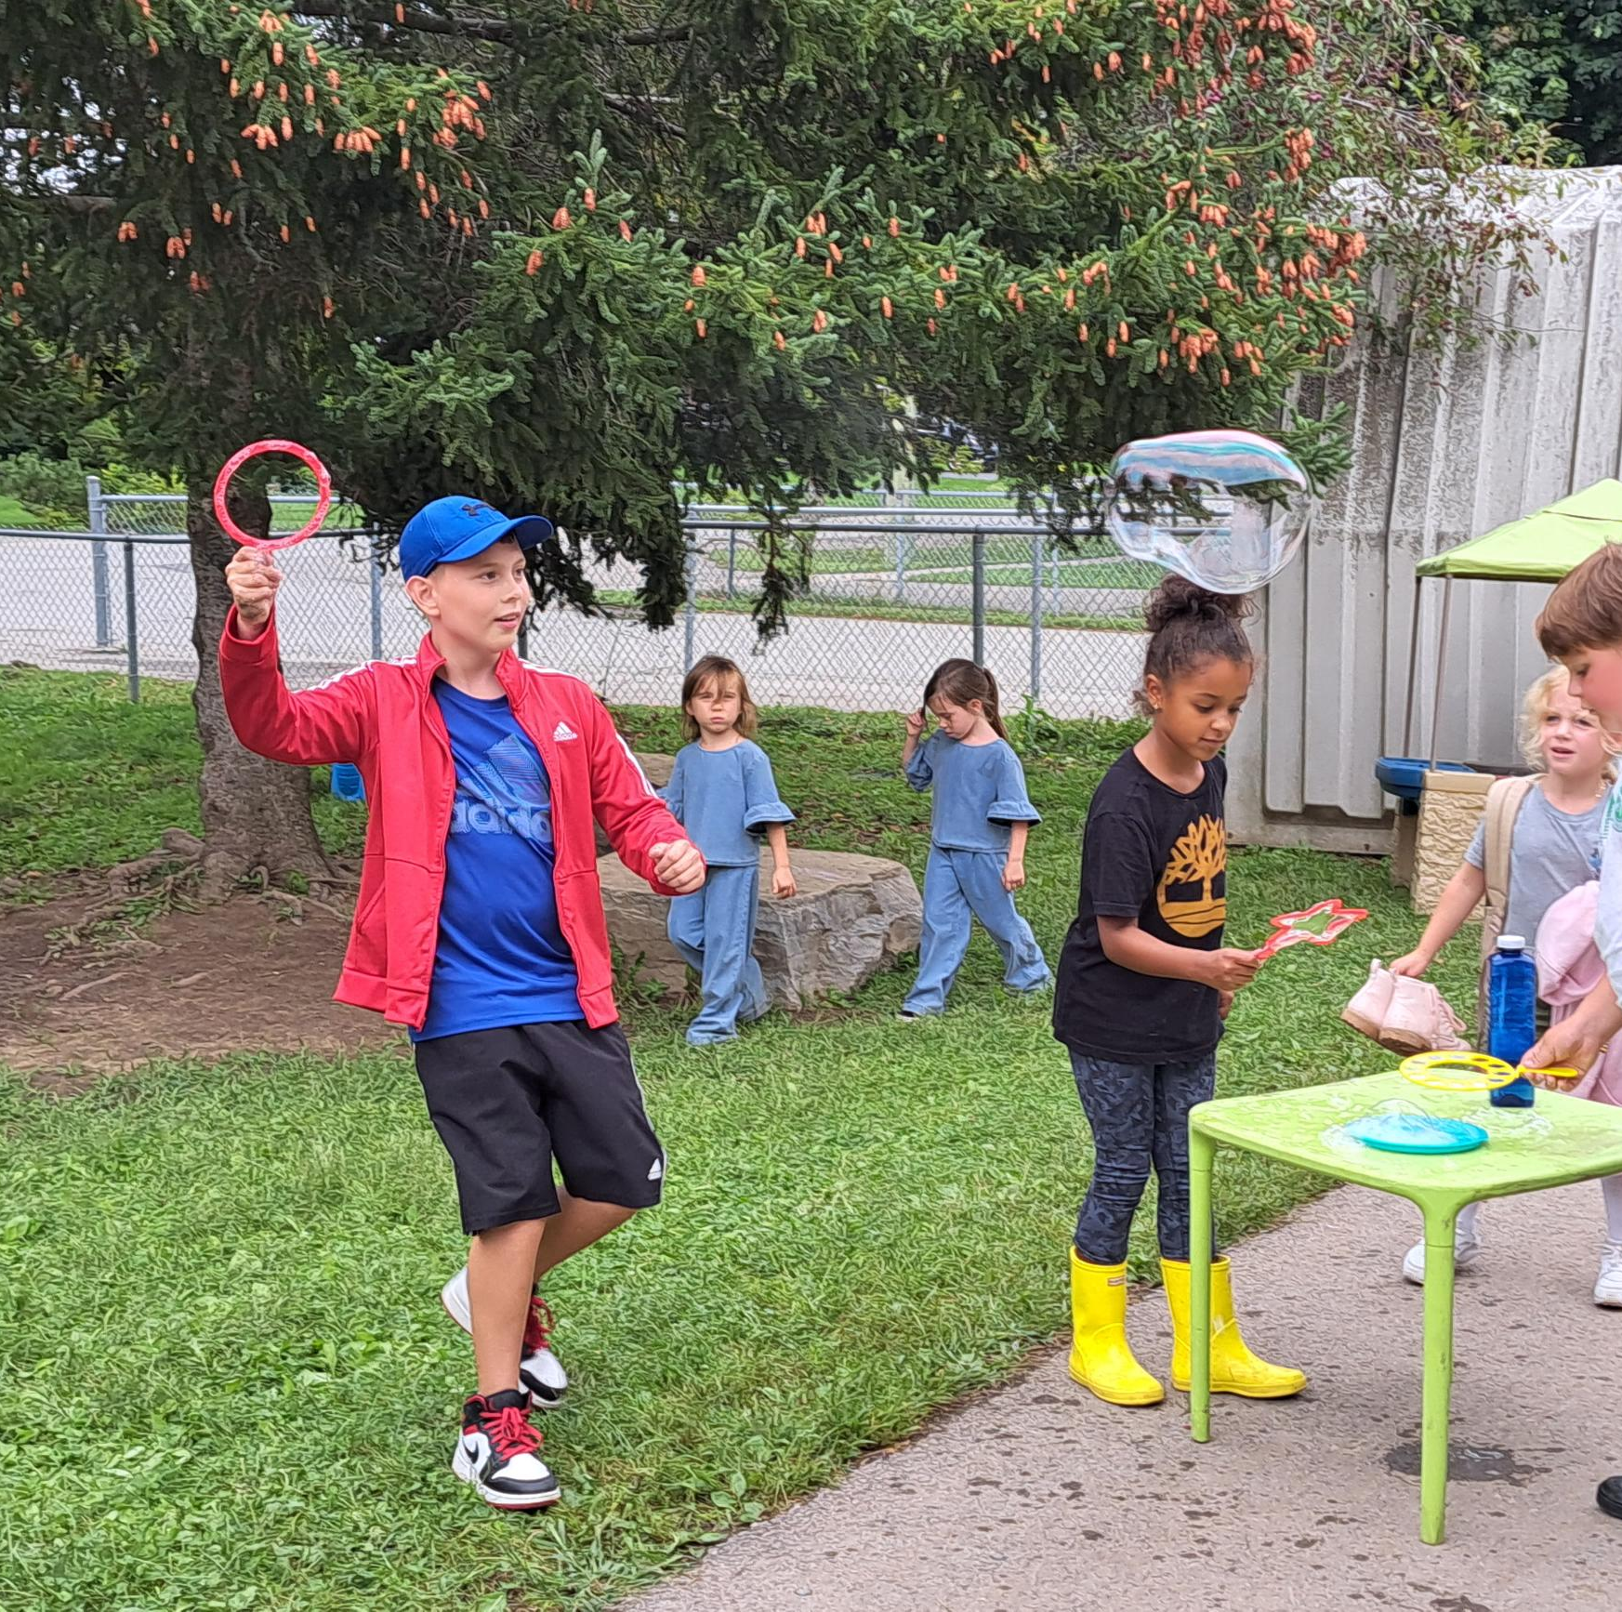
MOVEMENT PLAY
More space and freedom for large movement play.
Physical development
Unstructured play as well as adult-led activities.
Modelling
Notes:
When we explore the effectiveness of outdoor learning, we explore the opportunities for movement play and what it provides …….
More space and freedom for large movement play.
Perhaps one of the first learning opportunities that comes to mind when considering the outdoors is its potential for physically active play and motor development. Depending on the location and design of the outdoor environment, children potentially have more space and freedom for large movement play.
Physical development
Movement play supports children’s physical development – their alertness, stamina, co-ordination, strength and balance – all of which help them to gain control of their bodies and master fundamental movement skills.
Unstructured play as well as adult-led activities.
- Educator’s provide opportunities for both unstructured play as well as adult-led activities. Educator involvement in planning structured activities, modelling and providing feedback to children about their physical development is important for children’s development of fundamental movement skills.
Modelling
How many times as educators have, we have used a hula hoop to show children and encourage children to see how they can hula? Or using the hula hoops as a structured game. Modeling these provide children with the necessitates to mimic the play with their peers.

Slide 15
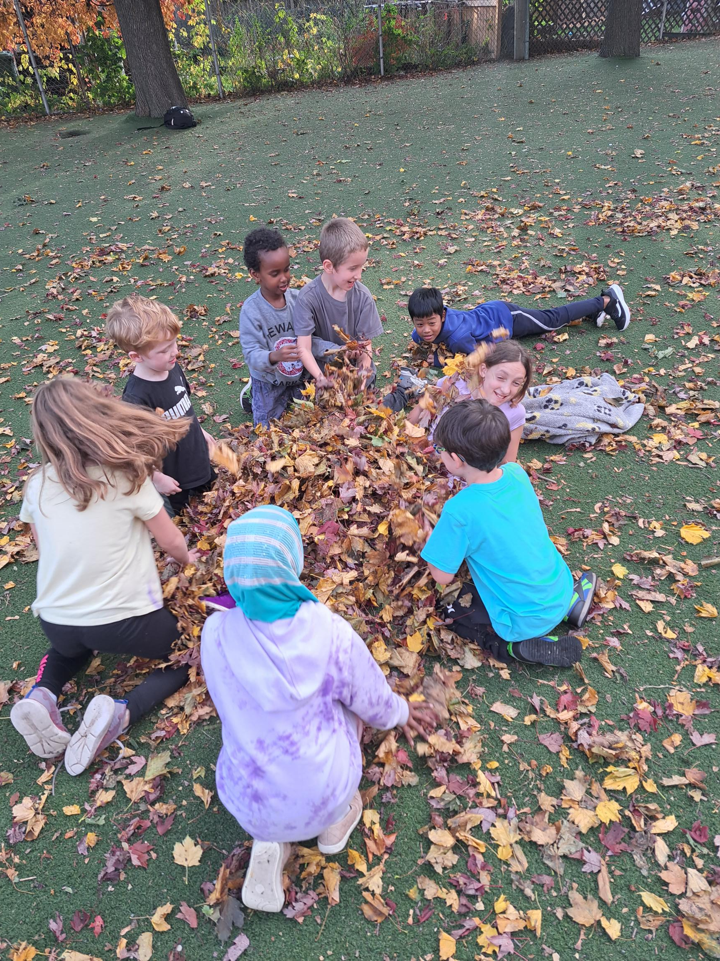
Children are 10 times more active when they are outdoors rather than indoors in child care settings.
Tucker and Vanderloo, 2019

Slide 16
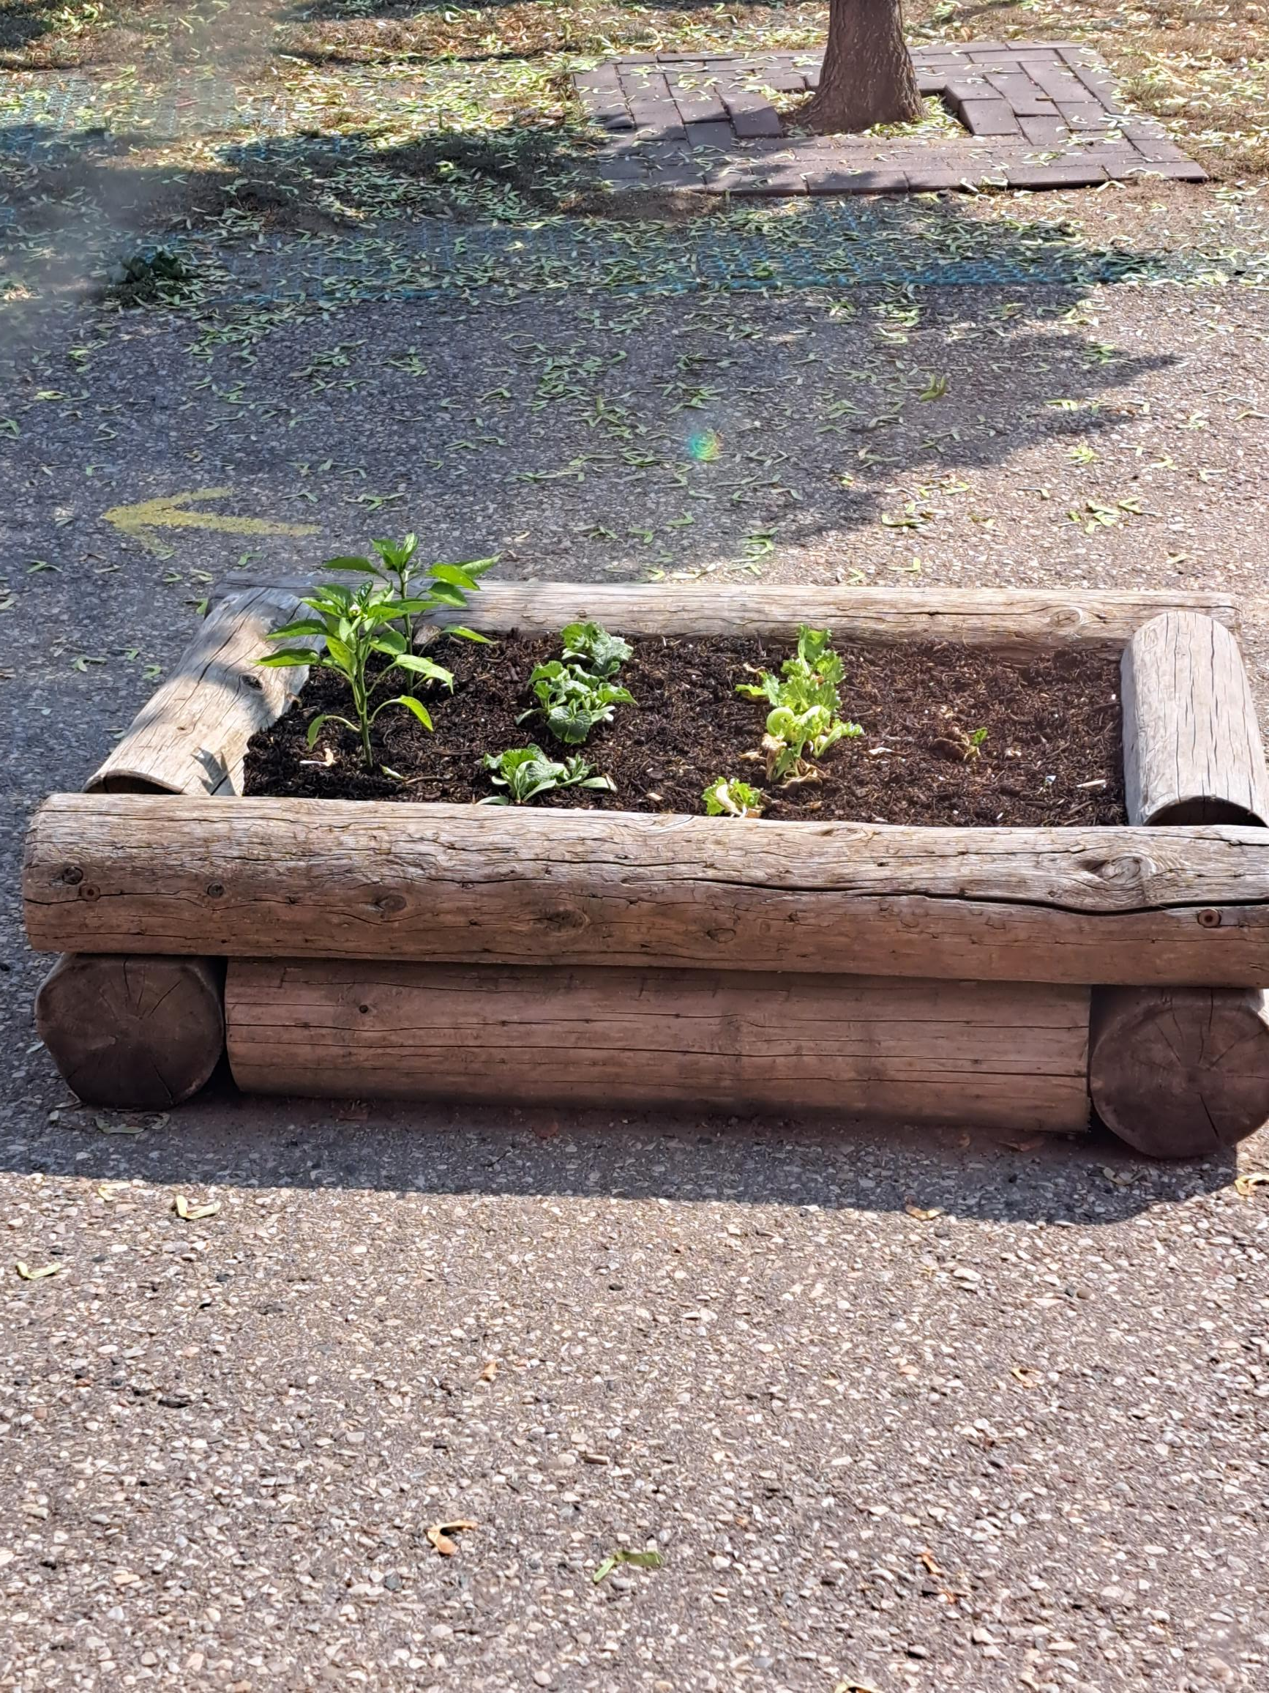
ENVIRONMENTAL AWARENESS
Natural elements
Fosters a sense of environmental stewardship and respect for nature.
Children’s hands-on activities in the outdoors
Children can have a visible impact on the environment.
Notes:
Outdoor environments that include natural elements, provide endless opportunities to learn about the world and the interaction between humans, the non-human world.
Fosters a sense of environmental stewardship and respect for nature.
- Outdoor learning fosters a sense of environmental stewardship and respect for nature – children learn ripping off the leaves of the trees or killing bugs is much more than educators telling children not to do that.
Children’s hands-on activities in the outdoors throughout the year provides opportunities for them to explore and learn about nature through their observations and asking questions.
impact on the environment. - Cooperative, imaginative free play in nature environments where children have freedom of choice, access to a variety of objects for discovery, and loose parts that they can use creatively, supports their awareness that they can have a visible impact on the environment.

Slide 17
"Given the degree of research indicating how critical children's interactions with the natural world are, it is the responsibility of early childhood educators to step in and advocate for children's rights to experience organic play spaces."
(Nedovic & Morrissey, 2013, p. 11)

Slide 18
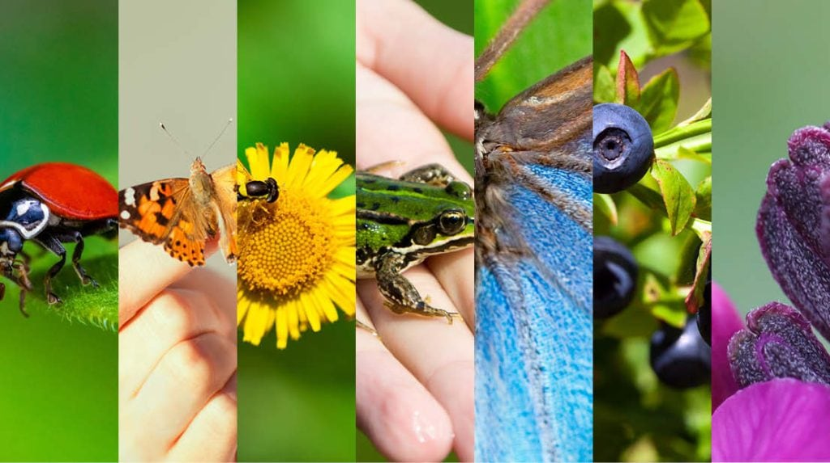
Rainbow Walk

Slide 19
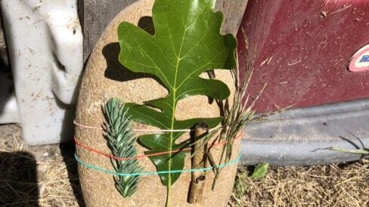
Rock weaving

Slide 20
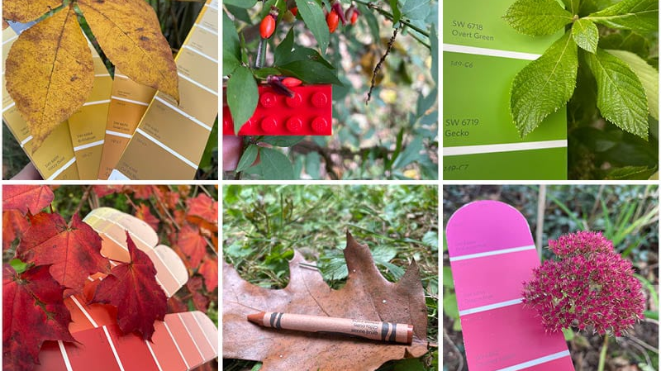
Color Matching Walk

Slide 21
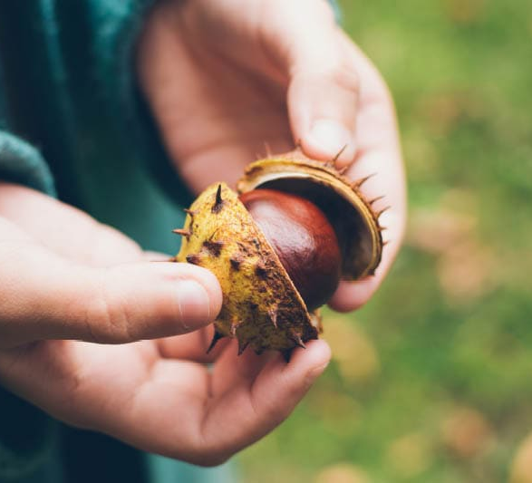

Texture Walk

Slide 22
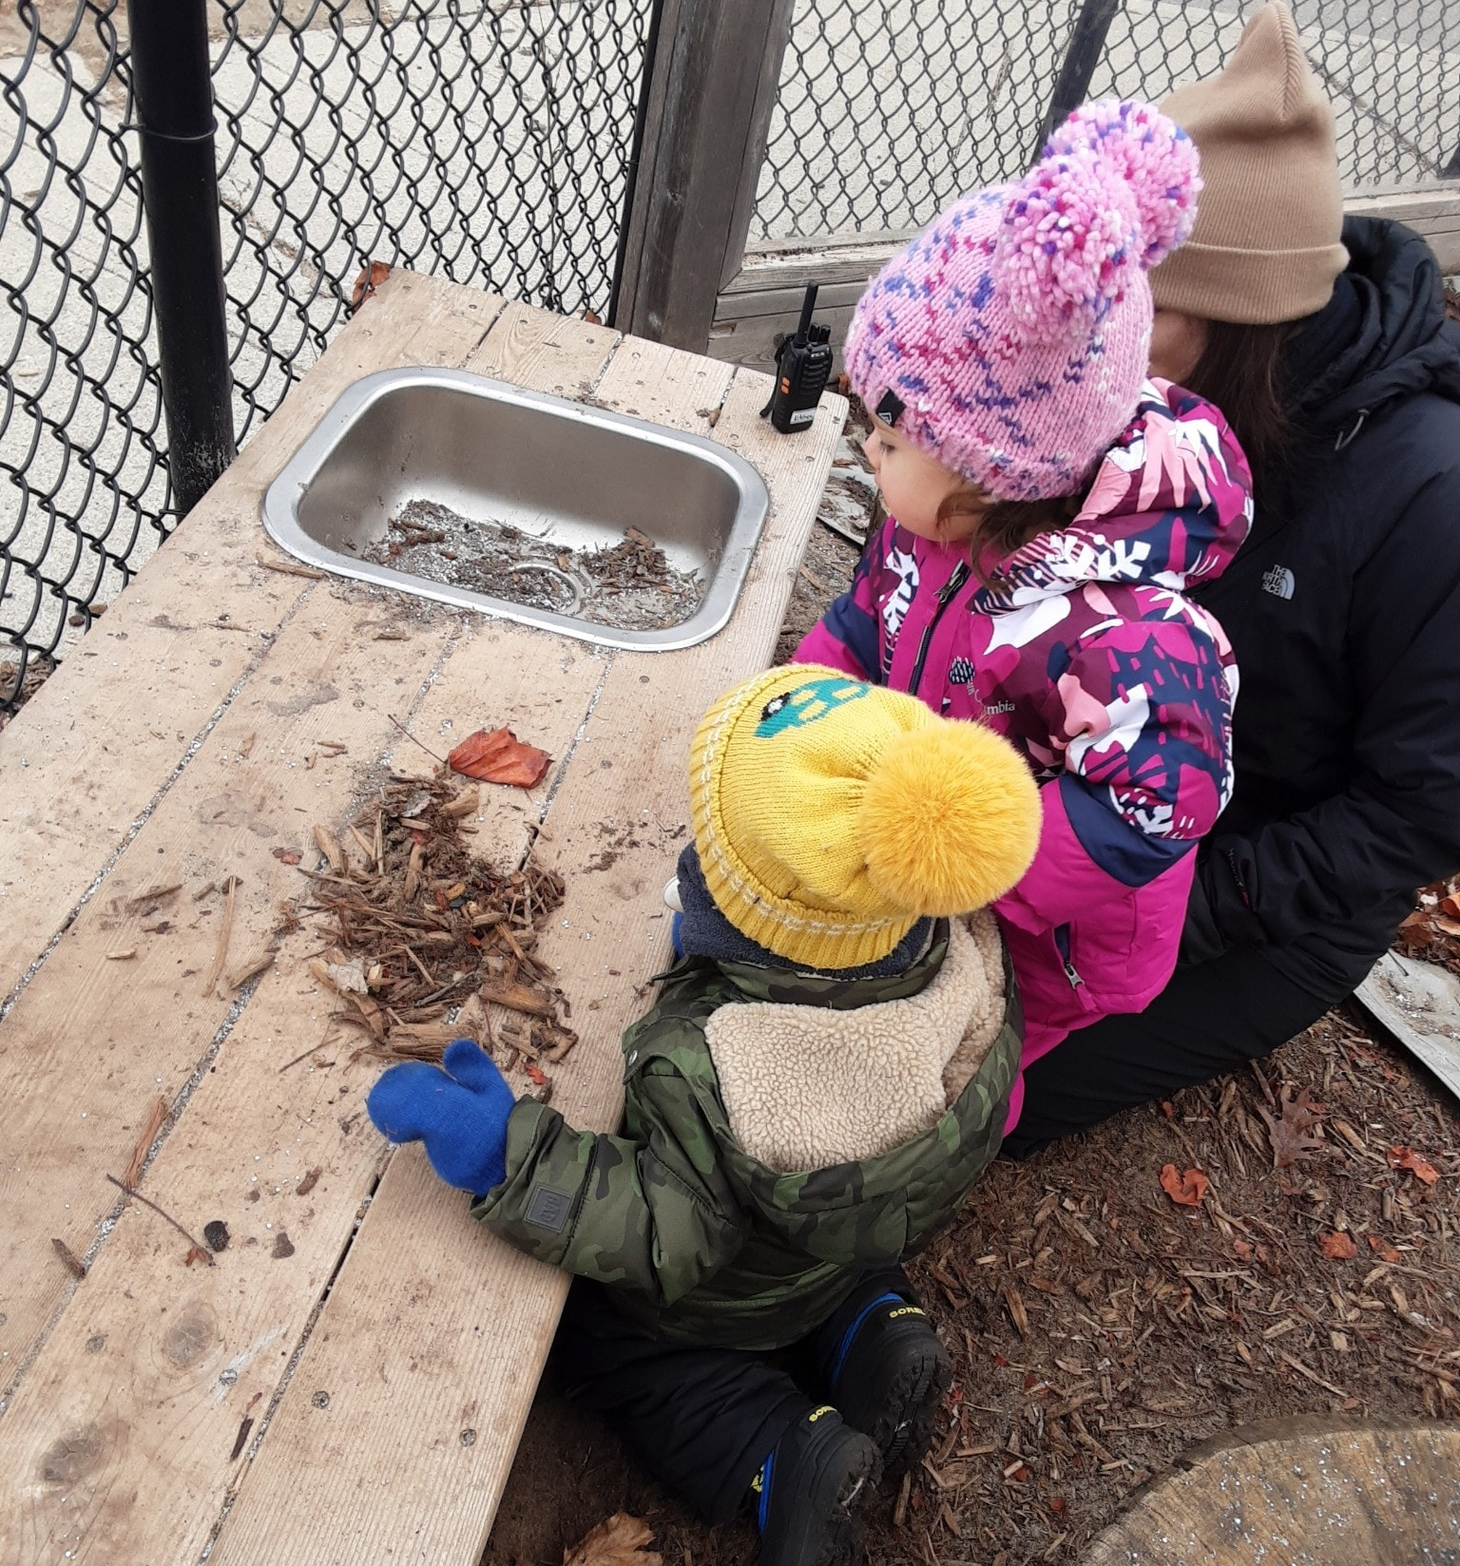
THE ROLE OF THE EDUCATOR
Educators play a crucial role in engaging children in outdoor spaces, fostering their development and providing valuable learning experiences. Here are several ways educators can actively participate in and enhance children's engagement in outdoor environments:
Notes:
Creating Inviting Environments:
Design outdoor spaces that are safe, accessible, and rich in diverse materials that encourage exploration and creativity.
Arrange outdoor spaces to promote both independent and collaborative play.
Facilitating Play-Based Learning:
Emphasize the importance of play as a tool for learning and development.
Provide open-ended materials that allow for imaginative play, problem-solving, and social interaction.
Guiding and Extending Learning:
Actively participate in children's play, offering guidance, encouragement, and support as needed.
Extend learning by asking open-ended questions that stimulate critical thinking and language development.
Promoting Physical Activity:
Encourage gross motor activities that enhance physical development and coordination.
Provide a variety of equipment and spaces for climbing, running, jumping, and other active play.
Nature Exploration and Inquiry:
Foster a sense of wonder and curiosity about the natural world.
Facilitate nature walks, outdoor experiments, and opportunities for hands-on exploration.
Encouraging Risk-Taking and Problem-Solving:
Support children in taking calculated risks, promoting resilience and problem-solving skills.
Create an environment where mistakes are viewed as opportunities for learning.
Building Social Skills:
Foster positive social interactions by creating spaces for group play and collaboration.
Teach conflict resolution and effective communication skills during outdoor activities.
Connecting with the Community:
Explore opportunities for community engagement, such as inviting guest speakers or organizing outdoor events.
Foster connections between outdoor learning and the broader community.
Modeling Environmental Stewardship:
Involve children in simple eco-friendly activities, such as planting, recycling, or composting.
Documentation and Reflection:
Document children's experiences through photographs, drawings, or written observations.
Reflect on the outdoor activities and use documentation to involve parents and caregivers in the learning process.
Professional Development:
Stay informed about best practices in outdoor education and participate in relevant professional development opportunities.
Collaborate with colleagues to share ideas and experiences related to outdoor learning.

Slide 23
UNSTRUCTURED FREE PLAY:
WHAT DOES IT LOOK LIKE?
https://www.instagram.com/reel/C1DcocAP10N/?utm_source=ig_web_copy_link

Slide 24
Children learn and develop by doing things, by playing and by having hands-on meaningful experiences.
Notes:
Outdoors is the perfect learning environment for experiences
Express themselves
Interact with others
Make choices
Test ideas and materials
Develop and practice skills
Stimulate curiosity
Develop consideration for others and independence
Explore and make discoveries
Solve problems

Slide 25
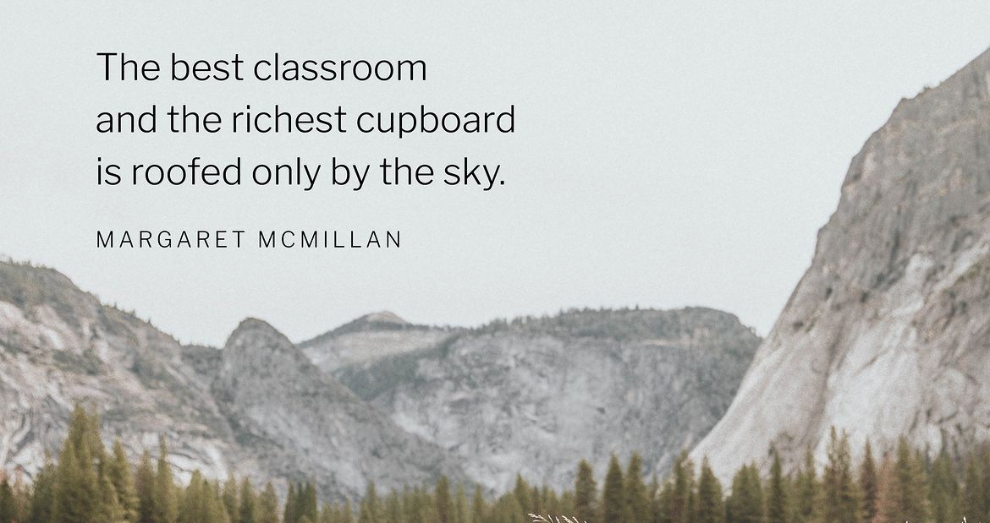

Slide 26

REFLECT: ON THE OUTDOOR SPACE:
As you observe children outdoors, do you notice differences in their attention and learning?
What are their interests and are they represented?
How do the children experience the different spaces or areas that have been designed outdoors?
How does the outdoor environment support each child’s development?
In what ways do I create areas of inquiry, curiosity, challenge, wonderment, and movement?
What ideas are emerging?
How can I support their ideas with provocations?
Notes:
When looking at your outdoor space, reflect on some of the questions, this will allow you to reflect on the space and make changes to enhance children’s learning.
For example: How do the children experience the different spaces or areas that have been designed outdoors?
When you break down this question you are first going to reflect on the different spaces, grass, turf, pavement. Then from this you are going to realize that you are working with 1-3 different spaces that your can plan activities with. What programming and learning centre can I offer on the grass area?

Slide 27
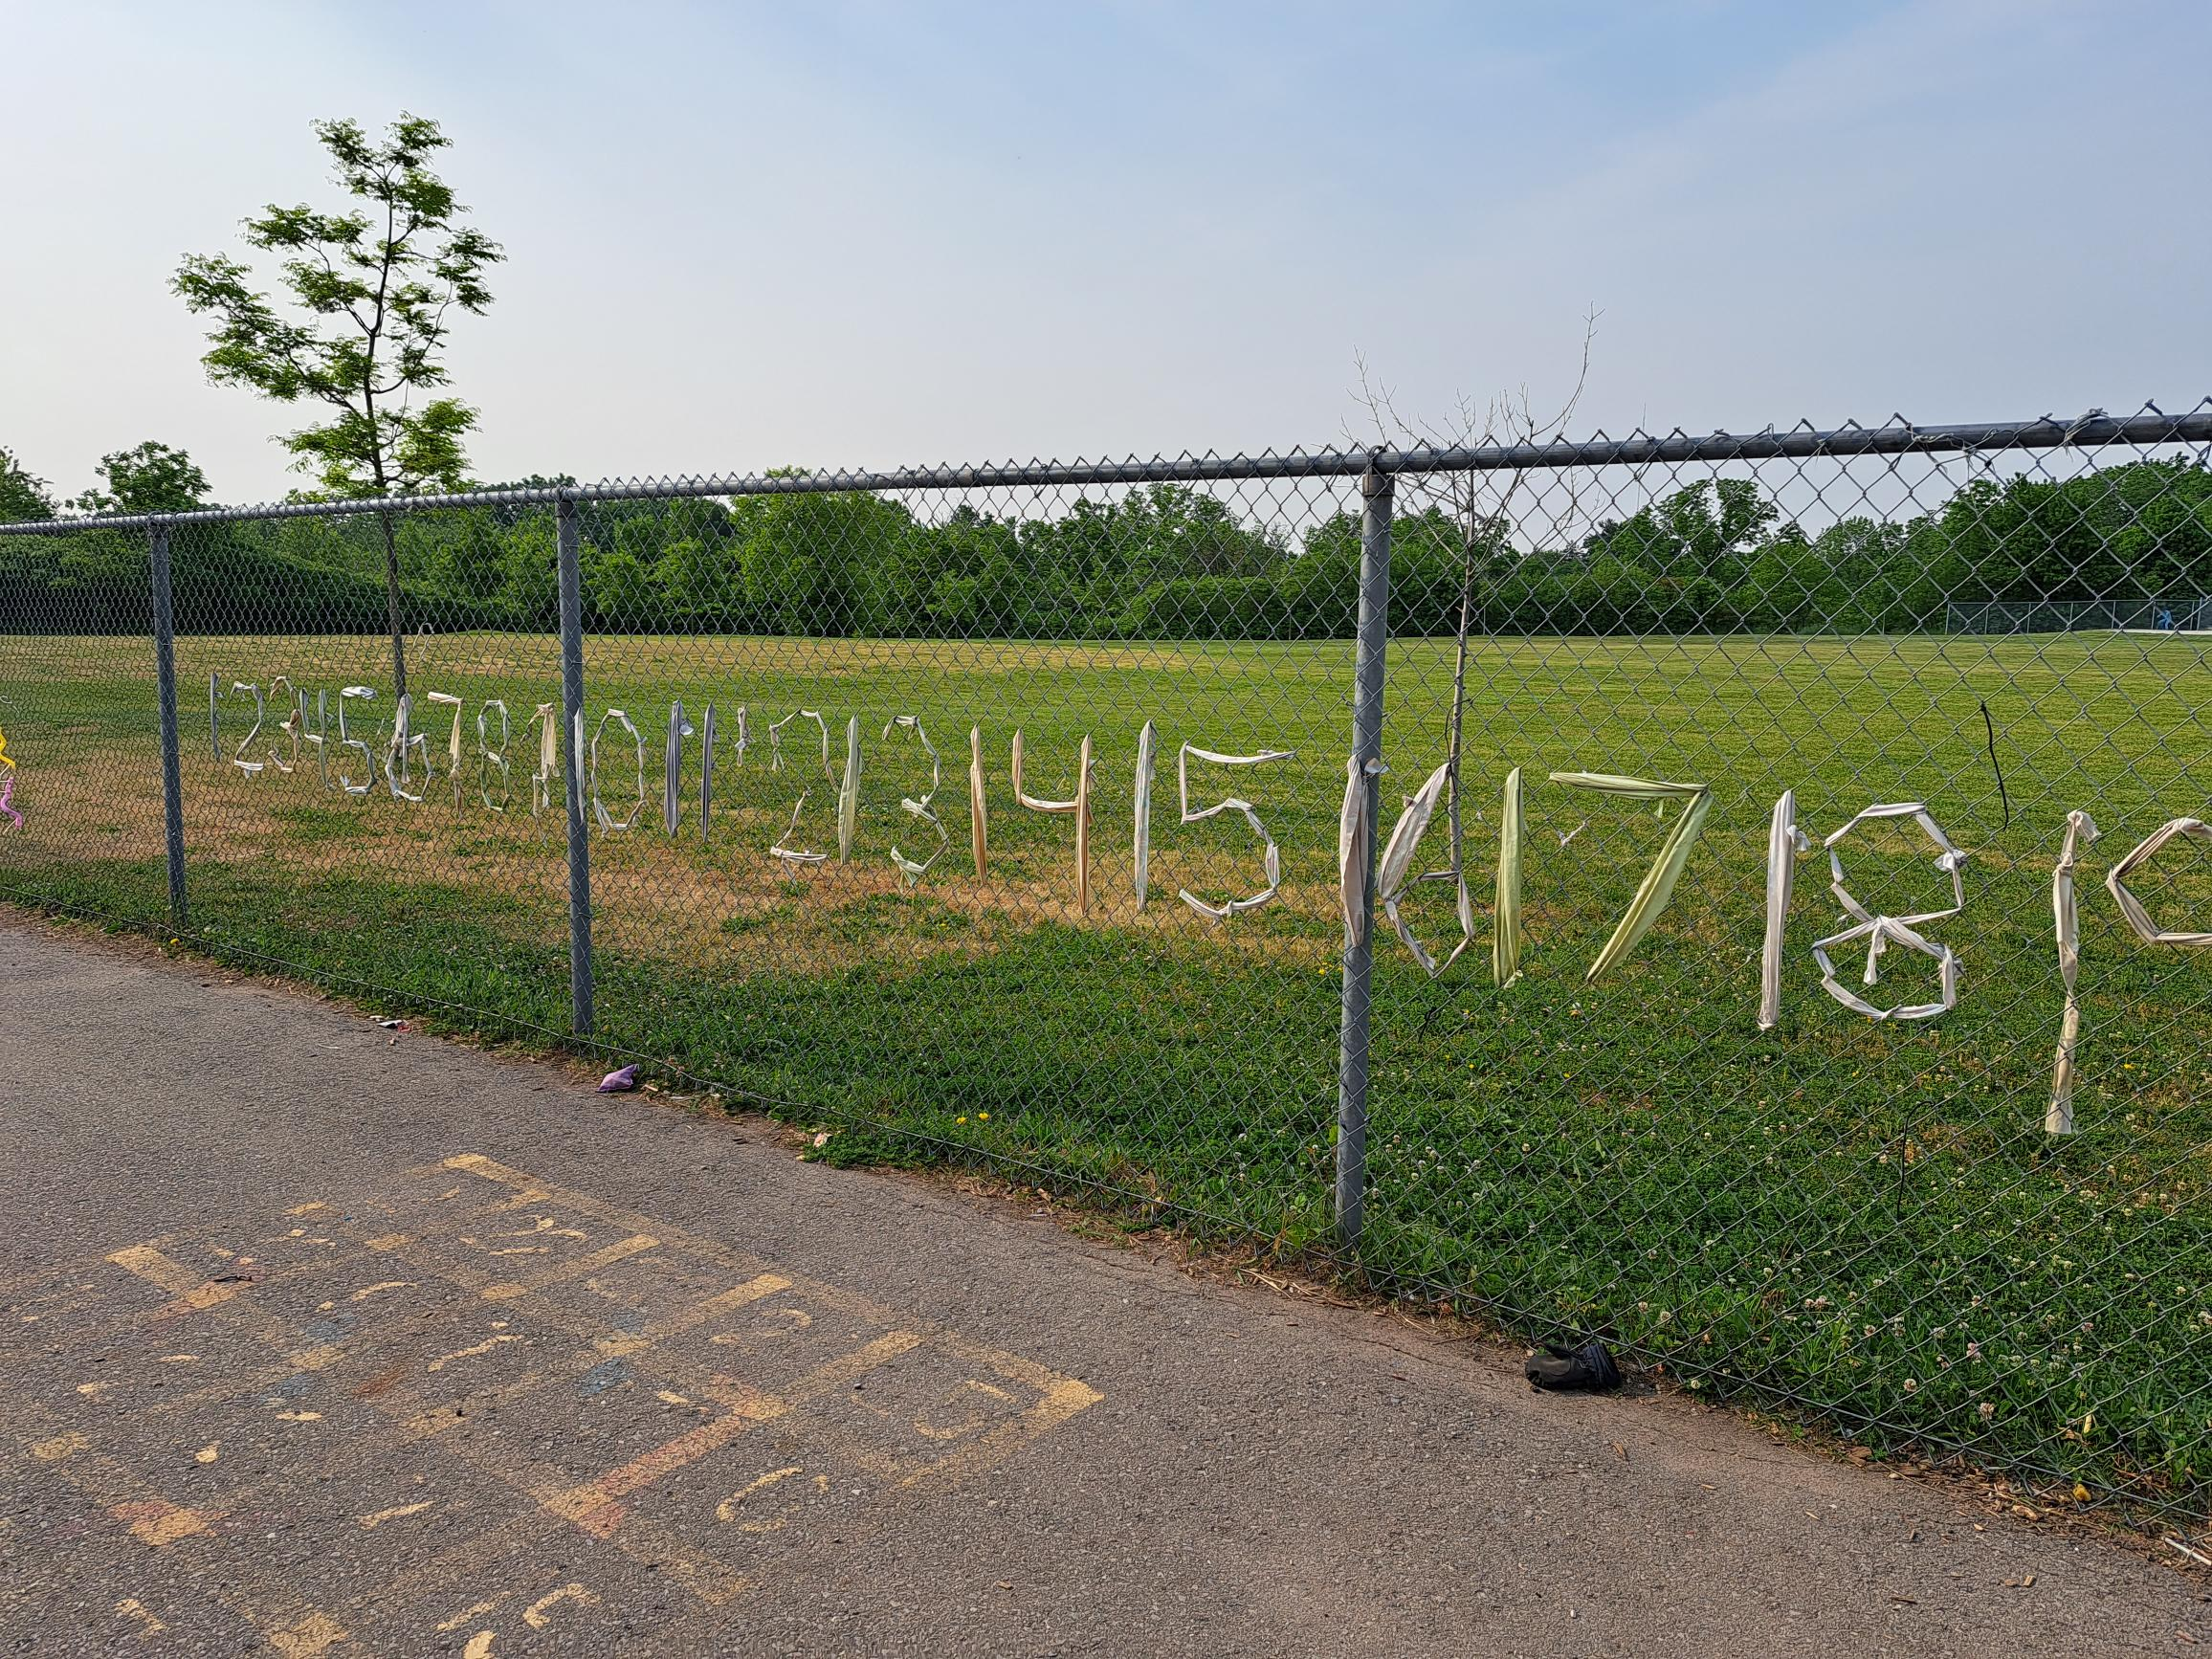
DESIGNING OUTDOOR PLAY SPACES:
Be realistic
Write it down.
Set-up the playground to reflect all learning areas
Seek out the perspective and voice of the children
Notes:
Be realistic and think about the actual space you have to develop, the ages of the children you usually work with. I find drawing a rough map of your current space can really help you visualize as you work through the design process.
Write it down. On a piece of paper write down the current areas, equipment and features you have in the space. Now work your way back down the list and tick what you feel works well or would like to keep/modify. You could also indicate whether current materials and equipment are fixed or non fixed.
Set-up the playground to reflect all learning areas!
Seek out the perspective and voice of the children – involve them in the design process. It is important and usually very helpful to involve children in this initial process and actively seek out their voice and perspective

Slide 28
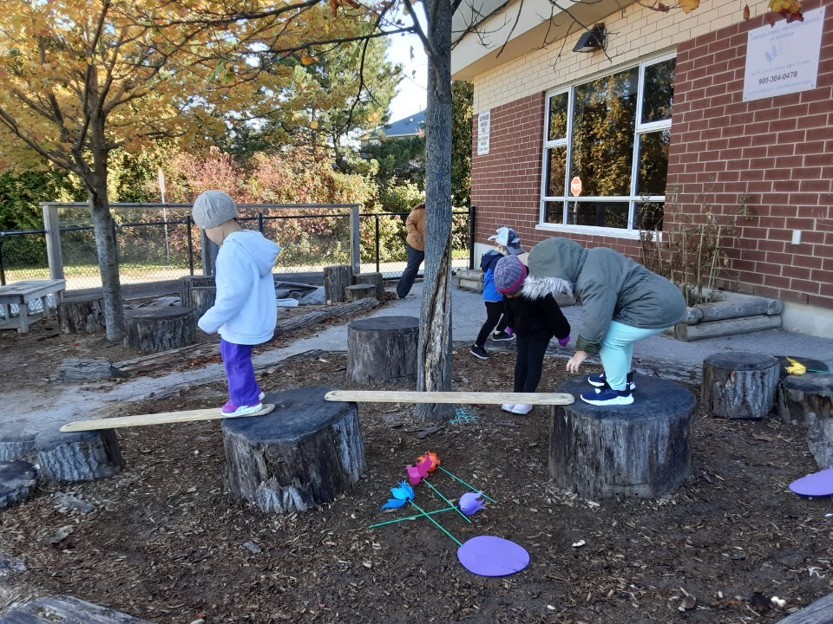
OUTDOOR LEARNING AREAS
Children’s play and activities
Promote engagement outdoors.
Break from being indoors
Safe and organized
Include provocations, activities as well as free time.
Notes:
Carefully design outdoor learning areas to support the full range of children’s play and activities. You can create activity areas, much like you do for your indoor space.
These areas may include quiet, manipulative, physical, nature, social, dramatic, and art. Many of the same materials you provide indoors can be used to promote engagement outdoors.
The purpose of an outdoor environment is to encourage children to be active, to give them a break from being indoors, and to support learning in a range of environments.
Like an indoor learning environment, your outdoor space should be safe and organized and include provocations, activities as well as free time.

Slide 29
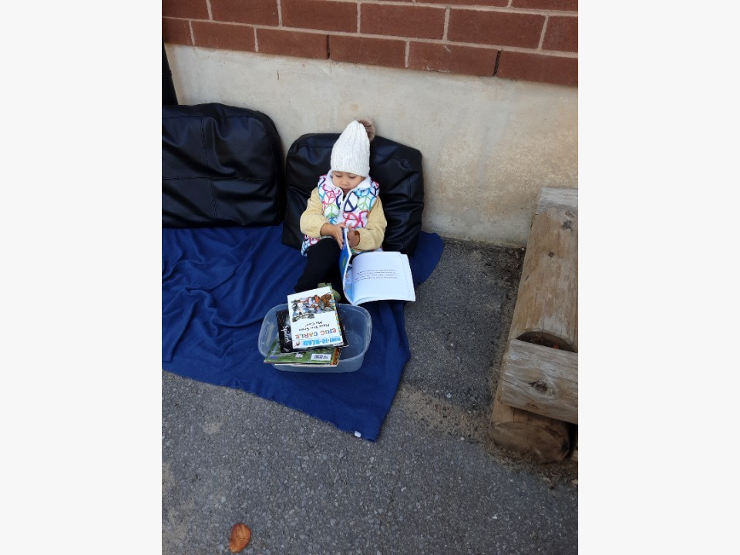
QUIET AREA:
Set up a cozy reading corner with comfortable cushions, blankets, and outdoor-friendly bean bags. Provide a small bookshelf with a variety of age-appropriate books for kids to enjoy in a quiet atmosphere.
Notes:
Set up a cozy reading corner with comfortable cushions, blankets, and outdoor-friendly bean bags. Provide a small bookshelf with a variety of age-appropriate books for kids to enjoy in a quiet atmosphere.
Nature-Inspired Art Station:
Place a small table with art supplies like colored pencils, sketchbooks, and nature-themed books. Kids can engage in quiet art activities while surrounded by the calming elements of nature.
Zen Garden or Sand Play Area:
Create a mini zen garden or a designated area with sandbox play. Include small rakes and tools for kids to create patterns in the sand, promoting a sense of calm and focus.
Listening Station:
Set up a listening station with headphones and a selection of calming nature sounds or soft instrumental music. This area provides a quiet space for children to listen and relax.
Mindfulness and Breathing Exercises:
Introduce simple mindfulness and breathing exercises. Use colorful cushions or mats for kids to sit comfortably while practicing mindfulness or deep-breathing techniques.
Quiet Corner with Tents or Canopies:
Create a secluded corner with small tents, canopies, or draped fabric to give kids a sense of enclosure. This provides a private space where they can retreat for quiet time.
Sensory Garden:
Design a sensory garden with plants that have interesting textures, colors, and scents. Kids can explore and engage their senses while enjoying the calming effects of nature.
Yoga and Stretching Area:
Set up a designated space with yoga mats or soft grass for kids to practice simple yoga poses or stretching exercises. This can promote physical relaxation and mindfulness.
Rock Garden or Meditation Stones:
Create a rock garden or place flat stones with positive affirmations in a quiet area. Kids can use these rocks for mindful activities or arrange them to express their feelings.
Quiet Water Feature:
Incorporate a small, tranquil water feature like a bubbling fountain or a reflecting pool. The gentle sound of water can create a serene environment for relaxation.
Outdoor Puzzle or Board Games Area:
Arrange a small area with puzzles or board games that encourage quiet, independent play. Use waterproof materials for games to make them suitable for outdoor use.
Bird Watching Spot:
Set up a bird watching station with bird feeders and a comfortable seating area. Kids can quietly observe and learn about local bird species.
Cloud gazing Zone:
Arrange comfortable seating like lounge chairs or blankets for kids to lie down and look at the sky. This area can be used during the day for cloud watching or in the evening for stargazing.

Slide 30
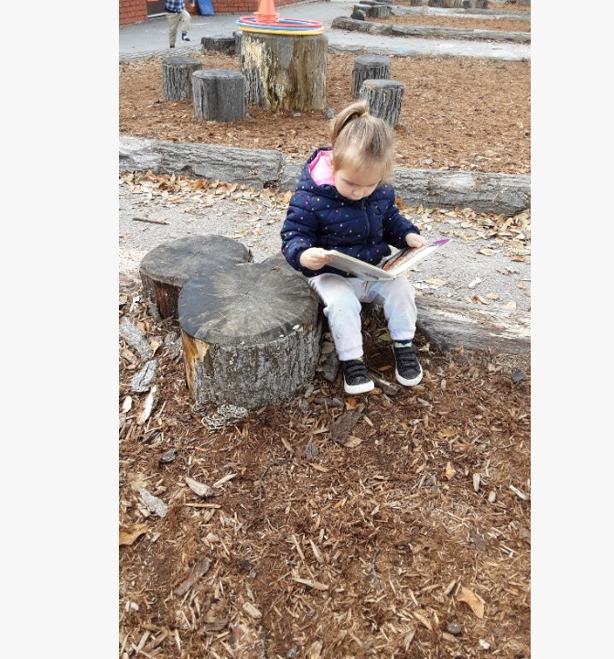
LANGUAGE AND LITERACY
Creating a language and literacy-rich outdoor environment for children is essential for their holistic development. Outdoor settings provide diverse opportunities for language exploration, communication, and literacy development.
Notes:
Creating a language and literacy-rich outdoor environment for children is essential for their holistic development. Outdoor settings provide diverse opportunities for language exploration, communication, and literacy development. Here are some ideas to enhance the language and literacy area outdoors for children:
Outdoor Library:
Install weather-resistant bookshelves or containers filled with a variety of age-appropriate books.
Create reading nooks with comfortable seating and soft cushions.
Nature Journaling Station:
Provide clipboards, paper, and art supplies for children to engage in nature journaling.
Encourage them to observe and document their outdoor experiences through drawing or writing.
Chalkboards and Whiteboards:
Install outdoor chalkboards or whiteboards on fences or walls for drawing, writing, and playing word games.
Use these surfaces for group activities or collaborative storytelling.
Outdoor Alphabet and Word Games:
Incorporate games like hopscotch with letters or words.
Use stencils to create a large alphabet on the ground for interactive learning.
Sensory Letters and Words:
Create tactile materials like sand, mud, or textured surfaces for children to trace letters and words.
Use natural materials like rocks or sticks to form letters and encourage exploration.
Interactive Garden Signs:
Label plants, flowers, or trees with signs that include the name and a brief description.
This helps children associate words with real-world objects.
Outdoor Puppet Theater:
Set up a small puppet theater with puppets and props for imaginative play.
Encourage children to create their own puppet shows, promoting language expression.
Outdoor Poetry Corner:
Display nature-inspired poems or rhymes on posters.
Invite children to contribute their own poetry or collaborate on creating outdoor poems.
Letter Hunts:
Hide letters or words around the outdoor space for children to find.
This promotes letter recognition and literacy in a playful manner.

Slide 31
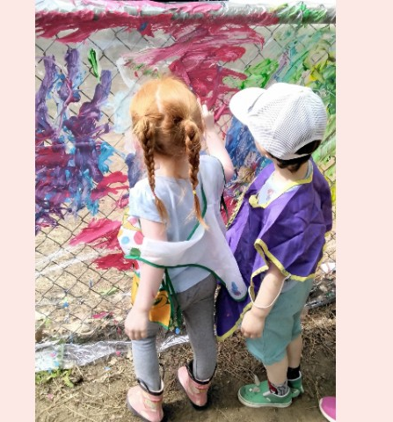
ART AND CREATIVE EXPRESSION
Bringing art and creative expression outdoors for children not only enhances their artistic abilities but also provides a holistic and sensory-rich learning experience.
Notes:
Bringing art and creative expression outdoors for children not only enhances their artistic abilities but also provides a holistic and sensory-rich learning experience.
Here are some ideas for fostering creativity in an outdoor setting:
Nature-inspired Art:
Use natural materials like leaves, sticks, flowers, and stones for art projects. Children can create nature collages, leaf rubbings, or use items found in the environment to paint or draw.
Sidewalk Chalk:
Sidewalk chalk is a versatile and mess-free way for children to express themselves outdoors. They can draw on pavement, create hopscotch games, or contribute to a collaborative mural.
Outdoor Easels:
Set up easels in an outdoor space and provide water-based paints. This allows children to paint landscapes, scenes from nature, or their imaginative creations while enjoying the fresh air.
Rock Painting:
Collect smooth rocks and let children paint them with vibrant colors. These painted rocks can be used to create outdoor art installations or as decorative elements in the garden.
Sensory Art Stations:
Create sensory stations with different textures, such as sand, mud, or water. Incorporate tools like brushes, sponges, and rollers for tactile and messy play that stimulates the senses.
Outdoor Murals:
Dedicate a wall or fence for an outdoor mural. Children can work collaboratively to create a large-scale artwork using washable and non-toxic paints.
Shadow Tracing:
Use the natural sunlight to trace shadows of objects or each other on large sheets of paper. Children can then fill in the silhouettes with colors and patterns.
Nature Mandalas:
Arrange natural materials like leaves, flowers, and pebbles into mandala patterns on the ground. This activity not only encourages creativity but also promotes a connection with the environment.
Outdoor Sculpture Garden:
Provide materials like clay, wire, or recycled items for children to create sculptures. Display their sculptures in an outdoor sculpture garden for everyone to admire.
Story Stones:
Paint or draw pictures on flat stones to represent characters, objects, or scenes. Children can use these story stones to create their own outdoor storytelling adventures.

Slide 32
MANIPULATIVE AREA
When we talk about manipulation in the context of activities for children, it typically refers to activities that involve using hands and fingers for fine motor skill development.
Notes:
When we talk about manipulation in the context of activities for children, it typically refers to activities that involve using hands and fingers for fine motor skill development.
Nature Scavenger Hunt:
Create a list of items for children to find in nature, such as pinecones, leaves, rocks, or flowers. Encourage them to pick up and manipulate these items as they explore the outdoor environment.
Sensory Bins:
Set up sensory bins with materials like sand, rice, or water outdoors. Hide small objects within the bins and let children use their hands to search for and manipulate the items.
Outdoor Art with Clay:
Provide modeling clay or playdough for children to create outdoor sculptures. This activity allows them to mold and shape the clay, promoting fine motor control.
Seed Planting:
Engage children in planting seeds in a garden. Handling seeds and soil involves fine motor skills, and the ongoing care of the plants provides a sense of responsibility.
Bubble Play:
Outdoor bubble activities involve using bubble wands, which require hand-eye coordination to dip, wave, and blow bubbles. Children can also try catching or popping bubbles.
Stringing Activities:
Set up a stringing station with beads, pasta, or other large items with holes. Children can thread these items onto strings, promoting hand-eye coordination and precision.
Nature Bracelets:
Provide children with tape or string and encourage them to create nature bracelets by attaching small natural items they find, like leaves, flowers, or seeds.
Outdoor Water Play:
Water activities such as pouring, scooping, and squeezing water from sponges or spray bottles involve hand manipulation. These activities are not only fun but also enhance fine motor skills.
Chalk Play:
Allow children to use chalk to draw and write on outdoor surfaces like sidewalks or chalkboards. This activity encourages hand movement and control.
Seed Sorting:
Offer a variety of seeds and challenge children to sort them based on size, color, or type. This activity enhances fine motor skills and visual discrimination.
Painting with Nature:
Use natural items like leaves, twigs, or flowers as paintbrushes. Children can dip these items in paint and create unique outdoor artworks, promoting creativity and fine motor control.
Outdoor Cooking or Mud Kitchen:
Set up a mud kitchen with pots, pans, and utensils. Children can engage in pretend play and manipulate natural materials to create mud-based culinary creations.
Rock Stacking:
Provide flat rocks for children to stack and balance. This activity not only improves fine motor skills but also promotes concentration and problem-solving.
Outdoor Construction Zone:
Provide materials like small sticks, twine, and cardboard for children to construct small outdoor structures or sculptures. This hands-on activity encourages creativity and fine motor control.

Slide 33
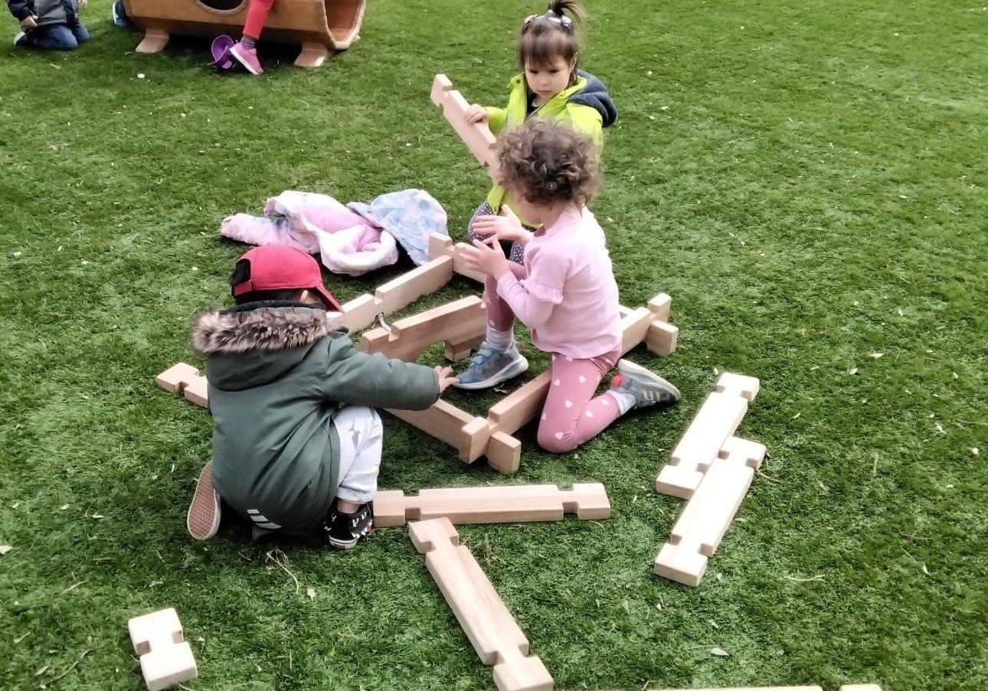
BLOCKS AND CONSTRUCTION
Outdoor block play and construction activities for children offer a fantastic opportunity for creativity, problem-solving, and physical development
Notes:
Outdoor block play and construction activities for children offer a fantastic opportunity for creativity, problem-solving, and physical development. Here are some ideas for blocks and construction play outdoors:
Giant Cardboard Blocks:
Use large cardboard boxes to create oversized building blocks. Children can stack, arrange, and build structures with these lightweight but sturdy blocks.
Natural Building Materials:
Provide children with natural building materials such as logs, branches, and large stones. These materials can be used for building forts, bridges, or other imaginative structures.
Foam Blocks for Water Play:
Foam blocks float, making them ideal for water play. Set up a water table or a shallow container of water, and let children build and experiment with enthusiasm.
Construction Site Role Play:
Create a construction site with toy construction vehicles, shovels, and buckets. Children can engage in role-play activities, moving "materials" around and building imaginary structures.
PVC Pipe Building:
Provide PVC pipes and connectors for children to create their own building structures. This allows for experimentation with balance and design.
Sand and Water Table:
Set up a sand and water table with scoops, shovels, and molds. Children can build sandcastles, dig moats, or experiment with mixing sand and water.
Brick or Paver Pathways:
Create pathways using bricks or pavers. Children can build structures along the pathway, encouraging both construction and imaginative play.
Outdoor Building Blocks:
Outdoor building blocks made of durable, weather-resistant materials. These can include large plastic or wooden blocks designed for outdoor use.
Chalk Blueprint Drawings:
Encourage children to plan their constructions by drawing blueprints or sketches with sidewalk chalk. This adds an element of design thinking to their play.
Mud Brick Making:
Mix mud and straw to create "bricks." Children can mold these into shapes and build structures, providing a sensory and tactile construction experience.
Tree Branch Construction:
Collect sturdy tree branches and let children use them to build structures or frames. This activity connects with nature while encouraging creativity.
Loose Parts Play:
Introduce a variety of loose parts such as PVC pipes, crates, buckets, and fabric. Children can use these items to build and rebuild structures in endless ways.
Construction-themed Obstacle Course:
Design an obstacle course with construction-themed challenges. For example, children might need to balance on a beam, crawl through a tunnel, or carry "construction materials" from one point to another.

Slide 34
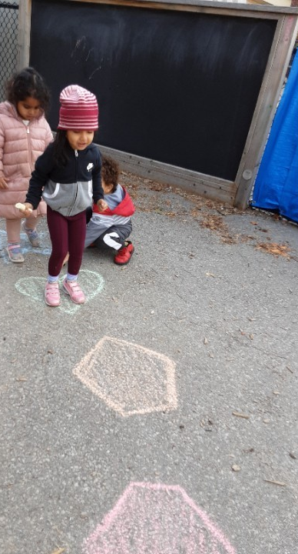
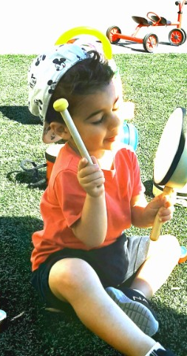
MUSIC AND MOVEMENT
Outdoor music and movement activities for children provide a fun and engaging way for them to explore rhythm, coordination, and creative expression.
Notes:
Outdoor music and movement activities for children provide a fun and engaging way for them to explore rhythm, coordination, and creative expression. Here are some ideas to incorporate music and movement into outdoor play:
Nature Instruments:
Create simple musical instruments using natural materials. For example, gather sticks to make rhythm sticks, use rocks as shakers, or arrange logs as a makeshift xylophone. Children can experiment with sounds and rhythms.
Outdoor Dance Party:
Set up a designated dance area with a portable speaker. Play lively music and encourage children to express themselves through dance. This can also be a great way to promote physical activity.
Musical Freeze Tag:
Combine music and a classic game of freeze tag. When the music plays, children dance and move around. When the music stops, they freeze in place until the music starts again.
Obstacle Course with Musical Stops:
Create an obstacle course with different stations. Each station has a musical instrument or a device to play music. Children move through the course, stopping at each station to engage with the music.
Sensory Sound Walk:
Arrange different surfaces (grass, gravel, sand) in a path. As children walk, stomp, or tip-toe along the path, they experience various sounds and textures under their feet.
Parachute Play:
Use a large parachute for group activities. Children can lift the parachute up and down to the beat of the music or play games like making waves or creating a "tent."
Musical Storytime:
Combine music with storytelling. Choose a story or create a narrative, and incorporate musical cues. For example, use different instruments or melodies to represent different characters or events in the story.
DIY Musical Instruments:
Allow children to create their own musical instruments using recycled materials. Examples include making drums from containers, rain sticks from tubes, or shakers from bottles filled with beans.
Giant Outdoor Piano:
Set up a giant "piano" on the ground using large, flat stones or painted squares. Children can hop or step on the squares to create musical notes and rhythms.
Hula Hoop Dance:
Provide hula hoops and play rhythmic music. Children can experiment with different ways to move the hula hoop to the beat, combining dance and coordination.
Musical Statues:
Play a game of musical statues where children dance while the music is playing, and freeze when it stops. It's a fun way to encourage listening skills and movement control.
Instrumental Nature Sounds:
Introduce children to the concept of outdoor music by listening to and imitating nature sounds. Use instruments to mimic bird calls, rustling leaves, or flowing water.
Ribbon Dancing:
Tie colorful ribbons to sticks or use ribbon wands. Children can dance and move the ribbons to the music, creating a visually dynamic and rhythmic experience.

Slide 35
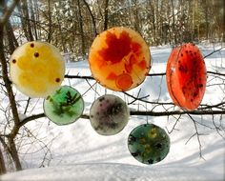
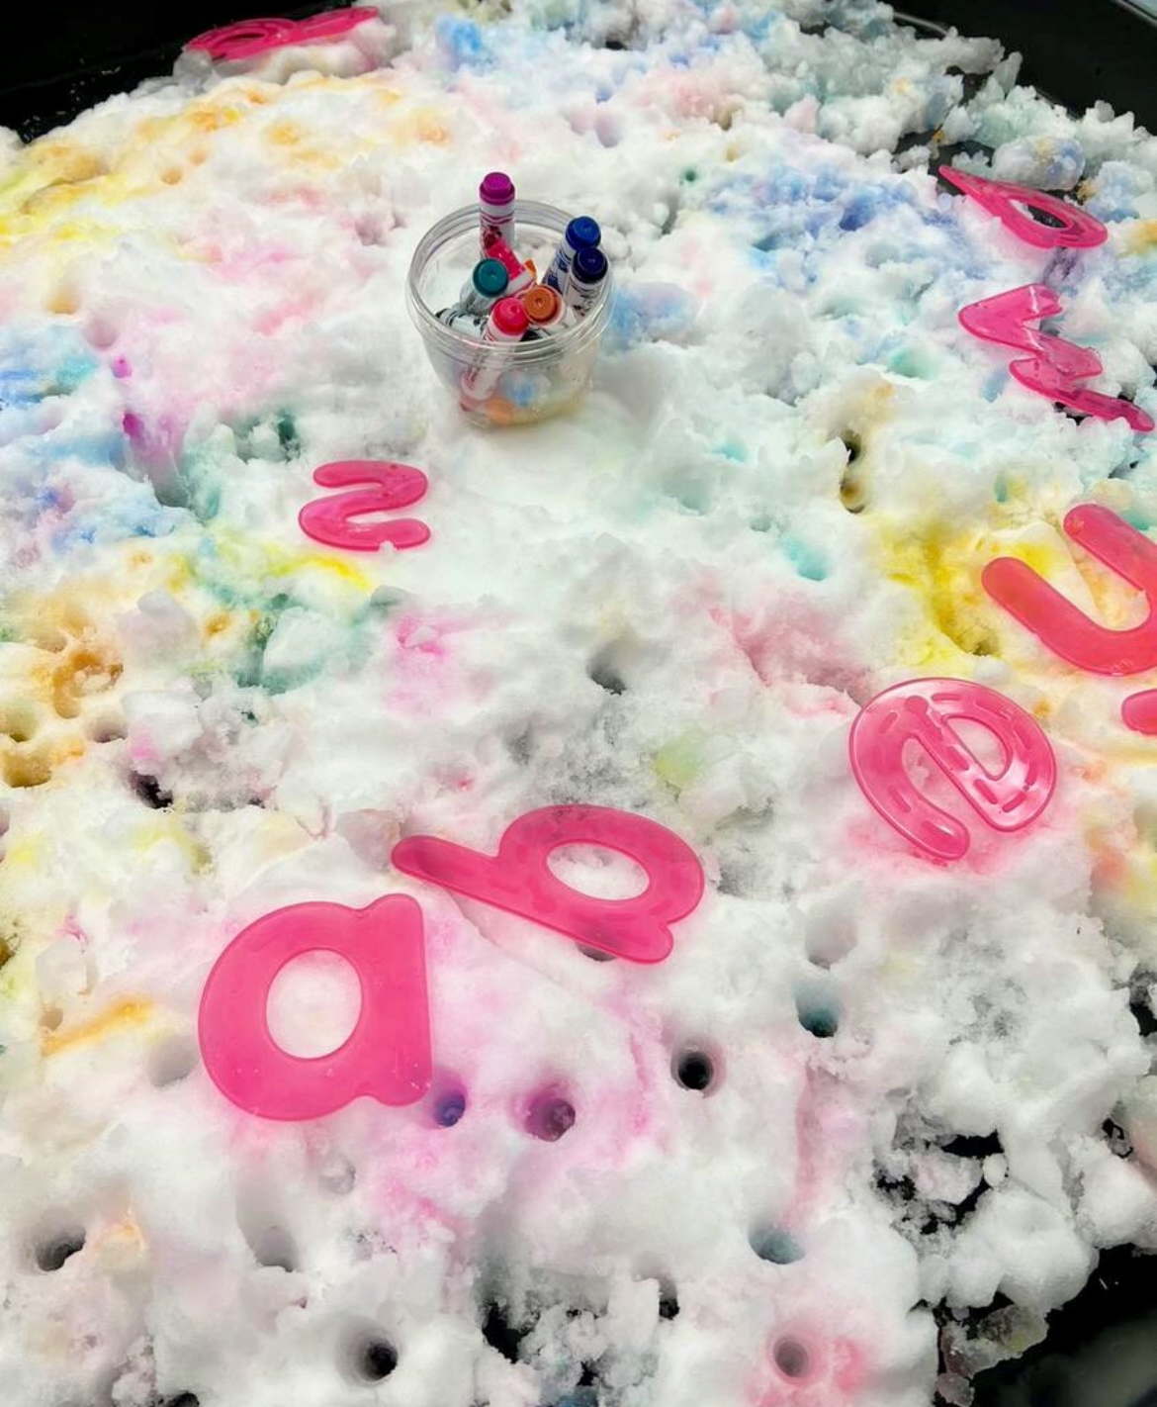
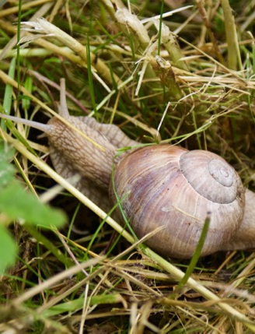
SCIENCE AND NATURE
Outdoor science and nature activities for children provide hands-on experiences that foster curiosity, exploration, and a deeper understanding of the natural world.
Notes:
Outdoor science and nature activities for children provide hands-on experiences that foster curiosity, exploration, and a deeper understanding of the natural world. Here are some ideas to engage children in science and nature exploration outdoors:
Nature Scavenger Hunt:
Create a list of items for children to find in nature, such as different types of leaves, rocks, flowers, or insects. This activity promotes observation skills and an appreciation for biodiversity.
Planting and Gardening:
Set up a garden area where children can plant seeds, water plants, and observe the growth process. This hands-on activity teaches them about plant life cycles and the importance of caring for living things.
Bug Investigation Station:
Provide magnifying glasses and containers for children to observe insects. Create a small bug investigation station with guidebooks to help identify the insects they discover.
Nature Art and Leaf Rubbings:
Encourage children to collect leaves, flowers, or other natural materials to create art. They can make leaf rubbings, create nature collages, or use items from nature to paint or dye paper.
Rock Painting
Collect rocks and stones and encourage children to paint or decorate them. This activity introduces basic creative expression.
Bird Watching:
Set up bird feeders or provide binoculars for children to observe birds in the area. Discuss different bird species, their behaviors, and the importance of birdwatching for scientific observation.
Weather Observations:
Set up a weather station with basic instruments like a thermometer, rain gauge, and wind vane. Encourage children to make daily weather observations and discuss weather patterns.
Nature Journaling:
Provide children with nature journals to document their observations, drawings, and thoughts about the outdoor environment. This helps develop scientific observation skills and a connection to nature.
DIY Bird Feeders:
Create simple bird feeders using pinecones, peanut butter, and birdseed. Hang them in a designated area and observe which birds come to feed. Discuss the different bird species and their behaviors.
Leaf Identification:
Collect a variety of leaves and help children identify the trees they come from. Discuss the different shapes, sizes, and textures of leaves.
Nature Sculptures:
Encourage children to use natural materials like sticks, stones, and leaves to create outdoor sculptures. This activity combines creativity with an appreciation for the environment.
Outdoor Microscope Exploration:
Use handheld microscopes to explore small details in nature, such as leaves, flowers, or insects. This allows children to see the intricate structures that are not visible to the naked eye.
Nature Math:
Incorporate math into outdoor activities by counting petals on flowers, measuring the height of plants, or observing patterns in nature. This integrates math skills into nature exploration.

Slide 36
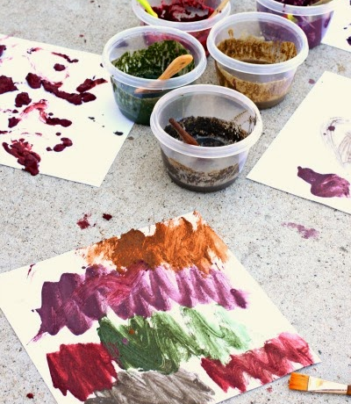
SENSORY AREA:
Creating a sensory area outdoors for children provides a rich and stimulating environment that engages their senses and promotes sensory exploration.
Notes:
Creating a sensory area outdoors for children provides a rich and stimulating environment that engages their senses and promotes sensory exploration. Here are some ideas for designing a sensory-friendly outdoor space:
Sensory Garden:
Plant a variety of fragrant flowers, herbs, and plants that children can touch, smell, and observe. Include plants with different textures and scents to enhance the sensory experience.
Barefoot Pathway:
Create a barefoot pathway using various materials like smooth stones, grass, sand, and pebbles. Walking barefoot on different surfaces stimulates the sense of touch and provides a unique sensory experience.
Sensory Bins:
Set up sensory bins filled with materials like rice, sand, water beads, or dried beans. Children can explore these bins using their hands, scoops, and various containers, promoting tactile exploration.
Outdoor Water Play:
Install a water play area with fountains, small waterfalls, or shallow basins. Water play engages the sense of touch and provides a soothing and refreshing experience.
Texture Wall:
Create a vertical texture wall using materials like burlap, fabric scraps, sponges, and brushes. Children can run their hands over the different textures, promoting tactile stimulation.
Outdoor Musical Instruments:
Include outdoor musical instruments such as chimes, drums, or xylophones. Playing these instruments not only engages the sense of hearing but also encourages rhythmic exploration.
Sensory Pathway:
Design a sensory pathway with elements like stepping stones, textured mats, or sensory tiles. Children can walk, hop, or jump along the pathway, experiencing different textures and surfaces.
Scented Playdough Station:
Set up a station with scented playdough. Children can mold and manipulate the playdough while enjoying the sensory experience of different scents.
Tactile Nature Exploration:
Provide natural materials like pinecones, shells, leaves, and tree bark for children to touch and explore. Incorporate items with varying textures to enrich the tactile experience.
Hanging Sensory Items:
Hang sensory items such as wind chimes, ribbons, or textured fabrics from tree branches or a play structure. Children can interact with these items, experiencing both visual and tactile stimulation.
Bubble Play:
Set up a bubble station with different types of bubble wands and solutions. Children can chase and pop bubbles, engaging in a visually stimulating and tactile activity.
Colorful Sensory Path:
Create a colorful sensory path using vibrant tiles, mats, or painted patterns on the ground. Each section can offer a different tactile experience, such as soft, bumpy, or smooth surfaces.
Sensory Art Station:
Provide materials like clay, finger paints, or textured paper for outdoor art activities. Children can express themselves creatively while experiencing different sensory inputs.

Slide 37
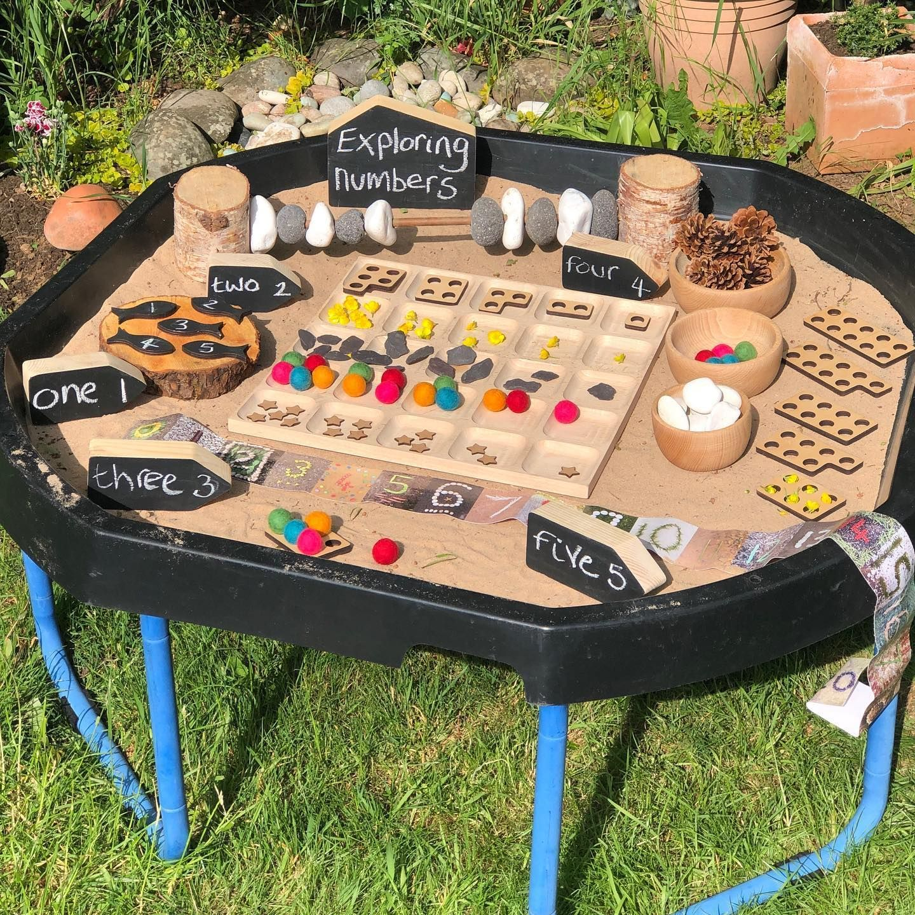
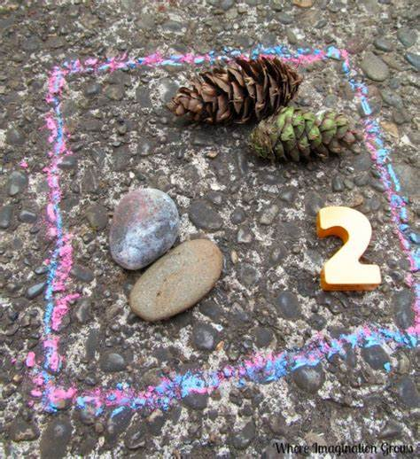
MATH AREA:
Creating a math area outdoors for children is a fantastic way to make learning math concepts enjoyable and hands-on.
Notes:
Creating a math area outdoors for children is a fantastic way to make learning math concepts enjoyable and hands-on. Here are some ideas to design an engaging outdoor math space:
Number Path:
Paint or use colorful tape to create a number path on the ground. Each number can have corresponding objects or shapes that children can count as they hop or step along the path.
Hopscotch Math:
Turn a traditional hopscotch game into a math activity by adding numbers, equations, or math problems in each square. Children can solve the problems as they hop through the course.
Math Trail:
Create a math trail with numbered stations or markers. At each station, provide a math-related activity or challenge, such as counting objects, solving equations, or identifying shapes.
Outdoor Math Games:
Set up classic math games like "Math Bingo" or "Math Memory" using large, durable cards. Children can play these games collaboratively or independently.
Numbered Rocks or Stepping Stones:
Paint numbers on rocks or use stepping stones with numbers. Children can arrange the stones in numerical order, skip count, or use them for various math games.
Geometry Garden:
Plant flowers or create garden beds in geometric shapes such as circles, squares, or triangles. Discuss the properties of each shape as children explore the garden.
Measuring Station:
Provide measuring tools like rulers, measuring tapes, or yardsticks. Children can measure the height of plants, the distance between objects, or their own jumps and strides.
Shape Hunt:
Create a list of shapes for children to find in the outdoor environment. They can search for circles, squares, triangles, and rectangles in nature
Math Murals:
Use chalk or outdoor paint to create large math murals on pavement or a wall. Include number lines, geometric shapes, and equations for children to interact with and solve.
Counting with Nature:
Incorporate natural materials like stones, leaves, or sticks for counting activities. Children can group items into sets, practice addition or subtraction, and explore basic math concepts.
Math Puzzles:
Scatter large puzzle pieces with numbers or mathematical symbols around the area. Children can work together to solve the puzzle and create a complete math equation.
Math Art:
Integrate math into art activities. For example, children can create symmetrical paintings, or make patterns with outdoor materials.

Slide 38
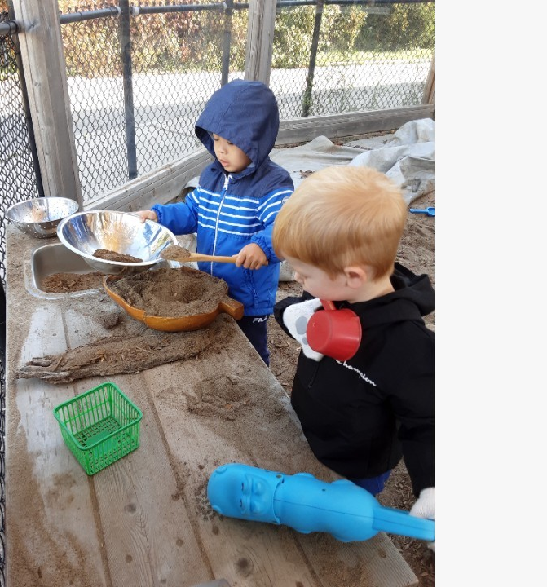
DRAMATIC PLAY
Designing a dramatic play area outdoors for children encourages imaginative play, creativity, and social interaction.
Educators to encourage and expand on children's ideas and ask open-ended questions.
Notes:
Designing a dramatic play area outdoors for children encourages imaginative play, creativity, and social interaction. Here are some ideas to create an engaging outdoor space for dramatic play:
Outdoor Kitchen or Mud Kitchen:
Set up an outdoor kitchen with pots, pans, utensils, and pretend food items. Consider incorporating natural materials like mud, sand, or water for a sensory experience.
Nature-themed Role Play:
Create a nature-themed role-play area with costumes and props related to outdoor exploration, such as explorer hats, binoculars, and magnifying glasses.
Outdoor Theater:
Create a stage area with a simple backdrop or use a playhouse as a stage. Children can put on impromptu plays, act out stories, or participate in puppet shows.
Gardening and Planting Station:
Provide child-sized gardening tools, pots, and artificial flowers. Children can engage in pretend gardening, planting, and taking care of their "plants."

Slide 39
WHAT'S THE MOST ADVENTUROUS THING YOU'VE DONE IN YOUR OUTDOOR SPACE?
https://www.menti.com/almq1hdx5dxk

Slide 40

OUTDOOR ENVIRONMENT AND
THE NEED FOR PLAY
Imagination
Developmental skills
Increase their problem-solving abilities
Notes:
Imagination -
The outdoor learning environment encourages learners to use their imagination, build cognitive skills, acquire social skills and sets the building blocks in place to develop the child holistically.
developmental skills - Play is key for many developmental skills, such as building on fine motor, cognitive development, and more.
problem-solving abilities - The benefits of play are immense as children gain knowledge through their play, increase their problem-solving abilities through games and puzzles, strengthen their language skills by modelling other children and adults, allows children to be creative while developing their own imaginations whilst discovering, investigating and exploring the world in which they live.

Slide 41
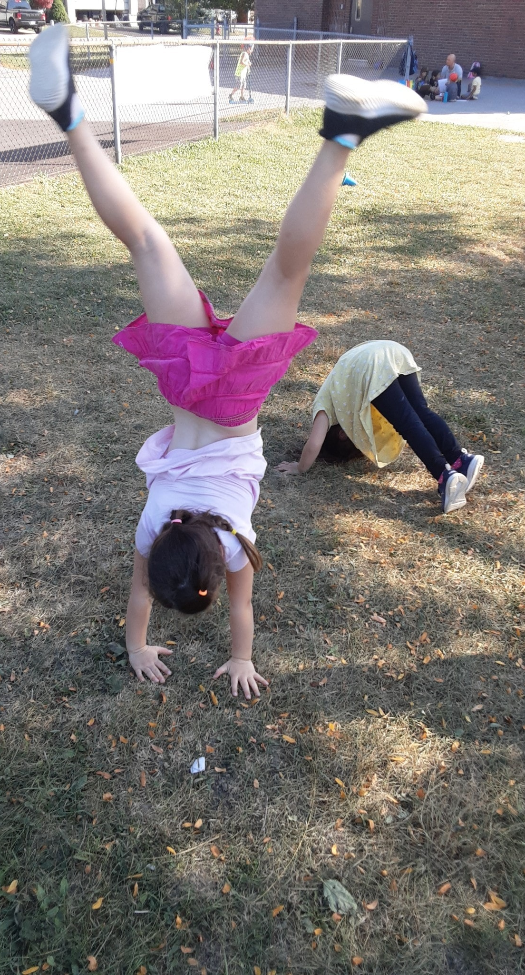
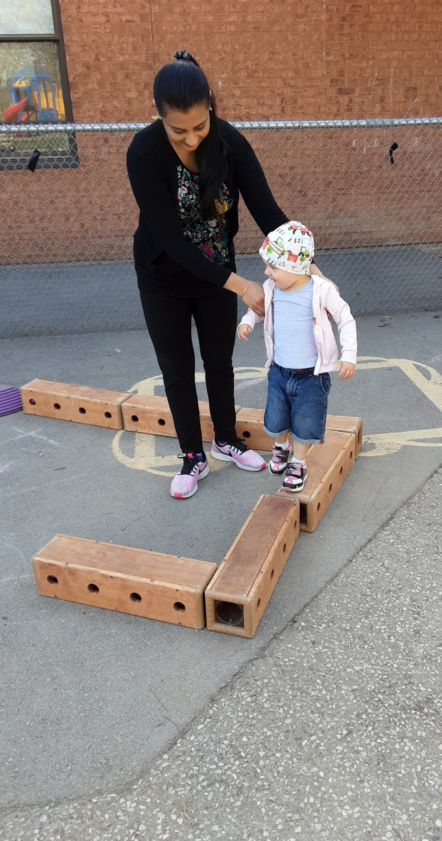
APPROPRIATE
RISK PLAY
Adventure and challenge in the process.
They face the risk of mistakes
Children are given a chance to engage freely in risky play
Children learn about themselves and their environment.
Confident children
Notes:
Adventure and challenge in the process.
- Children are continuously trying out new things and learning a great deal about adventure and challenge in the process. They need to learn how to navigate their challenges, but we need to provide the materials and equipment to do so.
They face the risk of mistakes, and we must allow them the opportunities to take these risks and involve them in risk assessing their own environment.
When children are given a chance to engage freely in risky play, they quickly learn to evaluate their own skills and match them to the demands of the environment.
Such children ask themselves — “how high can I climb”, or “is this branch strong enough to support me?” They learn about themselves and their environment.
Confident children
- Children who are confident about taking chances rebound well when things do not work out at first.
Risk play is essential for children's development as it helps build resilience, problem-solving skills, and a sense of self-confidence.
Having those conversations with families to ensure everyone is aware of the activities and understands the benefits of risk play

Slide 42
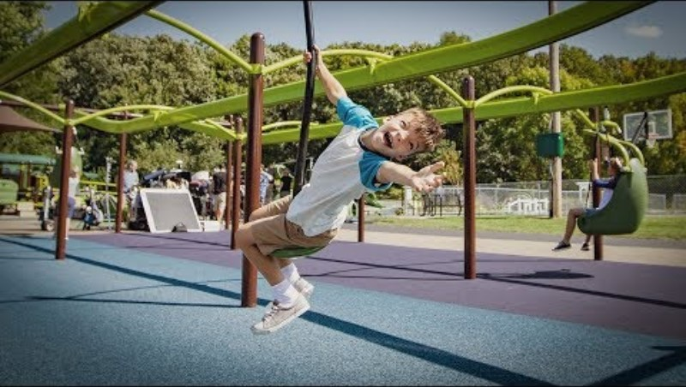
‘POWER OF PLAY FROM A CHILD’S PERSPECTIVE’.

Slide 43
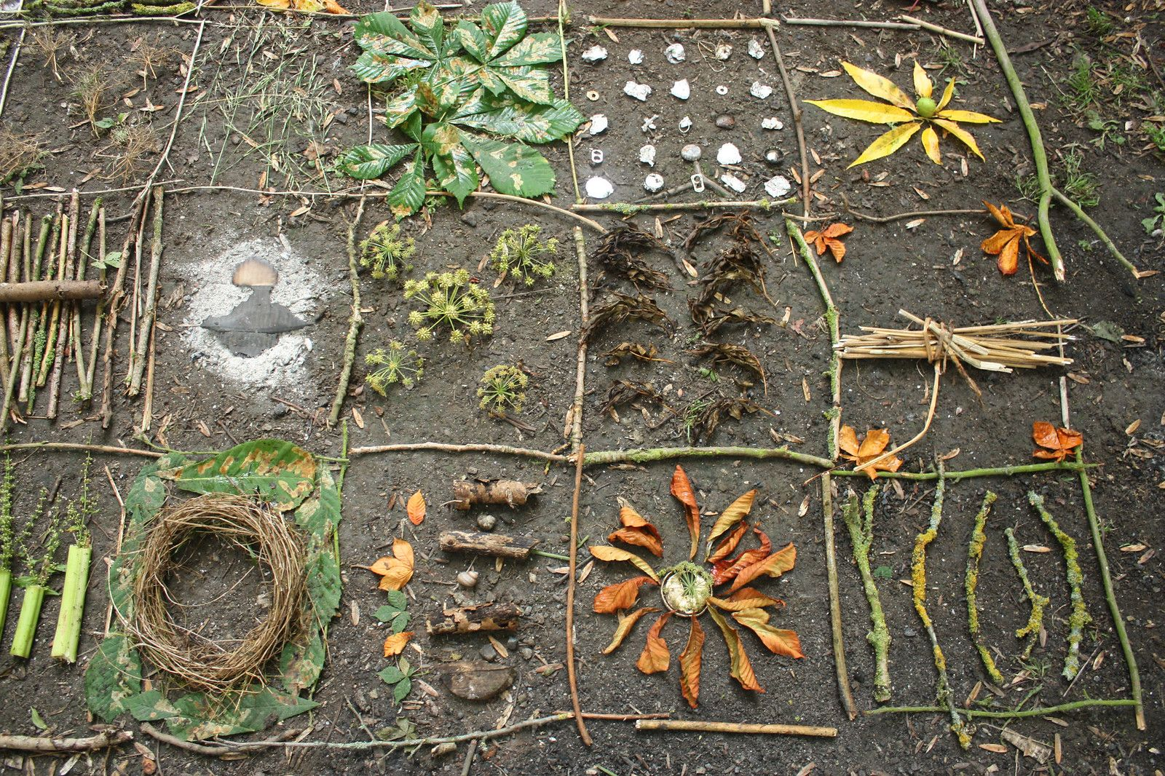
NATURE AND
NATURAL MATERIALS
Experience of hands-on involvement with natural materials.
When children are free to follow their own interests
Open-ended materials
Open-ended opportunities
Notes:
Children gain Experience with hands-on involvement with natural materials.
All the expensive equipment and all the indoor materials produced by the best makers in the world cannot replace the experience of hands-on involvement with natural materials. Have areas in our outdoor space for collecting natural materials or nature loose parts. Have families be a part of this collection and being nature items from their own outdoor spaces. Watch the children be more involved in creating a more natural space when they have a say in their learning.
When children are free to follow their own interests using ‘open-ended’ materials they learn to think for themselves, they choose their own natural materials to play and explore with, these natural materials are endless and therefor providing endless possibilities for children to explore, manipulate and learn.
Open-ended materials are those that allow children to determine for themselves what to do with them and how to do it.
Natural outdoor areas are full of open-ended opportunities.
A piece of wood can be a mobile phone, a plate, a camera, a truck… even a baby! Water can be tea, ice cream, even juice!
Sand can be made into roads; it can be food and when added to water it can become cement.
A cardboard box – as we all know – can be anything!

Slide 44
List some ways you can foster children’s curiosity about nature.
https://www.menti.com/almq1hdx5dxk

Slide 45
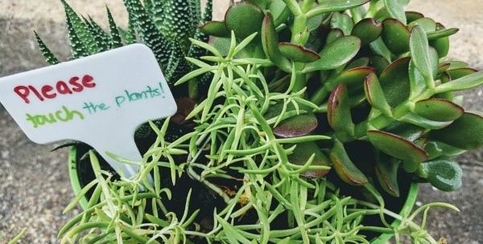
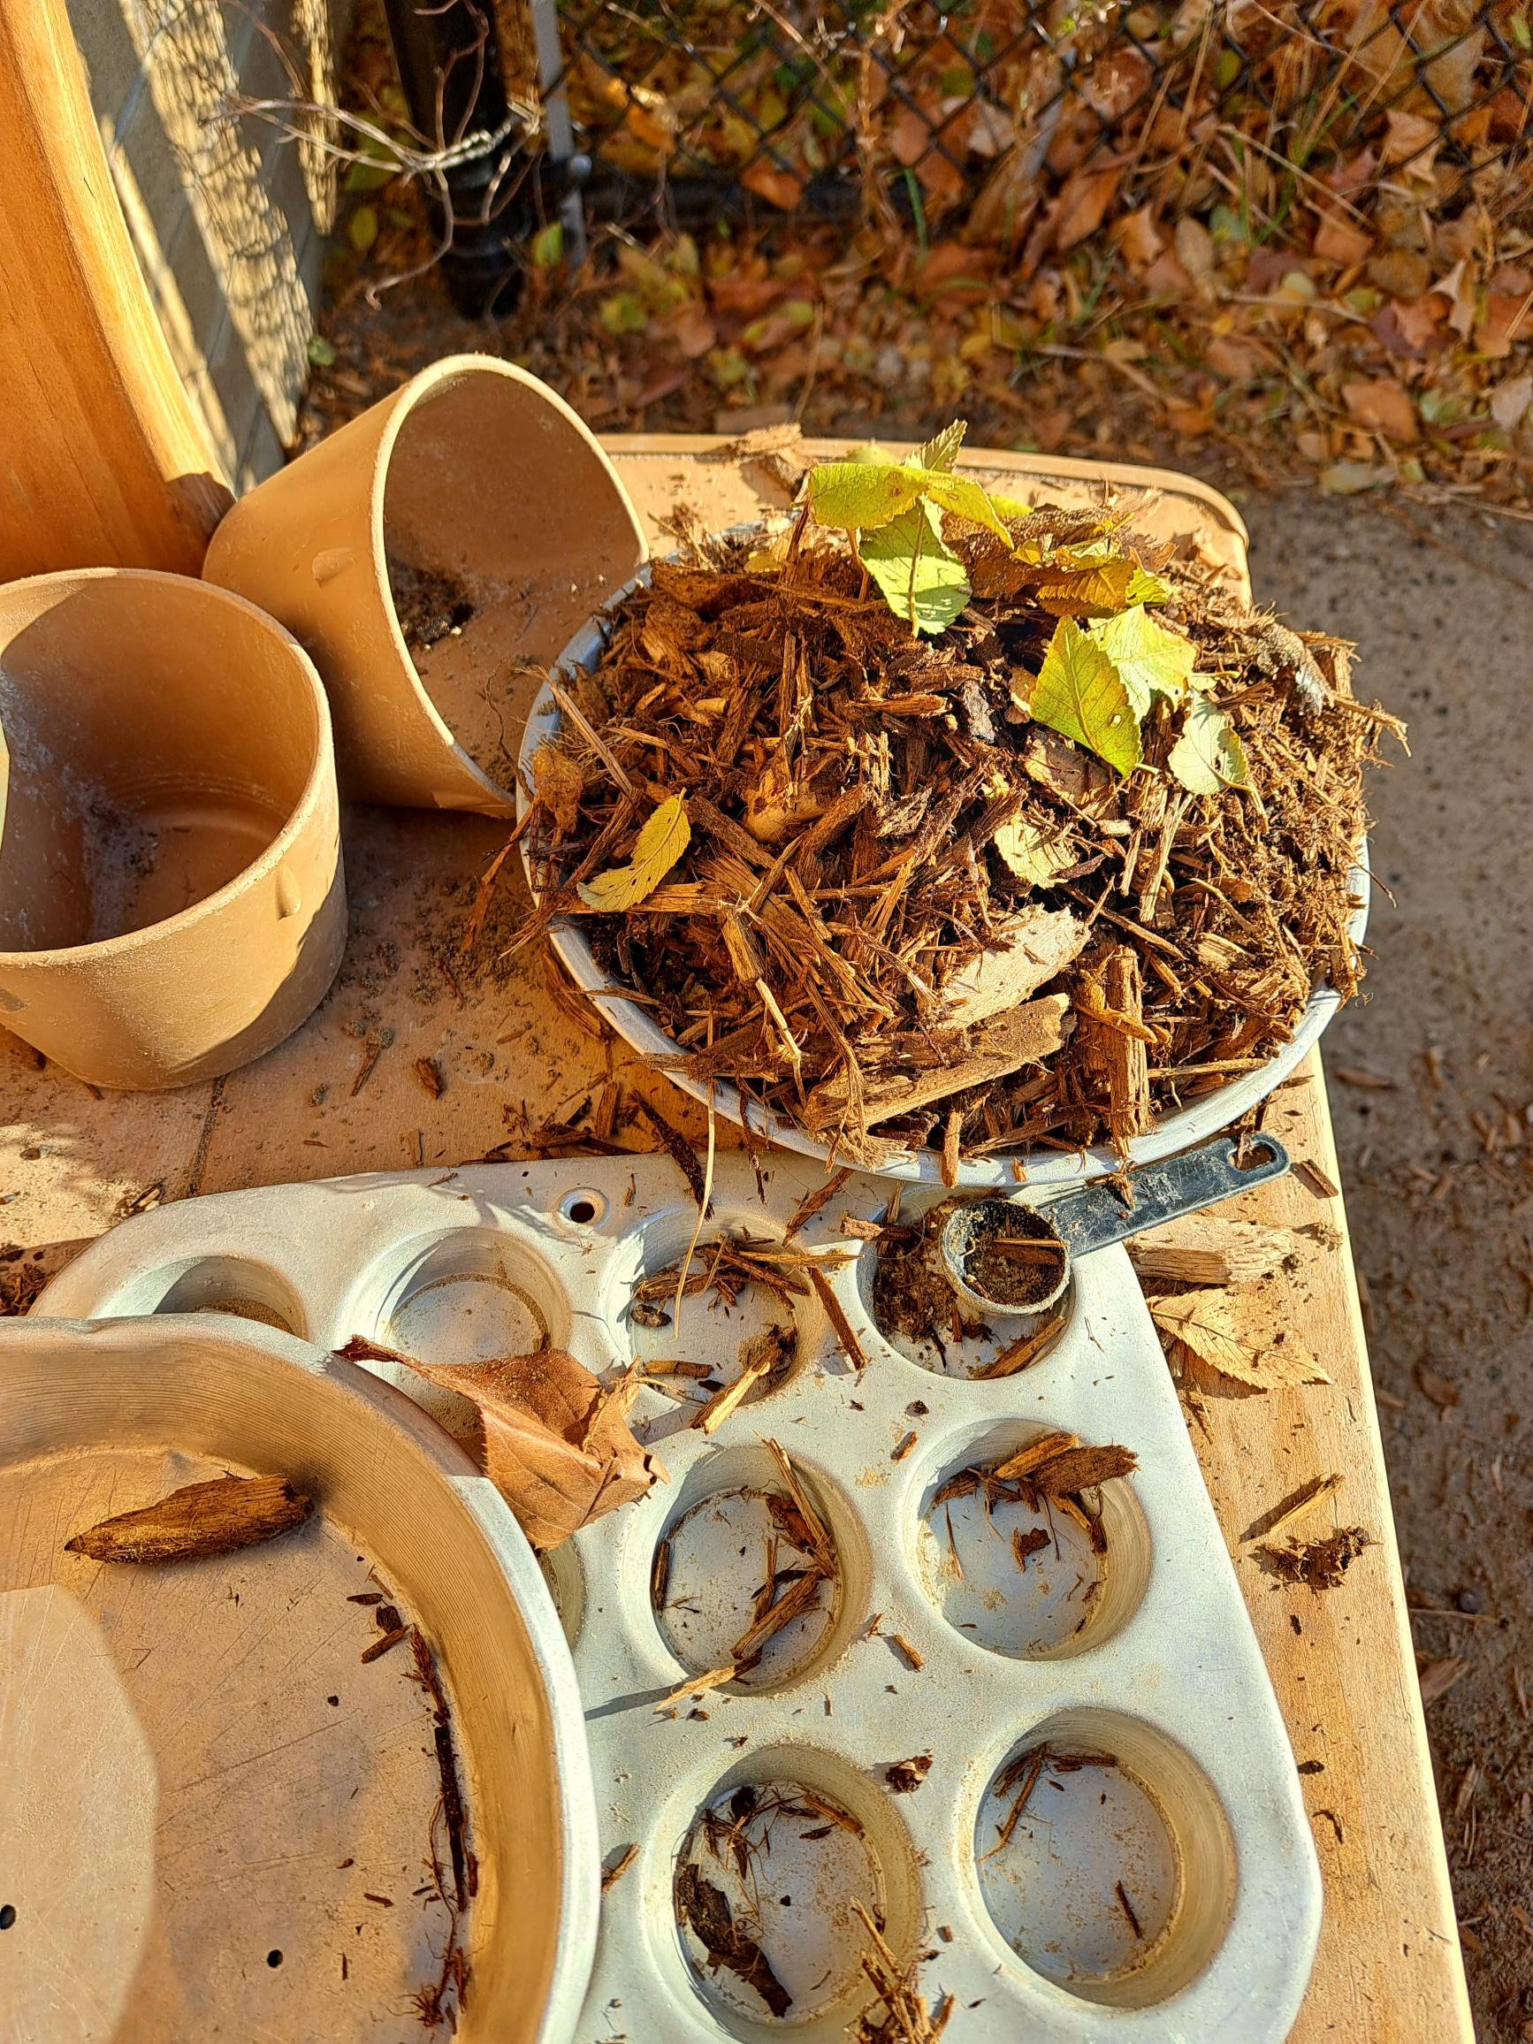
NATURE AREA:
Creating a nature area outdoors for children provides a space for exploration, connection with the natural world, and learning about the environment.
Notes:
Creating a nature area outdoors for children provides a space for exploration, connection with the natural world, and learning about the environment.
Sensory Garden:
Design a sensory garden with plants that engage multiple senses. Include fragrant flowers, textured leaves, and herbs that children can touch, smell, and even taste.
Bird Feeding Station:
Install bird feeders with different types of birdseed. Children can observe and identify various bird species that visit the feeding station.
Rock and Pebble Area:
Create a space with rocks, pebbles, and stones for children to explore. They can engage in activities like stacking rocks, arranging pebble patterns, or using stones for creative play.
Bug Hotel or Insect Habitat:
Build a bug hotel using natural materials like logs, bamboo, and leaves. This provides a habitat for insects and allows children to observe the diverse world of bugs.
Nature Art Station:
Set up an outdoor art station with natural materials like leaves, flowers, and twigs. Children can create nature-inspired artwork using these elements.
Nature Trail or Pathway:
Create a nature trail with a marked pathway where children can explore and observe different elements of the outdoor environment. Include signage with information about local flora and fauna.
Outdoor Classroom:
Arrange an outdoor learning space with logs or tree stumps as seating. This provides an opportunity for nature-based lessons, storytelling, or group activities.

Slide 46
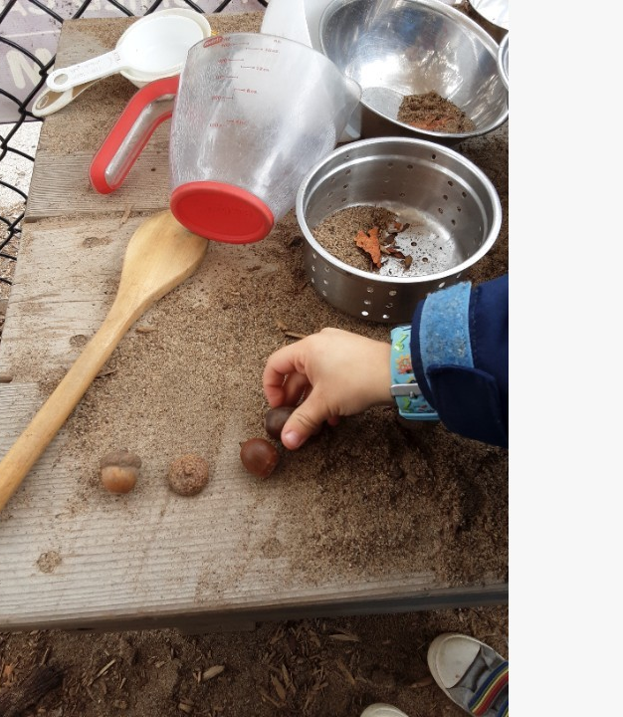
NATURAL LOOSE PARTS
A loose parts play area outdoors for children provides an open-ended and creative space where kids can use various materials to build, manipulate, and imagine.
Notes:
A loose parts play area outdoors for children provides an open-ended and creative space where kids can use various materials to build, manipulate, and imagine.
A loose parts play area outdoors for children provides an open-ended and creative space where kids can use various materials to build, manipulate, and imagine. Here are ideas for setting up a loose parts area:
Natural Materials:
Include a variety of natural loose parts such as sticks, leaves, pinecones, shells, stones, and acorns. These materials can be used for building, sorting, and creative play.
Logs and Tree Stumps:
Arrange logs and tree stumps to create seating or platforms for play. These can also serve as building blocks or elements for imaginative play.
Wooden Planks:
Provide wooden planks of different lengths and sizes. Children can use them to construct structures, bridges, or pathways.
Fabric and Textiles:
Offer fabric scraps, old sheets, or pieces of cloth. Children can use these materials for fort-building, costume creation, or as versatile props in their play.
Buckets, Tubs, and Containers:
Set out various containers of different sizes and shapes. These can be used for collecting, transporting, and sorting loose parts.
PVC Pipes and Tubes:
Include PVC pipes and tubes for constructing tunnels, ramps, or unique pathways. These materials encourage experimentation and problem-solving.
Rope and Twine:
Provide lengths of rope and twine for tying, hanging, and connecting loose parts. This adds a dynamic element to the play area.
Corks and Bottle Caps:
Small items like corks and bottle caps can be used for fine motor activities, sorting, and as embellishments in creative projects.
Shells and Stones:
Offer a variety of shells, stones, and pebbles. These natural loose parts can be used for sensory play, storytelling, or creating patterns.
Cardboard Boxes:
Set out cardboard boxes of various sizes. Children can use them for building structures, creating tunnels, or as canvases for artistic expression.
Garden Tools:
Provide child-sized garden tools like shovels, rakes, and watering cans. These tools can be used for digging, gardening, or incorporating loose parts into nature-based play.
Large Blocks:
Include large building blocks made of wood, foam, or recycled materials. These provide a stable base for constructing larger structures.
Mirrors:
Place unbreakable mirrors in the area to add an element of reflection and perspective to the play space. Mirrors can enhance creativity and self-discovery.

Slide 47
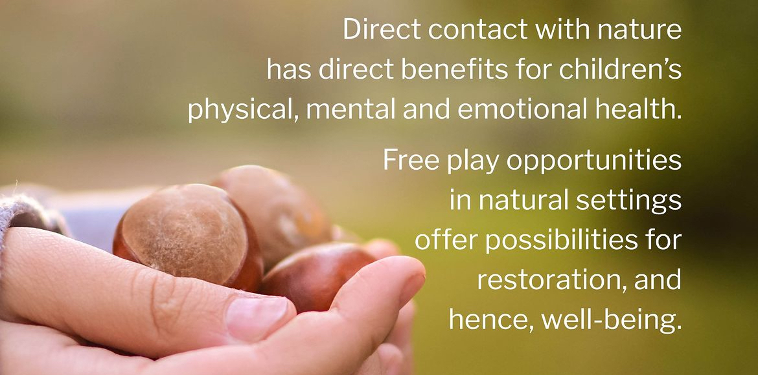

Slide 48
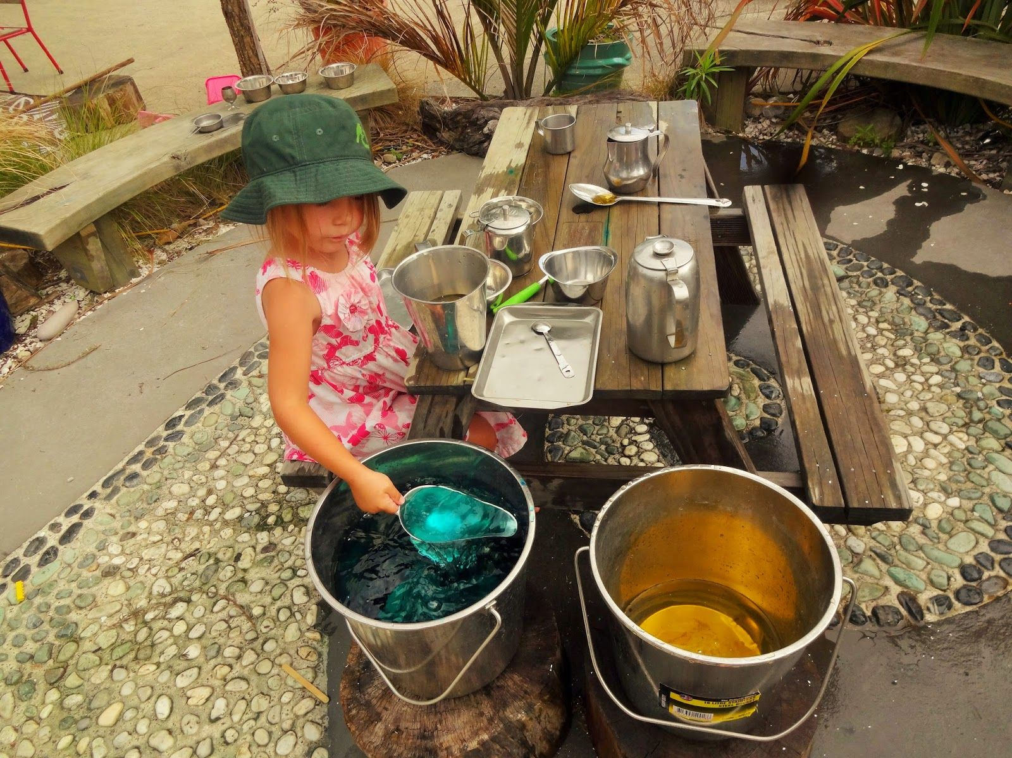
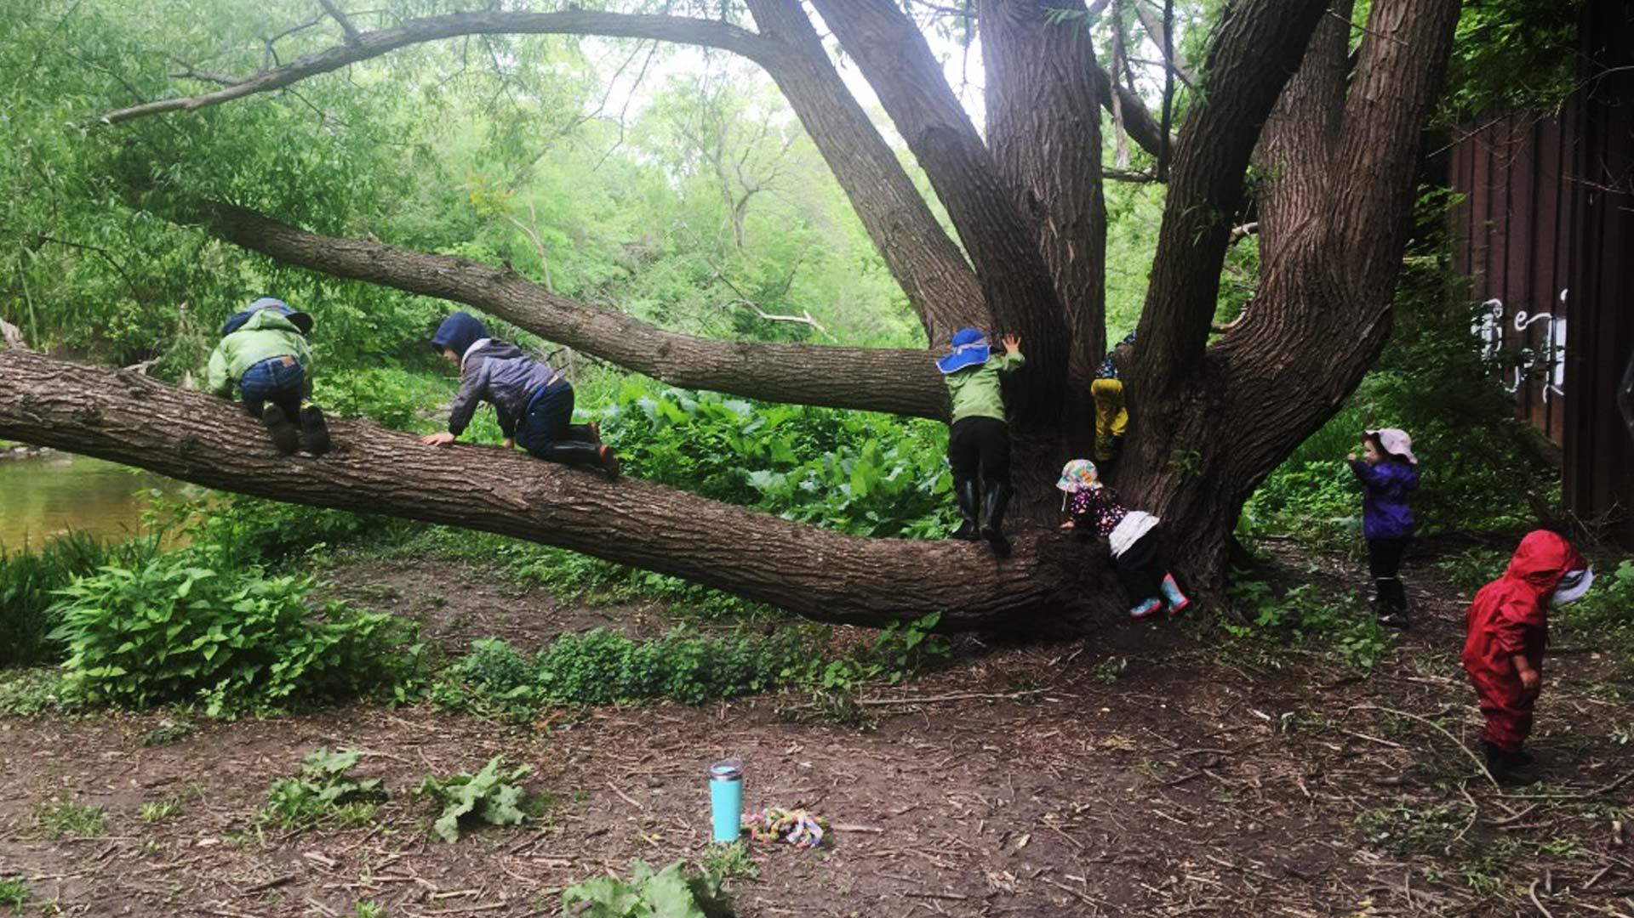
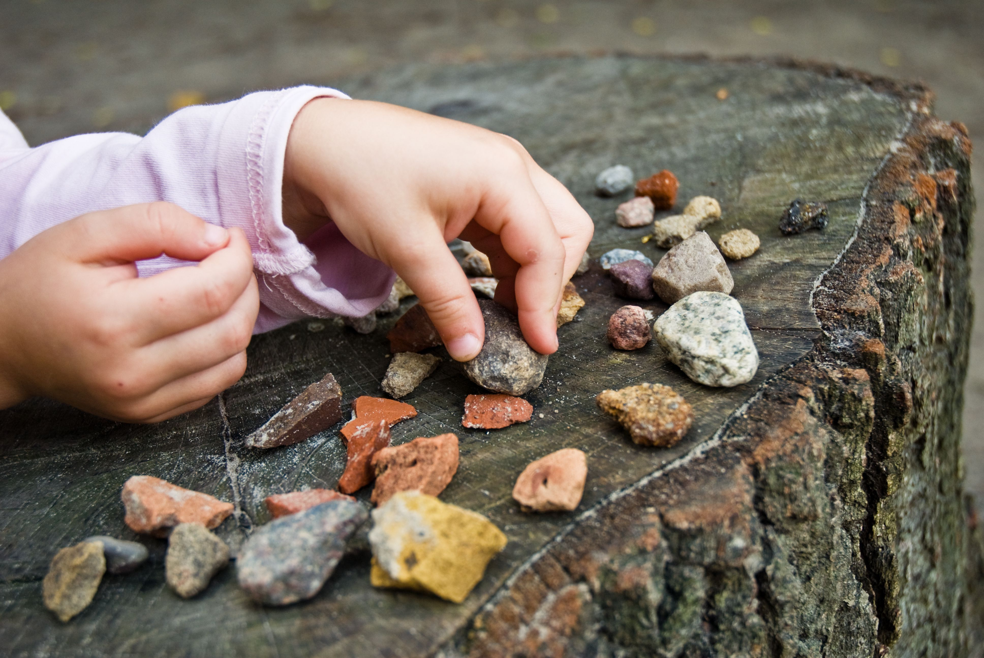
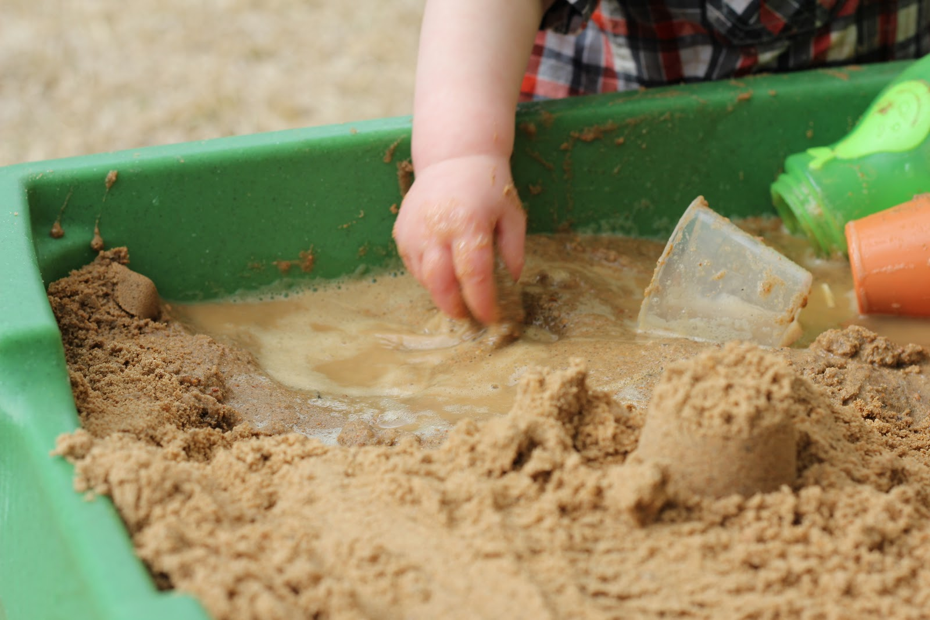
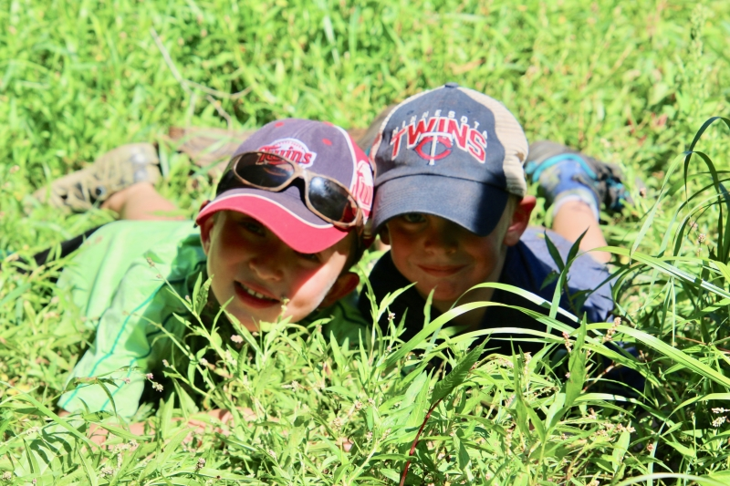
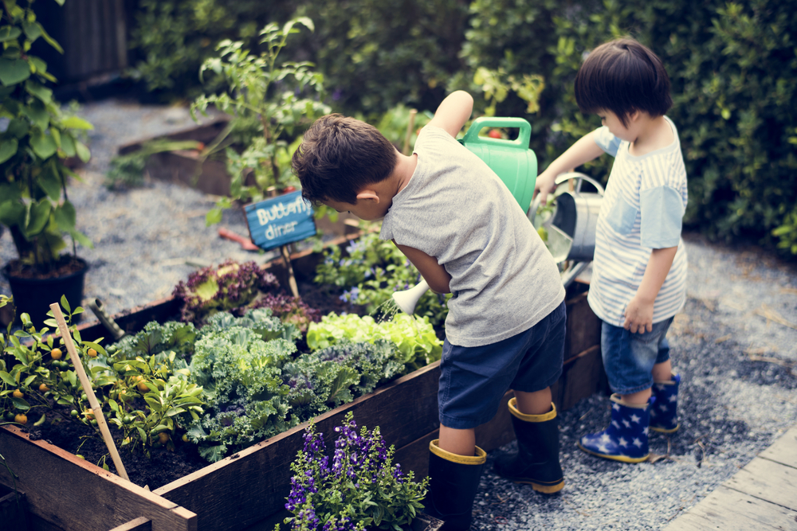
WAYS TO MAKE YOUR PLAYGROUND MORE NATURAL
Water
Trees
Rocks
Sand
Grass
Gardens
Notes:
Water
Water play benefits children’s learning through the practice of math and science. Mathematical concepts are easily incorporated into water play, as well as scientific learning and thinking. Estimating filling a cup or bucket, classification of patterns, sizes of leaves…
Trees
Trees create natural shade but also have many other benefits. Birds and wildlife visit trees, which exposes children to natural habitats. Tree bark and leaves also create great sensory experiences. The different types of bark and leaves.
Rocks
Rocks offer endless possibilities. They can be used for building, counting and art. Large rocks and boulders also allow for children to take risks and test their bodies through jumping and climbing.
Sand
Sand play has many benefits. It supports the development of motor skills, such as balance and coordination. Sand also provides tactile sensory input that builds fine-motor skills.
Grass
Grassy or open areas allow children the space to move their bodies freely during play. The space allows them to use their imagination and thinking to create games and/or engage in social interactive play. It is also a great space to take a rest.
Gardens
Gardening provides children with the perfect combination of skills and tasks to address many stages of development. It incorporates gross and fine-motor learning. It can also support social interactions and is a great sensory experience.

Slide 49
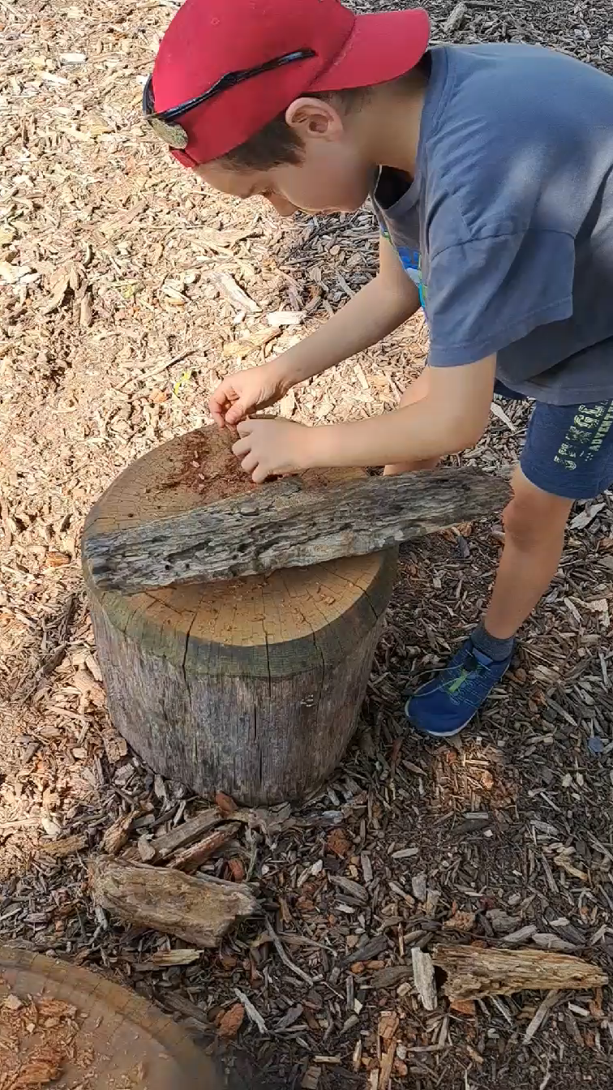
WHAT LEARNING IS VISIBLE?
https://www.menti.com/almq1hdx5dxk
Notes:
Some learning that comes to mind is fine and gross motor skills, problem solving, social skills,

Slide 50

The Outdoor Classroom
Provocations & Beautiful Materials
If our beautiful outdoor space, abounding with natural light and fresh air, is a great place for traditional “outdoor play”, could we enhance and broaden the children’s play by also offering the opportunity to engage in the play we might think of as “indoor play”?
Notes:
Outdoor provocations for children involve intentionally setting up environments or scenarios that inspire curiosity, exploration, and engagement. These provocations are designed to stimulate creativity, critical thinking, and imaginative play.
Nature Art Station:
Set up an art station with natural materials like leaves, flowers, sticks, and rocks. Encourage children to create their own nature-inspired artwork.
Sound Exploration:
Provide a variety of instruments, natural materials, and objects that make different sounds. Create an outdoor music area where children can experiment with sound and rhythm.
Sensory Garden Provocation:
Arrange a variety of textured plants, flowers, and sensory materials. Encourage children to explore the different textures and scents in the garden.
Loose Parts Building Zone:
Create an area with a diverse selection of loose parts like wooden planks, tubes, and fabric. Challenge children to build structures using their imagination.
Shadow Play:
Use sunlight to create a shadow play area. Provide materials like cut-out shapes, puppets, or objects that children can use to cast shadows on surfaces.
Outdoor Storytelling Circle:
Set up a cozy storytelling circle with cushions or logs. Place books, puppets, or story stones that inspire children to create and share stories.
Rock Balancing Challenge:
Introduce the art of rock balancing. Provide a variety of smooth stones and challenge children to create balanced rock structures.
Nature Scavenger Hunt:
Create a list of items for children to find in the outdoor environment. This can include specific leaves, rocks, or natural objects that encourage observation.
Outdoor Kitchen Provocation:
Arrange pots, pans, and natural materials to create an outdoor kitchen. Encourage children to engage in pretend cooking and imaginative play.
Insect Investigation Station:
Set up a station with magnifying glasses, bug catchers, and informational books about insects. Prompt children to explore the outdoor area for insects.
Nature Color Palette:
Provide a palette of natural materials with various colors, such as flowers, leaves, and stones. Challenge children to create color patterns or artworks.
Giant Building Blocks:
Introduce oversized building blocks made of materials like cardboard or foam. Children can use these blocks for collaborative building projects.
Seed Planting Station:
Create a gardening area where children can plant seeds. Provide soil, seeds, and small pots for a hands-on planting experience.
Weather Station:
Set up a weather station with instruments like a thermometer, wind vane, and rain gauge. Encourage children to observe and record weather conditions.
Natural Mirror Exploration:
Place unbreakable mirrors in the outdoor space. Children can use the mirrors to explore reflections, light, and perspective.
Outdoor Science Experiments:
Set up simple science experiments using natural materials. For example, create a DIY volcano with baking soda and vinegar or explore buoyancy with objects and water.
Bird Watching Hideout:
Create a small hideout with binoculars and bird identification charts. Children can observe and identify birds in the area.
Giant Weaving Wall:
Install a large weaving wall with natural materials like vines, branches, or fabric strips. Children can engage in collaborative weaving projects.
Outdoor Art Gallery:
Hang children's artwork on a designated outdoor wall or fence. This provocation encourages creativity and a sense of pride in their creations.

Slide 51


SETTING UP PROVOCATIONS
Outdoor provocations for children involve intentionally setting up environments or scenarios that inspire curiosity, exploration, and engagement. These provocations are designed to stimulate creativity, critical thinking, and imaginative play.
Notes:
Fostering Curiosity and Inquiry:
Provocations prompt children to ask questions, explore, and investigate the outdoor environment.
Encouraging Exploration and Discovery:
Outdoor provocations provide opportunities for hands-on exploration and discovery.
Promoting Problem-Solving Skills:
Provocations often present challenges or open-ended problems that require children to think critically and problem-solve.
Inspiring Imaginative Play:
They stimulate storytelling, role-playing, and the development of imaginative narratives.
Connecting with Nature:
Provocations in outdoor spaces encourage children to engage with and appreciate the natural world.
They promote a sense of environmental stewardship and awareness of the interconnectedness of living things.
Incorporating Multisensory Experiences:
Outdoor provocations often involve the use of natural materials and elements, providing multisensory experiences.

Slide 52


Slide 53

WHAT IS A
SIT SPOT?
It’s exactly as simple as it sounds like a spot where you sit!
A sit spot is a place away from distractions where kids can sit, be quiet, and observe nature. (High-traffic and noisy spots aren’t ideal.)
It’s a favorite place outdoors that can be re-visited across the seasons.

Slide 54

HOW DO YOU CHOOSE A SIT SPOT?
A sit spot should be:
child-selected
free of outside distractions
safe
(relatively) comfortable
where nature is present
Notes:
Kids can enjoy nature in a quiet, calm and independent way by using a “sit spot”.
The idea of outdoor time being a focus, being accessible, being simplified, being peaceful. We need to show our kids the value of slowing down and absorbing our environment at our own pace.
Time outdoors doesn’t always have to involve huge adventures or non-stop action; it can include micro-adventures and moments of tranquility.
Connecting with nature can be done while sitting.
Sit spot activities allow kids to engage their senses one-by-one, enhancing their focus and observation.
Come up with your own name to call it, make it a group discussion on what to call you ‘sit spot’.

Slide 55


Slide 56

WHAT CAN PARENTS DO?
Understanding the benefits that outdoor play
Being outside in all weathers
Encourage clothing to get dirty in
Notes:
Support parents by - You can help parents support their child’s enjoyment, learning and development by understanding the benefits that outdoor play – sometimes risky, sometimes messy and sometimes wet or cold – can provide.
Being outside in all weathers and in every season gives children the chance to experience ice and snow, sunshine and wind, the changing colour of the leaves in fall and the appearance of green shoots in spring.
Encourage clothing to get dirty in
Sometimes parents don’t like their children going outside to play because they don’t want them getting dirty.
Encourage parents and children to provide for your outdoor space, in which they can collect natural materials from their yard and bring to the playground – the children will enjoy sharing from their house to the centre.

Slide 57


Slide 58


Slide 59



Our playground is not just a playground …
It is a garden.
It is a stage.
It is a building space.
It is a giant chalk easel.
It is a painting studio.
It is a design room.
It is fresh air and open space.
It is a classroom without roof.
It is anything we can imagine it to be and every intriguing material we fill it with.

Slide 60
PARTICIPANTS WILL RECEIVE
Certificate of Outdoor Pedagogy Completion
Handouts
- Nature Colour Wheel
- Chalk Ideas for your outdoor space
- Loose Parts Mats for outdoor area
- 70 Outdoor educational ideas
- Sit Spots activities
- Outdoor provocation ideas
- Learning Area activities
Survey for staff

Slide 61

W
I
N
N
E
R
W
I
N
N
E
R

